Slide 1
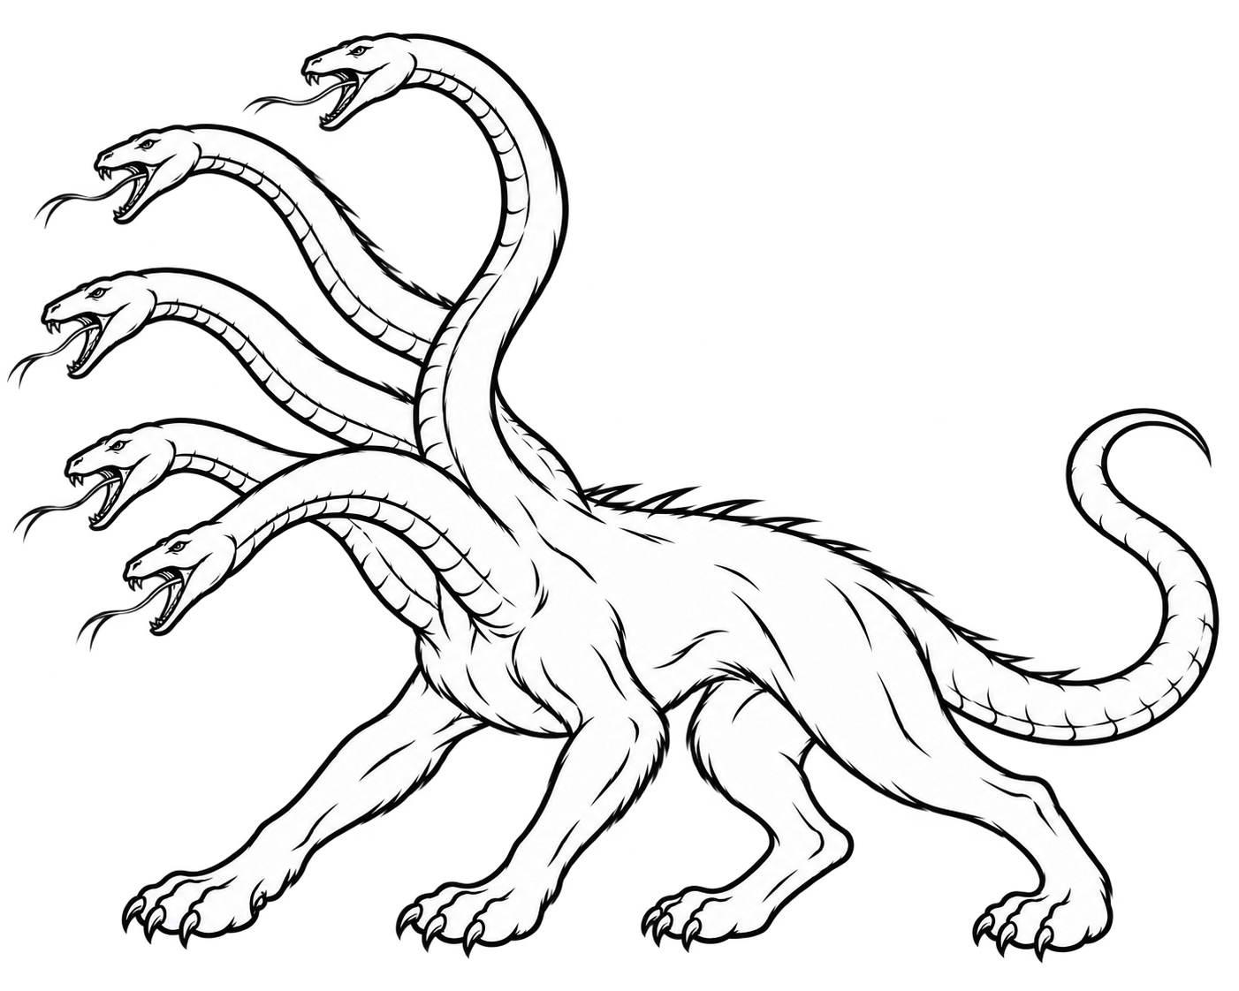
Hydra 4 architecture overview
Dave Gillespie, daveg@synaptics.com
Last updated: October 29, 2026
(Originally written in January 2022)

Slide 2
WORK IN PROGRESS!
This is a preview of an internal document that we use within Synaptics to describe our Hydra vector arithmetic processor
We are preparing a more public-friendly version, without the references to past versions, specific chip projects, and other stuff that is only of interest within Synaptics
The cleaned-up document, and the Hydra User’s Guide itself, as well as the analogous materials for our Chimera processor, will shortly be available here:
  github.com/synaptics-hydra
  github.com/synaptics-chimera
Until then, you are welcome to preview here the “raw” version …
Thank you!
— Dave Gillespie, daveg@synaptics.com

Slide 3
Hydra 4
Architecture overview
  Introduction
    What, why, where
  Using Hydra
    Examples, registers, instructions, types, modes, …
  Hardware and implementation
    Block diagrams, theory of operation, interesting details

Slide 4
Hydra 4
Architecture overview
  Introduction
    What is it
    Why we need it
    Where it came from
  Using Hydra
  Hardware and implementation

Slide 5
Hydra 4 at a glance
The Hydra arithmetic coprocessor adds powerful vector arithmetic capability to a small embedded MCU (such as SiFive RISC-V E, ARM Cortex-M, or Synaptics Chimera)
  It adapts “big CPU” vector capabilities to the scale, power, cost, and size of embedded systems
Synaptics products use Hydra for many things, such as:
  Accelerating touch algorithms • Signal processing • Fingerprint image processing + matching
Hydra 4 significantly accelerates many
operations including:
  Arithmetic on vectors, matrices, and images
  Matrix multiply • Linear algebra • FFTs
  1D and 2D convolutions and median filters
  Neural networks • Encryption and hashing
  Pseudo-random numbers • Trig functions
  Bit operations • Packing data into few bits
  And much more
Embedded
CPU
Host
intf
Registers
Decode
System bus
Hydra 4
Control
Mem intf
mask channel
Stored program unit
Data RAM
(Interleaved
banks)
Bank intf
SPU channel
Bank intf
src1 channel
ALU
(fixed-point and floating-point datapath)
Bank intf
src2 channel
Bank intf
misc channel
dest channel

Slide 6
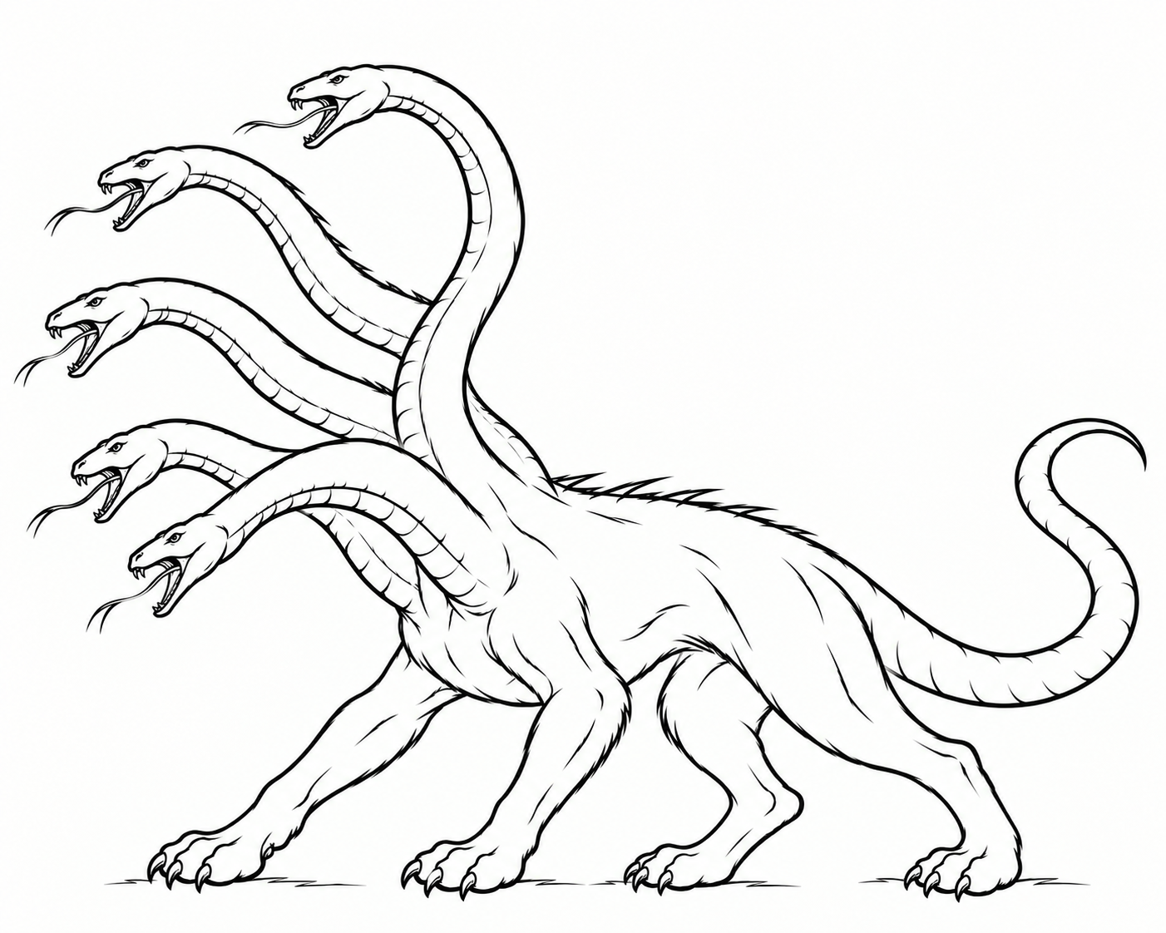
Hydra
Hydra is an arithmetic accelerator for small Synaptics chips
It works alongside a chip’s CPU such as Chimera, RISC-V, ARM, or Xtensa
Hydra does bulk calculations on vectors/arrays/matrices/images of data
Hydra version 1, 2, or 3 is found in many “high-performance” Synaptics touch chips
  DIG2401 and DIG2403–DIG2408 (touch controllers)
  TD7800, TD7850, TD7875 (automotive TDDI)
  B1422 “Prometheus” and B1442 “Triton”
  (fingerprint with match-in-sensor)
Hydra 4, the latest version, appears in our
newest chips
  First up: The SB7900 “SmartBridge” automotive chip
  and the DIG2409 “Byrd” and DIG2411 “Denmarke”
  touch controllers
“Hydra” of Greek mythology
Notes:
This drawing of the Hydra came from ChatGPT Images.

Slide 7
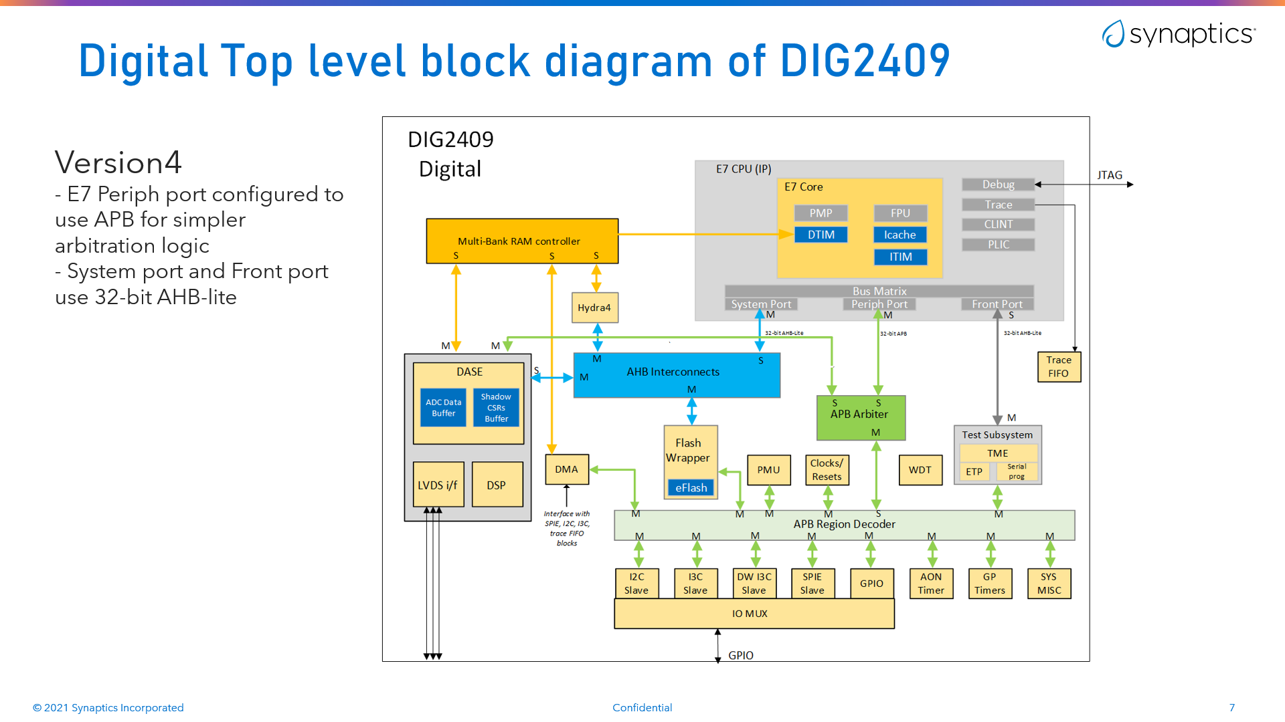
Hydra in context
Example: Hydra 4.0,
as integrated into the
DIG2409A “Byrd” chip
  The host CPU is an “E76”
  RISC-V core from SiFive
  The E76 connects to the chip’s
  data RAM as tightly-coupled
  (“DTIM”) memory
  Hydra connects to the CPU
  as a register-mapped
  peripheral via the AHB bus
  Hydra also connects directly
  to the same data RAM
  Optionally, Hydra can drive the
  data bus to access other parts
  of the chip (omitted on Byrd A0)
To touch analog

Slide 8
Vector processing on a small budget
Hydra is a vector processor: It operates on whole arrays (“vectors”) of data at a time
One instruction for a vector processor is like a complete loop in a program
The single instruction “VADD A, B, C” might do all this:
for (i = 0; i < N; i++) { A[i] = B[i] + C[i]; }
A big vector processor (e.g., x86 SSE / AVX, ARM Neon, or RISC-V “V”) will have wide registers and multiple arithmetic units to do all these additions at once, in parallel
Down in our price range, a vector processor must work through the vector iteratively
But it can work much more efficiently than ordinary CPU firmware can do
A[4]
B[0] | B[1] | B[2] | B[3] | B[4] | B[5] | B[6] | B[7] | ∙∙∙ | B[N-1]
+ | + | + | + | + | + | + | + |  | +
C[0] | C[1] | C[2] | C[3] | C[4] | C[5] | C[6] | C[7] | ∙∙∙ | C[N-1]
↓ | ↓ | ↓ | ↓ | ↓ | ↓ | ↓ | ↓ |  | ↓
A[0] | A[1] | A[2] | A[3] | A[4] | A[5] | A[6] | A[7] | ∙∙∙ | A[N-1]
A[3]
A[2]
A[1]
A[0]

Slide 9
DIG2409 “Byrd”
Byrd has dramatically higher computation needs (“MIPS”) than previous touch chips
  Foldable phones ⇒ Touch images twice as large
  Gaming phones ⇒ Crazy high frame rates!
  AFE improvements ⇒ FFTs per-frame or per-burst
Byrd replaces our Chimera CPU with a powerful RISC-V CPU: SiFive’s E76
  An 8-stage pipeline that can clock at 400 MHz (in TSMC’s 40nm Embedded Flash process)
  Full dual-issue superscalar operation, optimized for computational performance
  It’s a beast — at least 3x bigger than either Chimera or Hydra, but we needed the MIPS!
Even the E76 was barely enough to meet Byrd’s anticipated MIPS needs …
  So, once again, we augment the main CPU with Hydra
  A perfect time to refresh and modernize Hydra ⇒ “Hydra 4.0”

Slide 10
SB7900 “SmartBridge”
The SB7900 chip, for large automotive touchscreens, also has Hydra 4
  SB7900 shares a lot of Byrd’s architecture, again using E76 as its main CPU
Hydra 4 was included in SB7900 for more speculative reasons
  The auto industry cares much more about safety and robustness
  It is beginning to get very serious about cybersecurity, too
  Hydra 4’s AES, public-key, and SHA2 cryptographic functions should prove invaluable for these
In fact, the SB7900 chip taped out before Byrd
  Byrd is too expensive for any but the most demanding applications
  Byrd was shelved for a period, but it eventually taped out in 2024
  In any event, most modern Synaptics touch chips have shipped with Hydra, and our future ones will ship with Hydra 4

Slide 11
Hydra 4
A modern vector coprocessor that is built for small chips like ours
A 32-bit-oriented architecture that fits well with ARM, RISC-V, and modern Chimera
A clean design that is easy to use
A fresh implementation that is easy to maintain
Ground rules:
  Stay true to Hydra’s and Chimera’s “nimble” roots: Small, austere, efficient, flexible, agile
  Hydra is not trying to be as fast as RISC-V’s big “V” extension or ARM’s Neon
    But it is significantly faster than doing the same operations in microcontroller firmware
    And Hydra 4 is a lot faster than Hydra 3
  Keep it small and cheap: Roughly comparable in size to Hydra 3
  It is okay to break compatibility with Hydra 1/2/3, but make it easy to port existing firmware
  Fulfill longstanding feature requests from Hydra’s past users
  Look toward new application areas such as ultra-low-power small neural networks

Slide 12
First implementation: Hydra 4.0
Hydra 4.0 is a ground-up rewrite of Hydra’s Verilog RTL and test suite
  The latest version is now Hydra 4.2.1
The Hydra 4 User’s Guide defines quite a lot of functionality
  (Available soon on github.com/synaptics-hydra)
  We implemented most of this spec — as much as was possible — in time for SmartBridge tapeout
  Starting with the things needed for today’s algorithms and directly anticipated needs
  Beyond that, we will continue adding features and improvements as Hydra 4.x evolves
Hydra 4 aims to be “only fractionally larger” than Hydra 3
  Byrd and Keys synthesis results show Hydra 4.0 is 10–15% larger than fully configured Hydra 3.3
Hydra 4 is able to clock as fast as Byrd’s SiFive E76 host CPU (~400 MHz in 40nm EF)
  Hydra shouldn’t be what limits our clock speed
  Hence, Hydra 4 is much more extensively pipelined than Hydra 3

Slide 13
Major improvements vs. Hydra 3.3
Much faster (higher max MHz, and also does much more per MHz)
  Hydra 4 is twice as fast (per MHz) for floating-point and 32-bit integer computations
  Multiple 32-bit-wide channels to RAM • (Potentially) less instruction start/stop overhead
Much easier to use: No hairy macros or “Hydra assembler” required
Easy to integrate in hardware, with a clean, maintainable, 32-bit implementation
Much more flexible programming model:
  Instructions can mix any combination of integer, fixed, float, and packed data types
  and any combination of addressing modes
  FFTs, median filters, and sorting are now affordable standard features
Many new capabilities:
  Complex numbers • Half-precision floats • Sparse vector masks
  Pseudorandom numbers • Packed ints & floats • Generalized convolutions
  Neural networks • Pattern generation • Generalized matrices
  Cryptographic algorithms • Simplified SPU • Multi-threaded usage

Slide 14
Detailed improvements: General architecture
 | Hydra 3.3 | Hydra 4.2
Memory interface | Direct-style only | Choice of direct, AHB, or mix
Width of memory interfaces | 16 bits | 32 bits
Max memory data bandwidth | 64 bits/cycle | 128 bits/cycle
Memory address range | Up to 2¹⁹ (512K) bytes | Up to 2³² (4G) bytes
Host CPU interface | Chimera-style only | Chimera, AHB, APB, or direct
Width of host CPU interface | 16 bits | 32 bits
Width of arithmetic datapath | 16 bits | 32 bits
Hardware integration | Tricky timing and interfacing | Much easier
Compatibility | Mostly backward compatible through 10 years to Hydra 1.0 (in both the RTL and the user-visible architecture) | A fresh, clean new design inside and out (A “Hydra 3 compatibility” mode assists firmware porting)

Slide 15
Detailed improvements: Cost and performance
 | Hydra 3.3 | Hydra 4.2
Size of Hydra core | Approx. same as Chimera 4; Approx. 1/2 of ARM Cortex-M4; Approx. 1/3 of SiFive E76 | Similar; fractionally larger
Maximum clock rate (40nm EF) | < 300 MHz? | At least 400 MHz
Speed of 16-bit integer math | 1 result per cycle | At least 1 result per cycle
Speed of 32-bit integer math | 1 result per 2 cycles | 1 result per cycle (2x faster)
Speed of floating-point math | 1 result per 2 cycles | 1 result per cycle (2x faster)
Time for a typical float vector operation of size N | 2 N cycles + small overhead | N cycles + small overhead
Float multiply-add pipeline | 4 stages | 6 stages
Idle power (when not in use or between vector operations) | Nearly zero (leakage only) | Same
Power while operating | (Small; we never measured it) | Probably similar

Slide 16
Detailed improvements: Programming model
 | Hydra 3.3 | Hydra 4.2
Overall usability for firmware | Hard to use | Much easier to use
“HOCA_xxx” macro method | Ugly; used in most firmware | Only in compatibility mode
“Hydra assembler” method | Less ugly; in newer firmware | Only in compatibility mode
Easy function-style notation | No | Yes
Instruction opcodes | 16 bits wide | 32 bits wide
Instruction operands | Ad-hoc | Flexible vector-register model
Instruction buffering | 1 level + 1 partial level | 2 levels
CPU interrupts | 6 interrupt flags ⇒ 1 CPU intr | 7 interrupt flags ⇒ 1 CPU intr
Automatic handshaking to simplify register access by FW | No | Yes
Use by multi threads/tasks/cores | No | Yes
Error reporting | Basic | Detailed diagnostic info
Performance counter | No | Yes
Stored program unit | Hard to use | Flexible and easy to use

Slide 17
Detailed improvements: Arithmetic
 | Hydra 3.3 | Hydra 4.2
Fully IEEE 754-compliant floating-point arithmetic | Not quite | Yes
Support for NaN values | No | Yes
Support for denorm values | No | Yes
Fused multiply-adds | No | Yes
Correctly rounded division | No | Yes
Support for half-precision | No | Yes
Fixed-point arithmetic | 16-bit only | 8-, 16-, and 32-bit
Mixed-format arithmetic | No | Yes
Packed K-bit floats | No | Yes (using Posits)
Square roots | Yes (not IEEE-rounded) | Same
Support for sin/cos/log/exp/… | No | Yes
Support for frexp/ldexp/… | No | Yes

Slide 18
Detailed improvements: Memory addressing
 | Hydra 3.3 | Hydra 4.2
Linear/stride addressing | Yes | Yes
Scatter/gather indexing | Yes | Yes
Simple matrix addressing | Limited to 256 columns; tricky and confusing to use | Unlimited and easy to use
Transposed matrices | Limited | Flexible and general
General matrix row/col strides | No | Yes
Repeated-row/col matrices | No | Yes
Nested repeating patterns | No | Yes
Circular addressing | Very limited | Flexible and general
Bit-level data packing | Limited | Flexible and general
Pattern-mode source data | No | Yes
Memory scalar operands | No | Yes
Vector mask | Yes | More flexible, easier to use

Slide 19
Detailed improvements: Special operations
 | Hydra 3.3 | Hydra 4.2
Fast Fourier Transforms (FFT) | Simple/basic | Faster and more flexible
Convolutions (1D and 2D) | Confusing and hard to use | Easier and more flexible
Matrix multiply | Yes | Easier and more flexible
Median filters (1D and 2D) | Optional | Yes
Basic min/max operations | Yes | Yes
Find local minima/maxima (accelerates IFP segmentation) | No | Yes
Row/column-wise min/max | No | Yes
Complex number arithmetic | No | Yes
Classify special float values | No | Yes
Integer log₂ and variable shifts | No | Yes
Byte swap and bit reverse | No | Yes
Sorting/selection | Limited | Faster and more flexible
Block move or fill | Copy 32 bits per cycle | Copy 64 bits per cycle

Slide 20
Detailed improvements: Neural networks/ML/AI
 | Hydra 3.3 | Hydra 4.2
Byte data types | No | Yes
BFLOAT16 data type | No | Yes
Posit data type | No | Yes
Byte-granular convolutions | No | Yes
SIMD operations on byte data | No | Yes (Hydra 4.2+)
Packed convolution weights | No | Yes
Packed sparse weights | No | Yes (limited)
Min/max convolutions | No | Yes
Simple minpool/maxpool | No | Yes
General pooling convolutions | No | (Planned; Hydra 4.2 omits it)
ReLU or ReLU6 in 1 instruction | Yes | Yes
Reasonably fast exp(x) | No | Yes
Other ML-inspired features | No | Ongoing development…

Slide 21
Detailed improvements: Cryptographic features
 | Hydra 3.3 | Hydra 4.2
AES standard encrypt/decrypt | No | Yes (~10 cycles per byte)
AES/GCM carry-less multiply | No | Yes (~8 N² cycles for CLMUL)
XXTEA encrypt/decrypt | No | Yes (~10 cycles per byte)
SHA-256/-224 standard hash | No | Yes (~5 cycles per byte)
CRC32/CRC16 hash | No | Yes (2 cycles per byte)
Pseudorandom numbers | No | Yes (½ cycle per byte)
RSA/DSA public-key arithmetic | Limited | Yes (N² cycles to multiply two 32N-bit-wide integers)
Note: In areas such as Neural Networks and Cryptography, remember that Hydra is not trying to be as powerful as a big, expensive, dedicated NPU, GPU, or Crypto IP core
  It aims to deliver significantly better performance than pure firmware can do …
  … at modest, incremental hardware cost: Cheap enough to include it always “just in case”
  If we know we need (say) a big NPU, and our market justifies its cost, fine: We can get one that meets the need
  Hydra includes these features for a different reason: Cheaply looking ahead to meet speculative future needs
  This is important since our chips often live on for many years, eventually to be used in many products

Slide 22
“Hydra Junior”
Hydra 4 can be built in a way that significantly reduces its area and cost, in return for a decrease in functionality
  `define HYDRA_JUNIOR
The Hydra Junior configuration removes features that are rarely used or not required for our basic touch firmware functionality:
  Slower FFTs, median filters, sorting, neural networks, and special math functions
  No cryptographic encryption or hashing; no random number generation
  No packed data, half-precision floats, or Posit data types
  No Stored Program Unit, multi-threaded operation, or Hydra 3 Compatibility Mode
  … and various other cost savings
Hydra 4 Junior is over 40% smaller than the full configuration of Hydra 4
  Full Hydra 4.2 is ~108K gates, and Hydra 4.2 Junior is ~61K gates, in TSMC 40nm EF
  (These are base synthesis numbers when not pushed for the fastest clock rate)
  We first used Hydra 4.1 Junior in the cost-reduced DIG2411 “Denmarke” chip

Slide 23
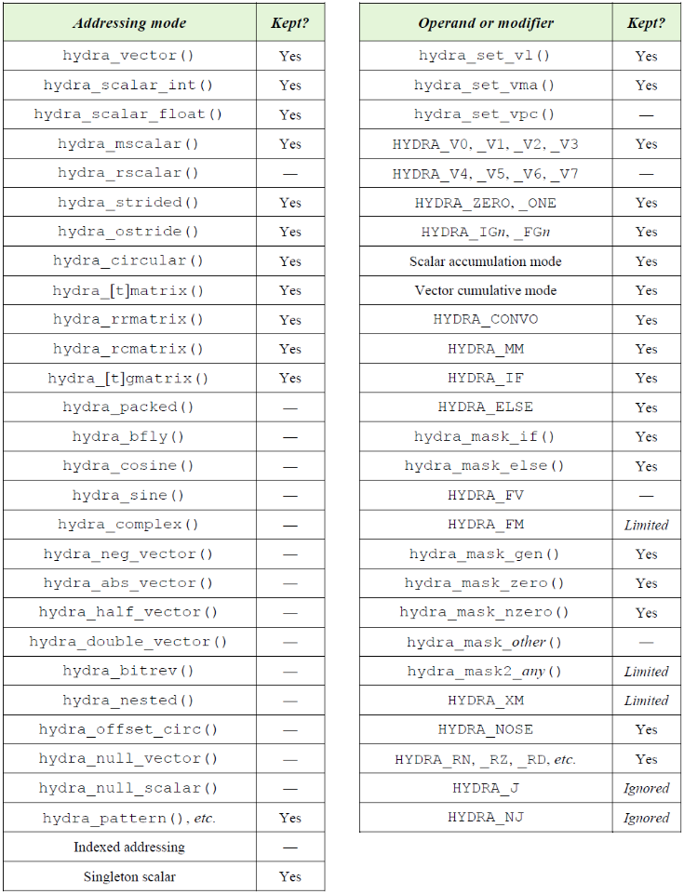
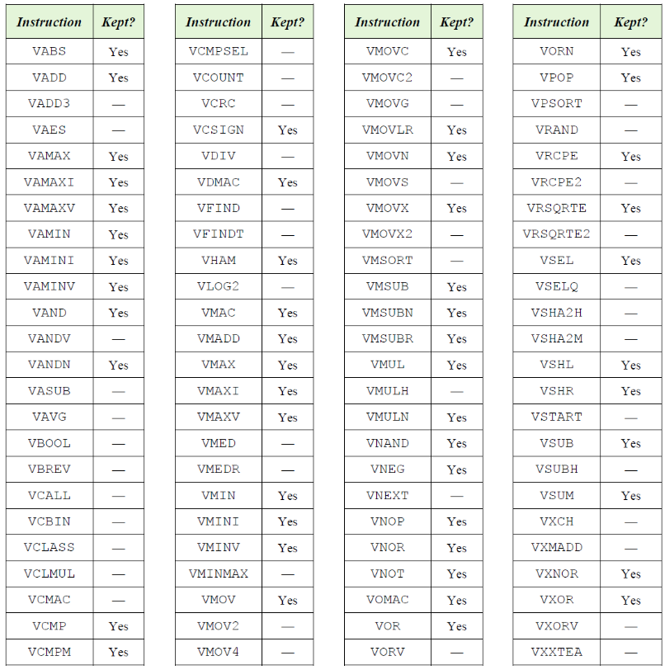
“Hydra Junior”

Slide 24
Hydra 4
Architecture overview
  Introduction
    What is it
    Why we need it
    Where it came from
  Using Hydra
  Hardware and implementation

Slide 25
Refreshing Hydra 3
Hydra versions 1.0–3.3 have served us well in a variety of touch, display, and fingerprint chips at Synaptics
  Hydra is present in many of our most successful chips, but not in some of the highest-volume, lowest-cost chips
  This makes it hard to work out the total number of Hydras produced so far …
  … But most likely, well over a billion chips have shipped to date with some version of Hydra
Still, Hydra 3 was showing its age
Hydra 3.3 is still largely backward compatible to the original ten-year-old Hydra 1.0
  An architecture based on guesswork from days when our firmware was much less mature
  It was built around the 16-bit-centric architecture of older Chimera CPUs, which puts it
  out of step with modern CPUs including our own Chimera 4.2
⇒ Time for a thorough refresh
Notes:
Maybe a few billion by now…?

Slide 26
Why refresh Hydra? (1)
Hydra is valuable: For example, Prometheus (and Triton) fingerprint matching
  Its image processing module runs 6x faster with Hydra 3 than it does in pure firmware on our Prometheus chip’s Tensilica Xtensa CPU
  … even though Prometheus has a maximally-configured >200K-gate 32-bit Xtensa at 192 MHz
  ⇒ Match-in-sensor would not have been feasible without Hydra or something like it

Slide 27
Why refresh Hydra? (2)
Hydra is valuable: For example, Prometheus (and Triton) fingerprint matching
Hydra is strategically valuable: For example, noise countermeasures in touch firmware
  With Hydra 2, we solved OLED display noise “in firmware” instead of with a one-year chip spin
    (Yes, I know, oversimplifying…)
  OLED display noise was not known yet, and our algorithms for it were not invented yet, back when we designed our DIG240x series chips with Hydra
  We had originally developed Hydra for something else
  We carried it forward into those chips “just in case” new tough problems might need more computational power
  That bet paid off when OLEDs came along
  ⇒ A chip conceived and built with only enough strength for our pre-OLED firmware
  would never have had the horsepower to handle OLED displays

Slide 28
Why refresh Hydra? (3)
Hydra is valuable: For example, Prometheus (and Triton) fingerprint matching
Hydra is strategically valuable: For example, OLED touch firmware
Hydra is still strategically valuable:
  Sure, future chips can (and should!) solve things like OLED noise in a more fundamental way
  Maybe they will have faster CPUs or better AFEs
  But without Hydra or something like it, we would have nothing left “in our back pocket”
  for the next OLED-like challenge
⇒ And that is Synaptics’ bread and butter!
  Customers look to us because our technology has the strength and ingrained flexibility …
  … to “fix in firmware” with speed and agility …
  … even the toughest problems

Slide 29
Why refresh Hydra? (4)
Hydra is valuable: For example, Prometheus (and Triton) fingerprint matching
Hydra is strategically valuable: For example, OLED touch firmware
Hydra is still strategically valuable:
Hydra is necessary
  Even our existing firmware is hard to run without it
  SiFive’s E76 is maxed out by Byrd’s needs
    … even though it is much larger than Chimera + Hydra combined
    Even if we can clock a CPU that fast, it is not clear we always should,
    from a power/noise/cost perspective
  Also, no affordable ARM processor can run as fast as E76
  ⇒ We don’t know how to build an ARM-based touch controller that can run our full firmware
  unless we pair the ARM with Hydra or something like it
This was written with Cortex-M7 in mind; the newer Cortex-M52 might change that, but it is quite big and only questionably “affordable”!

Slide 30
Why refresh Hydra? (5)
That’s all great, but Hydra 3 itself was getting old …
Our modern chips are 32-bit-oriented
  Synaptics’ Chimera and Hydra began as small 16-bit processors
  But Chimera 4.2 now supports 32-bit data, 32-bit addressing, and 32-bit interfaces to RAM
  (used today in DIG2405 / DIG2407 / DIG2408 “Vulcan” and “Keys”)
  Some customers want a 32-bit commercial CPU (e.g., one customer specified ARM Cortex-M4)
  Byrd and SmartBridge use a 32-bit RISC-V CPU, and future chips may use it too
Hydra 3 still has a 16-bit data path with 16-bit addressing and 16-bit RAM interfaces
  ⇒ This is needlessly old-fashioned!
  Hydra 3 reads and writes floating-point numbers in two 16-bit halves, sequentially
    Its float operations run at half speed, even though our memories now support 32-bit-wide access
  Hydra 3’s 16-bit architecture has a hard time with > 64KW of RAM
  It is awkward to use when connected to modern 32-bit processors
  And it’s awkward to connect! It uses Chimera-specific buses; no AHB or APB

Slide 31
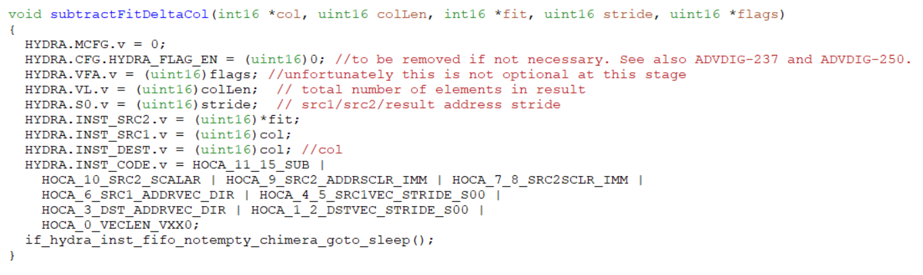
Why refresh Hydra? (6)
Hydra 3 is too hard to use
Recent versions have made improvements, but it is still clumsy
  It is hard to construct the numeric “opcode”
  Parameters of the operation mingle in tricky ways
  Some parameters must be specified in multiple places
  Lots of sticky modes to watch out for; lots of restrictions to navigate
  Not a very “natural” interface to the firmware
  Meanwhile, we
  should be making
  Hydra easier and
  more accessible:
  Hydra’s best early
  power users are
  no longer here
One Hydra 3 VSUB instruction
(in real IFP firmware) ↓

Slide 32
Why refresh Hydra? (7)
Hydra 3 is hard to maintain
  The RTL was originally written by Kam Li in 2012 w/architectural guidance from Mark Pearce and me
  Hydra has evolved dramatically since then, but Hydra 3.3 is still built upon that old RTL
  Mark left Synaptics in 2014, and Kam left in 2017
  I took over Hydra, finished the work for Prometheus, and maintained and developed it since then
  I cultivated Cody Cziesler in Rochester to co-own Hydra; we lost him when RDC closed in 2018
  Today, I handle all of Hydra’s architecture, design, documentation, testing, and some tools by myself
  This is not “scalable”!
  So it would be great if Hydra’s internals were easy to teach and to work with; sadly …
Hydra 3 is hard to work with
  Its Verilog RTL is quirky and obscure “spaghetti code”: People find it impenetrable
  I took the time to learn it, but even I have a hard time implementing some feature requests
  It was getting hard to push Hydra 3 any further

Slide 33
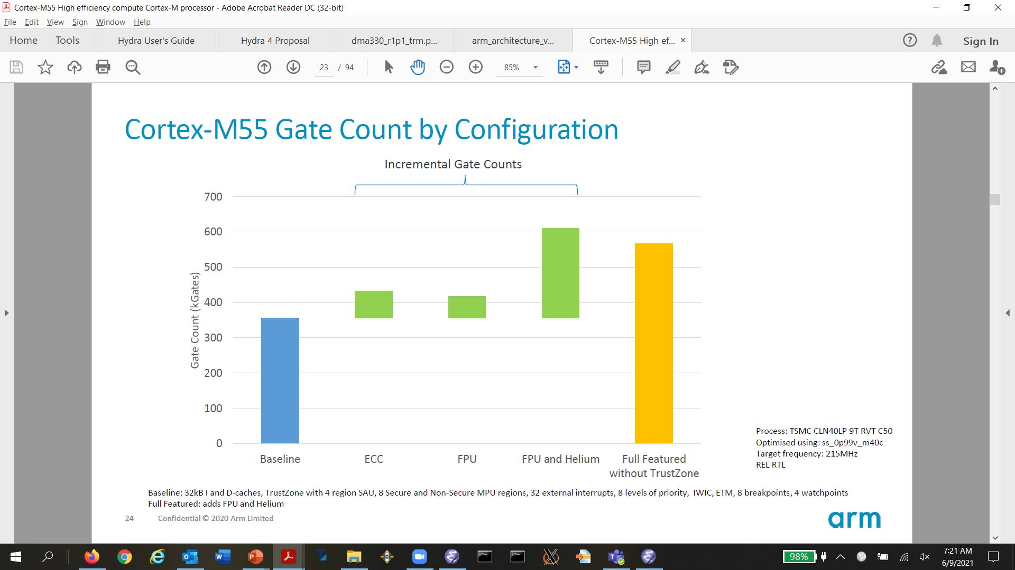
Why not just buy it?
Vector processors are an old idea — but getting popular again
However, even today’s “small” commercial vector processors are really big
  ARM recently released Cortex-M55 with “Helium / MVE” M-profile Vector Extension
  Yay! But …
Hydra 3 is less than 100K gates
  Similar in size to Chimera
  Together they are only as big as
  ARM M4 or SiFive RISC-V E34
SiFive’s E76 is quite a bit larger
than ARM M4, and Hydra 4 is
somewhat larger than Hydra 3
  But the principle is the same:
  Our chips are small; industry
  standard vector CPUs are not!
Hydra 3.3
Chimera 4.2
My idea of small!
(To be fair, ARM released a smaller Cortex-M52 since I wrote this in 2022)
Notes:
It would be good to get analogous numbers for ARM’s Cortex-M52.

Slide 34
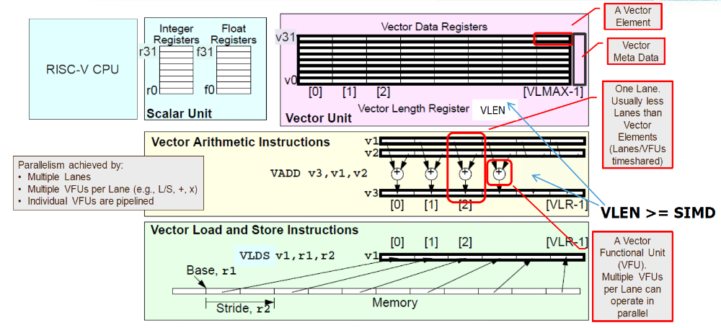
Why not just buy it in RISC-V?
RISC-V offers a “V” vector extension
  An elegant state-of-the-art vector architecture
  Scalable in principle from “large” to “small”
  implementations
  But even its smallest configuration is still
  pretty big: 32×128-bit vector registers, etc.
Vendors like SiFive and Andes offer “V” mainly
in their largest CPUs (> 1 million gates)
  With 512-bit-wide registers that can hold 16 floats at once
  And enough cache bandwidth to load or store 512 bits on every cycle
  And 16 floating-point multipliers and adders in a row, all operating in parallel
  Cool stuff, but way out of our league!
So, in today’s world, for our tiny chips, it still makes sense to build and develop Hydra
From a webinar on andestech.com

Slide 35
Why not just buy it in RISC-V?
RISC-V offers a “V” vector extension
  An elegant state-of-the-art vector architecture
  Scalable in principle from “large” to “small”
  implementations
  But even its smallest configuration is still
  pretty big: 32×128-bit vector registers, etc.
Vendors like SiFive and Andes offer “V” mainly
in their largest CPUs (> 1 million gates)
  With 512-bit-wide registers that can hold 16 floats at once
  And enough cache bandwidth to load or store 512 bits on every cycle
  And 16 floating-point multipliers and adders in a row, all operating in parallel
  Cool stuff, but way out of our league!
So, in today’s world, for our tiny chips, it still makes sense to build and develop Hydra
Since this slide was written, there are now some smaller CPUs available with the “V” extension in the 128-bit vector size, such as SiFive’s X160. But they are still quite large!
For example, “V”’s small-configured vector register file alone contains 32 x 128 = 4096 flip-flops, which is more flip-flops than in the entire Hydra 4.2 non-Junior core including all the registers, FIFOs, pipelines, arithmetic functions, address generators, controllers, etc., all together
From a webinar on andestech.com

Slide 36
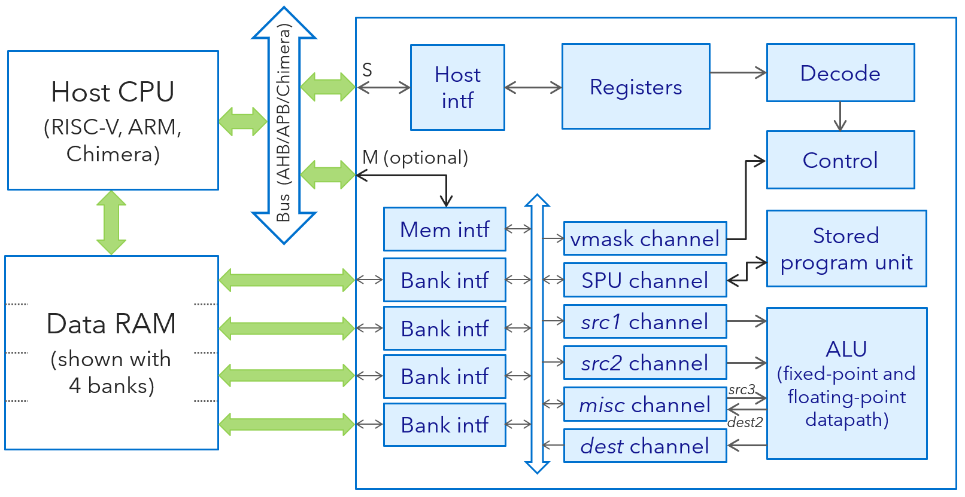
Big: RISC-V “V”, ARM Neon / SVE / MVE | Small: Hydra coprocessor
Many wide vector registers inside the CPU | Vector data resides in the main data RAM
Many ALUs / FPUs operating in parallel | Stream the data through one pipelined ALU / FPU
Vector Load + Vector Arithmetic + Vector Store are separate instructions | Multiple DMA channels load and store data in parallel with the ALU’s operation
To keep the ALUs busy, combine all these loads, arithmetic, and stores in superscalar fashion | The ALU is 100% utilized during large vector operations: No need for a big superscalar CPU
Without superscalar, a RAM-to-RAM vector multiply would need 4 cycles [load + load + multiply + store] to do (e.g.) 4 floating-point multiplications | Same net speed: One float multiplication per cycle For neural nets: Up to 4 SIMD byte MACs per cycle ⇒ 3.2 GOPS at Byrd’s 400 MHz
V0
V1
V2
V3
V4
V5
V6
⁝
V30
V31
 | [0] | [1] | [2] | [3] | [4] | [5] | ∙∙∙ | [N-1]
…
Hydra 4.2
ALUs
vfmul.vv v30,v1,v3
128–1024 bits
vle32.v v1,(a2)
vse32.v v30,(t0)
RISC-V Vector extension

Slide 37
Big: RISC-V “V”, ARM Neon / SVE / MVE | Small: Hydra coprocessor
Vectors need a lot of RAM bandwidth | Vectors still need a lot of RAM bandwidth!
RAM bandwidth comes from wide cache access: Read or write a whole cache line at a time | RAM bandwidth comes from multiple DMA channels connected to multiple interleaved banks of RAM
Big chips need a data cache anyway … | Small chips prefer to use tightly-coupled data RAM …
… so wide cache access is a natural fit | … and several small RAMs are faster than one big RAM, so we get our multiple-banked RAM for free
Scalable to almost arbitrarily huge systems | Optimized specifically for small “edge” systems
V0
V1
V2
V3
V4
V5
V6
⁝
V30
V31
 | [0] | [1] | [2] | [3] | [4] | [5] | ∙∙∙ | [N-1]
Load
Store
Data
cache
…
Hydra 4.2
ALUs
vfmul.vv v30,v1,v3
128–1024 bits
…
vle32.v v1,(a2)
vse32.v v30,(t0)
RISC-V Vector extension

Slide 38
Hydra 4
Architecture overview
  Introduction
    What is it
    Why we need it
    Where it came from
  Using Hydra
  Hardware and implementation

Slide 39
Hydra’s motivation and design
Why is a vector processor a good choice for us?
The next few slides tell the story behind Hydra’s development
  They are adapted from my earlier presentation, Hydra: A Supercomputer on Our Scale,
  which described Hydra 3
  Before we get into the details of Hydra 4, let’s see what motivated Hydra’s general architecture
  and approach
  The story goes back about 10 years, with echoes going much further back …

Slide 40

Scalable computation
In 2012, large touch screens on laptops looked to be the Next Big Thing for Synaptics
They inspired us back then to develop Hydra version 1
Even though LTS did not become the big market we hoped …
… Hydra has proven effective, since then, for other
compute-intensive tasks in our products
  In touch algorithms like OLED noise removal
  In fingerprint algorithms like Quantum Matcher
  And now, as smartphone screens and
  automotive screens get ever larger
  Recently: Hydra accelerates neural networks
  for state-of-the-art Accidental Contact Mitigation
  in our laptop touchpads and moisture immunity
  in our touchscreens for phones

Slide 41

Scalable computation
What was so special about large touch screens?
Computationally, a large touch screen is like a small touch screen … but large!
  In every algorithm that scales with some “N”, N is larger
  N might be the number of row or column channels, or
  the number of touch pixels, max number of fingers, …
Also, our products were using more image
processing and other advanced algorithms
that crunch data in bulk
If N is 3x larger, you could just buy a 3x-faster CPU
  They exist, but they scale quickly in size and complexity
  More than 3x as big, expensive, and power-hungry
  For example, Byrd’s E76 is ~3x bigger than Chimera,
  but less than twice as fast (running real firmware)
⇒ Is there a smarter answer than brute force?
Notes:
See What Chimera Is All About for various E76/Chimera size and performance comparisons.

Slide 42
Scaling with N: Vector processors
A vector processor is a computer that works on numbers N-at-a-time
On a traditional general-purpose processor, each instruction does one “thing” at a time:
ADD a, b, c // Set a ← b + c (using a hypothetical example processor…)
Such processors are called scalar processors
  (Borrowing the mathematical term for “a single number” instead of a vector or matrix)
Some processors can do several scalar operations at once, as if one larger operation:
ADD a, b, c // Set a ← b + c
LOAD i, 0 // Set i ← 0
This is still scalar, not vector, because it is programmed in terms of scalar operations
  Instead, it is called superscalar
  See our Chimera for a simple example, and SiFive’s E76 for a larger-scale example
  See big x86 and ARM Cortex-A processors for really ambitious examples
Both together in one clock cycle

Slide 43
Scaling with N: Vector processors
When a scalar processor works on a vector, doing the same thing to a whole array of N numbers, it must use a loop of scalar instructions:
LOAD i, 0 // Start with i ← 0 (again using a hypothetical processor!)
again: LOAD B[i] // Load the next two input vector elements …
ADD C[i] // … and compute their sum
STORE A[i] // Set A[i] ← B[i] + C[i]
ADD i, 1 // Increase i ← i + 1
BLT i, N, again // Branch if i < N back to do it again
A vector processor expresses the whole thing as one instruction:
VADD VL(N) A, B, C // Set A[i] ← B[i] + C[i] for all i = 0 … N−1
It may be a slow instruction, internally taking many steps to work through a big vector …
… but it is still much better than a loop of 5N instructions!

Slide 44
Mixing vector and scalar processing
Vector processors are efficient when your program is composed all of vector operations such as “add vector B to vector C”
Real programs are not like that:
  Our touch and fingerprint firmware sometimes operates on N channels or N pixels in bulk
  … but other times, it does lots of individual “this-and-that” operations on scalar data
So, in reality, we can’t replace our general-purpose scalar processor with a vector processor
Instead: Combine the two!

Slide 45
Mixing vector and scalar processing
Two ways to combine vector + scalar:
  Make a processor that can do both scalar instructions and vector instructions
  Or augment a general-purpose processor with a vector “co-processor” to help with heavy math
For the T1326 “Oahu” touch controller (circa 2012), we decided to add a vector coprocessor to sit alongside our traditional Chimera processor
This became Hydra 1.0
  Implemented by Kam Li; architected by Mark Pearce and Dave G.
Scalar
Vector
Scalar
Vector

Slide 46
A legendary example
What kind of vector coprocessor should we use?
  Off-the-shelf vector processors were far too “big” for touch controllers (still true today, c. 2022!)
  So, in true Synaptics style, we built our own vector coprocessor to suit our needs
What kinds of operations should it support?
Can we just recast our firmware’s algorithms in the form of specialized hardware?
  No: Our firmware evolves way too fast for that
  And the firmware varies too much, adapting to the needs of each customer and project
Instead, we wanted a reasonably general-purpose, flexible vector architecture
  What does that look like?
For a model, we looked to the most famous vector computer of all …

Slide 47
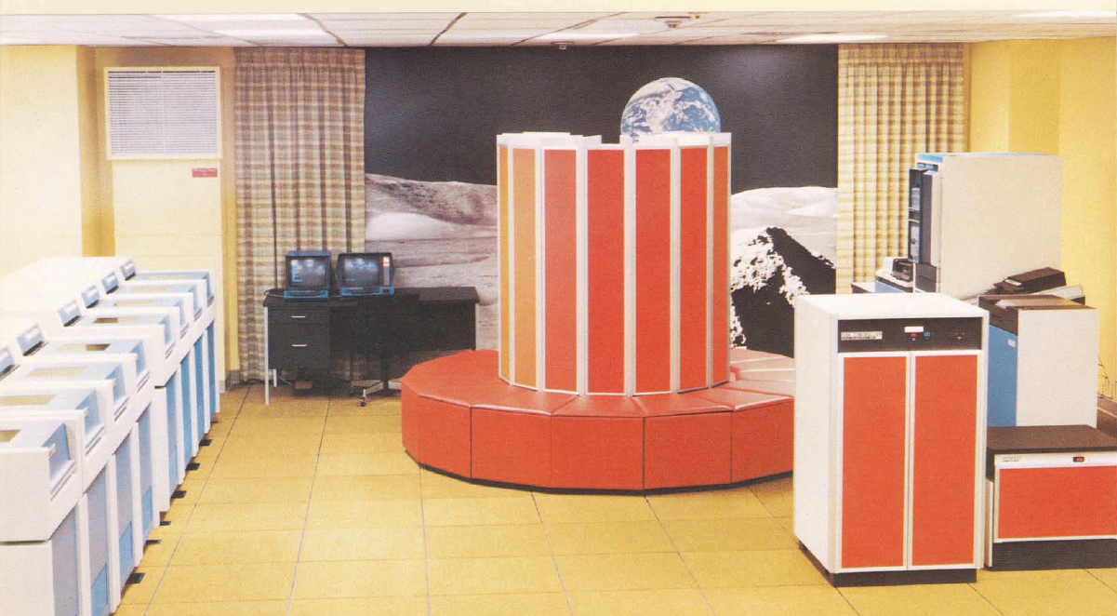
The Cray-1 supercomputer
Notes:
Photo is “The Original Cray 1 Supercomputer, at AT&T Bell Labs circa 1977”, not sure where I found it.

Slide 48
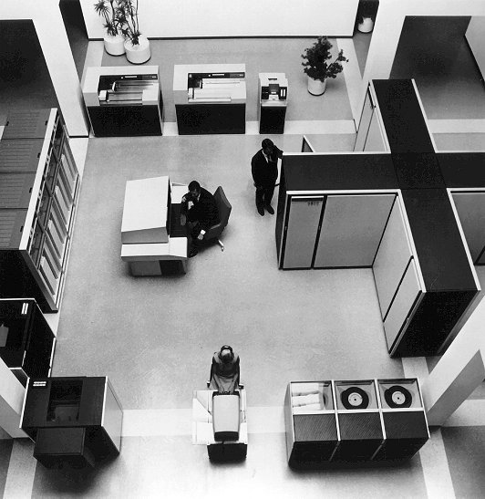
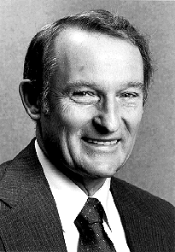
Seymour Cray’s heritage
The Cray-1’s designer, Seymour Cray, first made his name with the CDC-6600 supercomputer
When it came out in 1964, the CDC-6600 was 3x faster than its fastest competitor
It remained the world’s fastest computer until 1969
[Wikipedia]

Slide 49
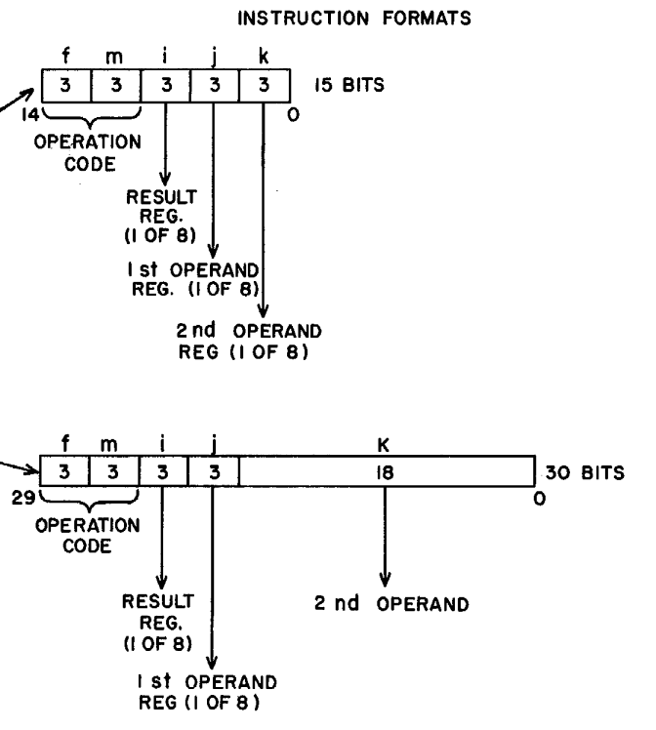
Cray’s innovations
How did Cray achieve such a huge jump
in performance?
⇒ Design innovation!
He rethought everything about computer
architecture and design
For example:
The CDC-6600 pioneered the “load/store”
organization that paved the way for all
modern RISC processor architectures
This idea is still widely used today
In fact, our Chimera is a rare bird for not using it
  Why? See my talk, “What Chimera is All About”
CDC-6600 reference manual
Notes:
The Chimera slide deck will be available soon on github.com/synaptics-chimera.

Slide 50
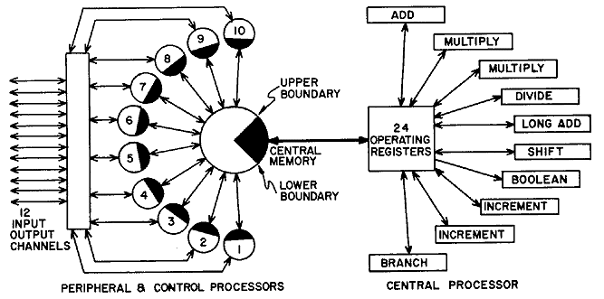
Cray’s innovations
For another example:
The CDC-6600 could keep multiple
instructions running simultaneously,
one in each functional unit
⇒ Superscalar execution
This idea, too, was pioneered by Cray
and is still widely used today
(… including, in a simple form, in our
own Chimera processor!)

Slide 51
Cray’s innovations: One more example

Slide 52
Cray’s innovations: One more example
To let the fast main processor focus on the main task …
The CDC-6600 had a separate peripheral processor to manage real‐time hardware functions
Each of 10 peripherals gets its own “virtual” control processor, dedicated to the peripheral
A single hardware processor simulates 10 independent processors by time-slicing
It performs one instruction at a time from each virtual processor in round-robin fashion

Slide 53
Cray’s innovations: One more example
In other words: The CDC-6600 had hardware multithreading!
Interleaved hardware threads are not so common in today’s computers
But if you work at Synaptics, the idea might sound familiar!
Chimera uses threads for the same reason: Efficiently dividing its time among many real-time tasks
Seymour Cray’s innovations have quietly guided us all along

Slide 54
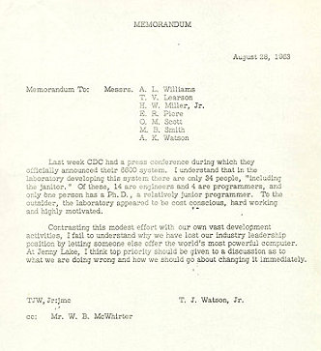
Another Cray hallmark
Cray designed his machines by hand,
with a small, focused team
The head of IBM asked how Cray could so
badly beat IBM’s “vast development activities”
with “only 34 people, including the janitor”
Cray: “It seems like Mr. Watson has
answered his own question”
We follow Cray’s lead in this, too
  Chimera’s hardware team has varied in size,
  sometimes as “vast” as 4 or 5 people,
  sometimes just me alone
  Hydra 1.0 was architected by Mark Pierce,
  Kam Li, and me; and Kam (and later I)
  did the whole implementation solo
  A small team can (and must!) focus to succeed
Notes:
The legendary “Janitor Memo”, and several other images here, came from www.computerhistory.org.

Slide 55
Another Cray hallmark
Cray designed his machines by hand,
with a small, focused team
The head of IBM asked how Cray could so
badly beat IBM’s “vast development activities”
with “only 34 people, including the janitor”
Cray: “It seems like Mr. Watson has
answered his own question”
We follow Cray’s lead in this, too
  Chimera’s hardware team has varied in size,
  sometimes as “vast” as 4 or 5 people,
  sometimes just me alone
  Hydra 1.0 was architected by Mark Pierce,
  Kam Li, and me; and Kam (and later I)
  did the whole implementation solo
  A small team can (and must!) focus to succeed
A related, wonderful (maybe apocryphal?) story:
Jobs to Cray: We used your Cray-1 to design the Mac!
Cray’s reply: Funny, I’m designing the Cray-3 on a Mac!

Slide 56
The Cray-1
For his next computer, Cray looked for the next huge leap in performance
He observed that scientific computations often involve arithmetic on large
vectors and matrices
Why not build a computer that’s actually meant for that kind of computation?
for (i = 0; i < N; i++)
A[i] = B[i] + C[i];
VADD A, B, C
B[0] | B[1] | B[2] | B[3] | B[4] | B[5] | B[6] | B[7] | ∙∙∙ | B[N-1]
+ | + | + | + | + | + | + | + |  | +
C[0] | C[1] | C[2] | C[3] | C[4] | C[5] | C[6] | C[7] | ∙∙∙ | C[N-1]
↓ | ↓ | ↓ | ↓ | ↓ | ↓ | ↓ | ↓ |  | ↓
A[0] | A[1] | A[2] | A[3] | A[4] | A[5] | A[6] | A[7] | ∙∙∙ | A[N-1]

Slide 57
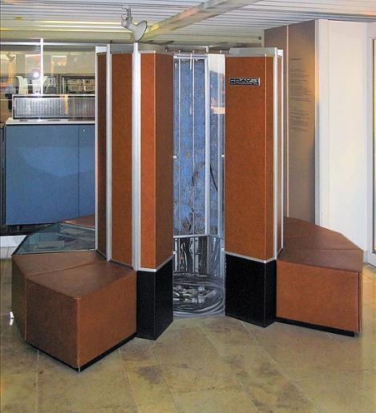
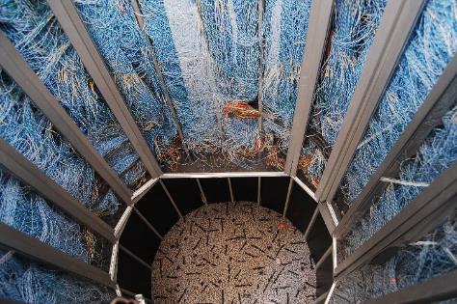
The Cray-1
Cray-1, introduced in 1976, once again
held the speed record for years
As usual, it was packed with
innovations at every level
Not just the vector instruction set
But even the physical design
  Its distinctive round shape was not just
  for show: It optimized routing of wires
  Wires were all cut to the same length
  so that the speed-of-light delays
  through them were balanced!
Cray-1 reference manual

Slide 58
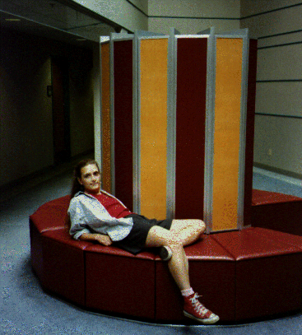
The Cray-1 is now history
Literally: You can find it and other Cray machines at the Computer History Museum
in Mountain View, California
Cray-1’s are still used today …
… but only as stylish furniture
  Actually those are power / cooling units, but anyway …
Vector machines in general fell out of fashion
  Most computer architectures have “SIMD” instructions instead,
  which are like vector instructions but with small fixed N = 2 or 4
  The open-source RISC-V processor architecture has
  an excellent vector extension that is gaining traction
  (and whose designers also cite Cray as inspiration)
Cray’s vector approach lives on today in Hydra
(Google images)

Slide 59
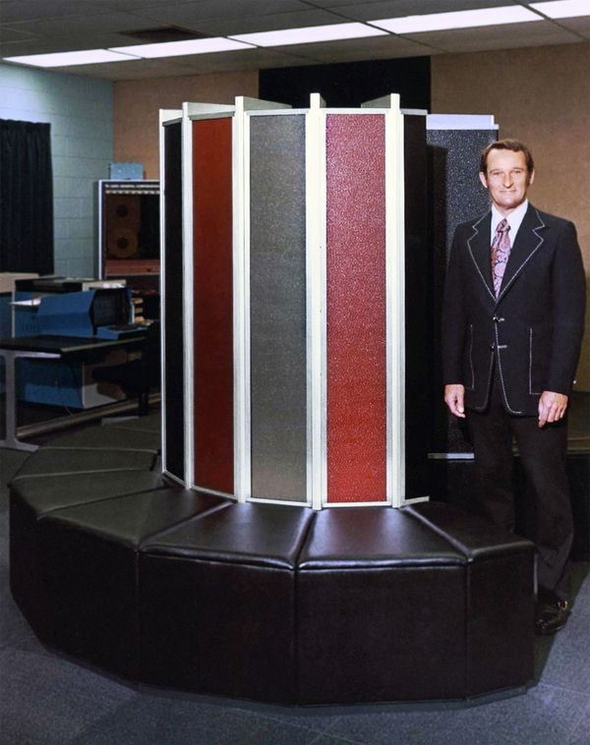
Ancient history?
Here we are, a quarter or so into the 21st century
Why care about antique machines like the CDC-6600
or the Cray-1?
  Apple’s M1 Ultra chip (c. 2022) has 114 billion transistors — wow!
  So why are our chips stuck in the unfashionable 1970’s?
  Why study such dinosaurs when they are so totally outclassed
  by modern technology?
The touch controllers we build today can afford a few
million transistors at most
  The M1 Ultra’s innovations, impressive as they are …
  … and fun as they are to learn about …
  … are irrelevant to what we do here
  Many orders of magnitude bigger than we could dream of
  in our tiny mixed-signal embedded-Flash high-voltage silicon

Slide 60
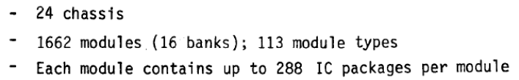
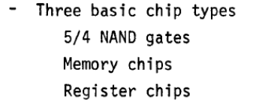
Ancient history
The largest discrete touch chip we have ever built, DIG2409 “Byrd”, has roughly
½ million gates of digital logic
  How many gates of logic did the Cray-1 have?
  ⇒ About the same!
  The Cray-1 may have filled a room, but in the
  most important way, it was “about as big” as Byrd
This was an era when the best computer
designers in the world …
  … with enormous resources on tap, a “blank check” from their customers …
  … overcoming the severe technological limitations of their day …
  … were building top-performing computers on our current budget of complexity
For us, the Cray-1, not the M1, is the model of greatness that makes the most sense to study and aspire to
Cray-1 reference manual

Slide 61
Vector processors
A vector processor offers single instructions for various common operations on vectors
  VADD A, B, C // Add two vectors: A[i] ← B[i] + C[i] (for all 0 ≤ i < N)
  VMADD A, B, C, D // Multiply-add: A[i] ← B[i] + (C[i] * D[i])
  VMAC sum, B, C // Multiply-accumulate: sum ← (B[0] * C[0]) + (B[1] * C[1]) + ∙∙∙
  VMOVG A, B, C // Move-and-gather: A[i] ← B[C[i]]
  … and so on
If N = 4 (say), we could just build 4 arithmetic units that work in parallel, all at once
  This is the approach taken by, e.g., x86 SSE/AVX; ARM Cortex-M4 SIMD; Cortex-A with Neon
But in general, we can’t afford to do an N-element vector operation all in one clock cycle
  Not when N gets large
  Especially not when N is large and variable!
Instead, Hydra works sequentially, but very efficiently, using a deep pipeline

Slide 62
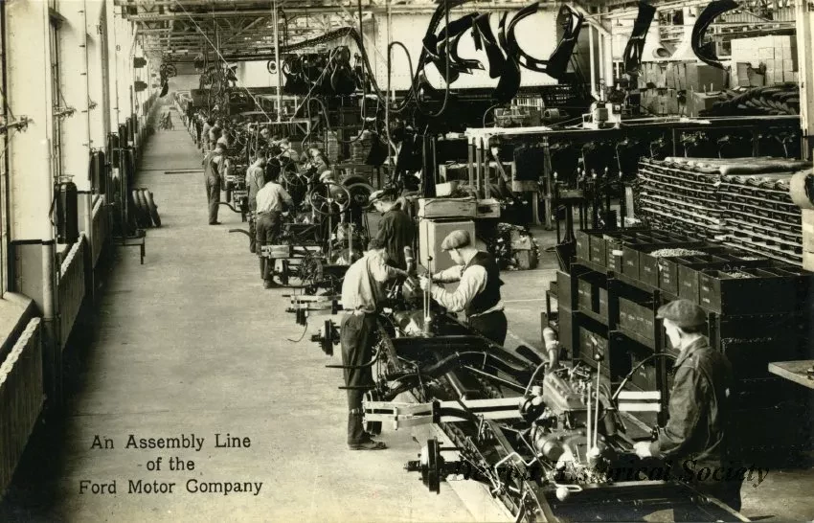
Pipelined processing
Computers go fast by breaking
a complex operation into several
small steps
Each step does a self-contained
piece of the job
These self-contained steps
can be overlapped in
assembly-line fashion
A “pipeline” of steps
This is much more efficient
than finishing each whole
operation before starting
the next
Detroit Historical Society
Notes:
Postcard image is from the Detroit Historical Society website (which grants free permission to reproduce)

Slide 63
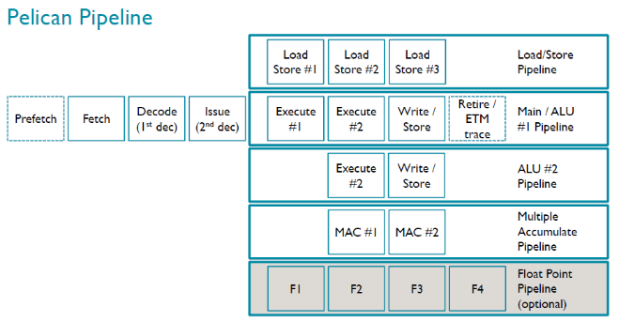
Deep pipelines
Long computer pipelines, with many steps, get complicated very quickly!
There are countless potential interactions among all the instructions in the various stages
This makes them either …
  … inefficient, as the pipeline often stalls to resolve the interactions …
  … or very hard to program, due to the instruction rearrangement needed to avoid stalling …
  … or painfully big and complicated, due to the extensive hazard detection, data forwarding,
  speculative execution, dynamic instruction reordering, and branch prediction needed to
  eliminate stalls at the hardware level
“Billion transistor” CPUs can efficiently use deep pipelines
  The Intel chip in your laptop might have a 20-stage pipeline!
But general-purpose CPUs in our price range cannot
  This is why low-cost microcontrollers have short pipelines
  And, in turn, it’s why small micros can’t clock nearly as fast as
  big application processors
ARM Cortex-M7
8-stage pipeline

Slide 64
Pipelined vector processors
But for a vector processor, deep pipelines are [relatively] easy!
Consecutive operations are predictable
The stages can’t possibly interact: Each stage is working on a different vector element
B[0] | B[1] | B[2] | B[3] | B[4] | B[5] | B[6] | B[7] | B[8] | B[9]
+ | + | + | + | + | + | + | + | + | +
C[0] | C[1] | C[2] | C[3] | C[4] | C[5] | C[6] | C[7] | C[8] | C[9]
↓ | ↓ | ↓ | ↓ | ↓ | ↓ | ↓ | ↓ | ↓ | ↓
A[0] | A[1] | A[2] | A[3] | A[4] | A[5] | A[6] | A[7] | A[8] | A[9]
(Hydra’s actual pipeline is deeper than shown here)
Fetch B | B[0] | B[1] | B[2] | B[3] | B[4] | B[5] | B[6] | B[7] | B[8] | B[9]
Fetch C |  | C[0] | C[1] | C[2] | C[3] | C[4] | C[5] | C[6] | C[7] | C[8] | C[9]
Exec (1) |  |  | [0] | [1] | [2] | [3] | [4] | [5] | [6] | [7] | [8] | [9]
Exec (2) |  |  |  | [0] | [1] | [2] | [3] | [4] | [5] | [6] | [7] | [8] | [9]
Write A |  |  |  |  | A[0] | A[1] | A[2] | A[3] | A[4] | A[5] | A[6] | A[7] | A[8] | A[9]

Slide 65
Getting the data in and out
Vector processors need lots of bandwidth to vector memory
During this vector operation, every cycle reads two numbers and writes a third number
How is this possible?
  One answer: Keep “A”, “B”, and “C” in separate memories
  The Cray-1 did this by holding vector data in eight “vector registers”
  built as 8 independent 64-entry RAMs (today, RISC-V “V” works similarly)
  Traditional DSPs do this by forcing people to manually allocate different
  vectors in different sections of main RAM (“X memory” vs. “Y memory”);
  then the DSP can access X RAM and Y RAM at once via two parallel ports
Fetch B | B[0] | B[1] | B[2] | B[3] | B[4] | B[5] | B[6] | B[7] | B[8] | B[9]
Fetch C |  | C[0] | C[1] | C[2] | C[3] | C[4] | C[5] | C[6] | C[7] | C[8] | C[9]
Exec (1) |  |  | [0] | [1] | [2] | [3] | [4] | [5] | [6] | [7] | [8] | [9]
Exec (2) |  |  |  | [0] | [1] | [2] | [3] | [4] | [5] | [6] | [7] | [8] | [9]
Write A |  |  |  |  | A[0] | A[1] | A[2] | A[3] | A[4] | A[5] | A[6] | A[7] | A[8] | A[9]

Slide 66
Banked data RAM
 | 0 | 1 | 2 | 3 | 4 | 5 | 6 | 7
0000
0001
0002
0003
0004
0005
0006
0007
0008
0009
000A
000B
000C
000D
000E
000F
0010
0011
0012
0013
0014
0015
0016
0017
0018
0019
001A
001B
001C
001D
001E
001F
0020
Another answer: Suppose we structure RAM as (say) 8 interleaved banks
The data word at memory word address X is stored in bank (X % 8)
at offset (X / 8) within the bank
Notice that “fetch B”, “fetch C”, and “write A” always use different banks!
The vector engine can operate at full speed on vectors directly in RAM
  If the vectors are aligned in memory in a favorable way
  See later for how Hydra deals well with unfavorably/randomly aligned data
Some early vector machines used interleaved RAM (CDC STAR; Cray-1),
and we use this approach in Hydra
Fetch B | B[0] | B[1] | B[2] | B[3] | B[4] | B[5] | B[6] | B[7] | B[8] | B[9]
Fetch C |  | C[0] | C[1] | C[2] | C[3] | C[4] | C[5] | C[6] | C[7] | C[8] | C[9]
Exec (1) |  |  | [0] | [1] | [2] | [3] | [4] | [5] | [6] | [7] | [8] | [9]
Exec (2) |  |  |  | [0] | [1] | [2] | [3] | [4] | [5] | [6] | [7] | [8] | [9]
Write A |  |  |  |  | A[0] | A[1] | A[2] | A[3] | A[4] | A[5] | A[6] | A[7] | A[8] | A[9]

Slide 67
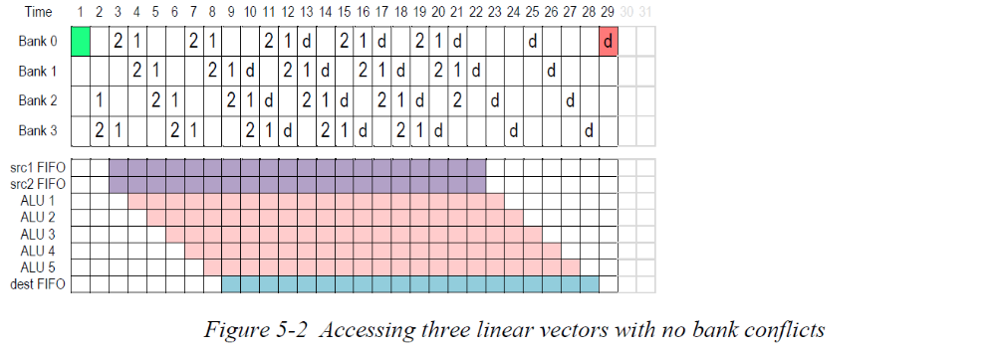
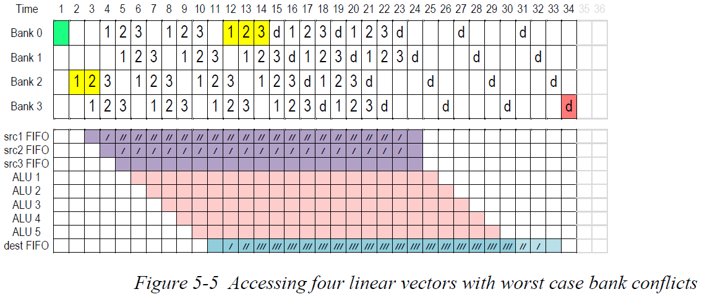
Hydra’s pipeline
Here are some actual timing diagrams
from the Hydra 4 User’s Guide
(based on chip simulation traces)
First, a VADD operation on a chip with
Hydra 4.2 and four banks of RAM ⇒
This VMADD (fused multiply-add)
accesses four vectors at once
in four banks ⇒
  Here, Hydra’s channel FIFO buffers
  absorb some stalls that occur due
  to the vectors’ alignment in RAM
  (see the “Hardware” section later)

Slide 68
The Hydra 4 vector coprocessor
The rest of this presentation introduces Hydra 4, Synaptics’ latest vector coprocessor
  First silicon in the SB7900A0 “SmartBridge” chip in early 2023
  Also appearing in DIG2409 “Byrd” in 2024 and DIG2411 “Denmarke” in 2025
  Hydra 4.2 is due to appear first in DIG2409B in 2026
  Probably next in the B1458 “Atlas” match-in-sensor fingerprint chip
Leveraging the success of Hydra 3 while improving every detail
Drawing upon the rich heritage of vector processors established by Cray

Slide 69
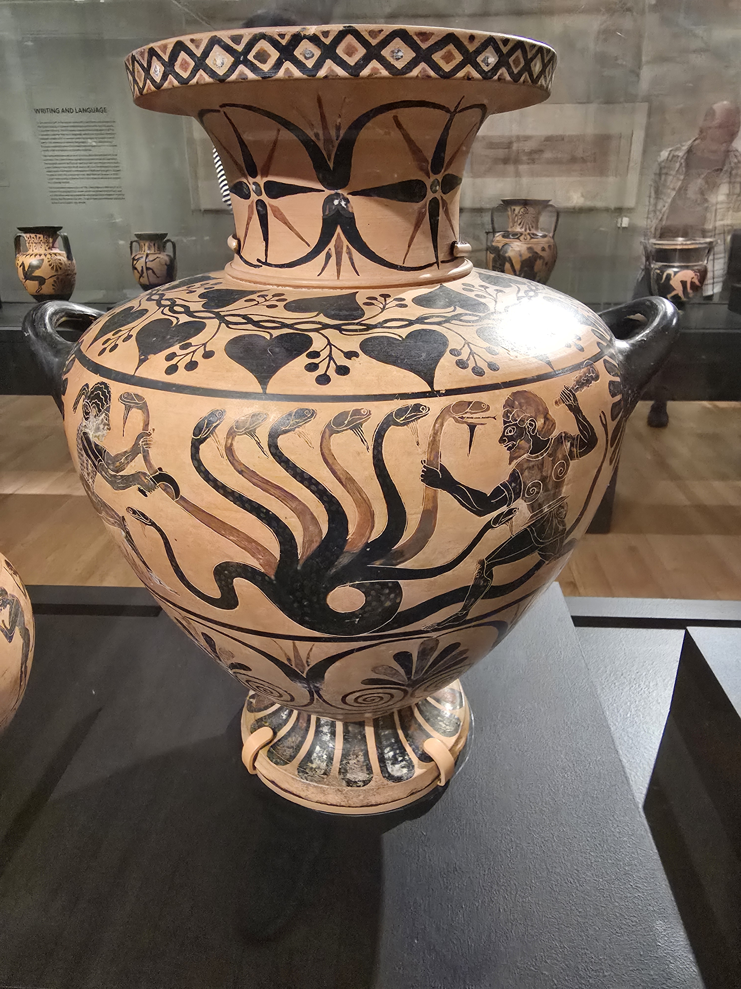
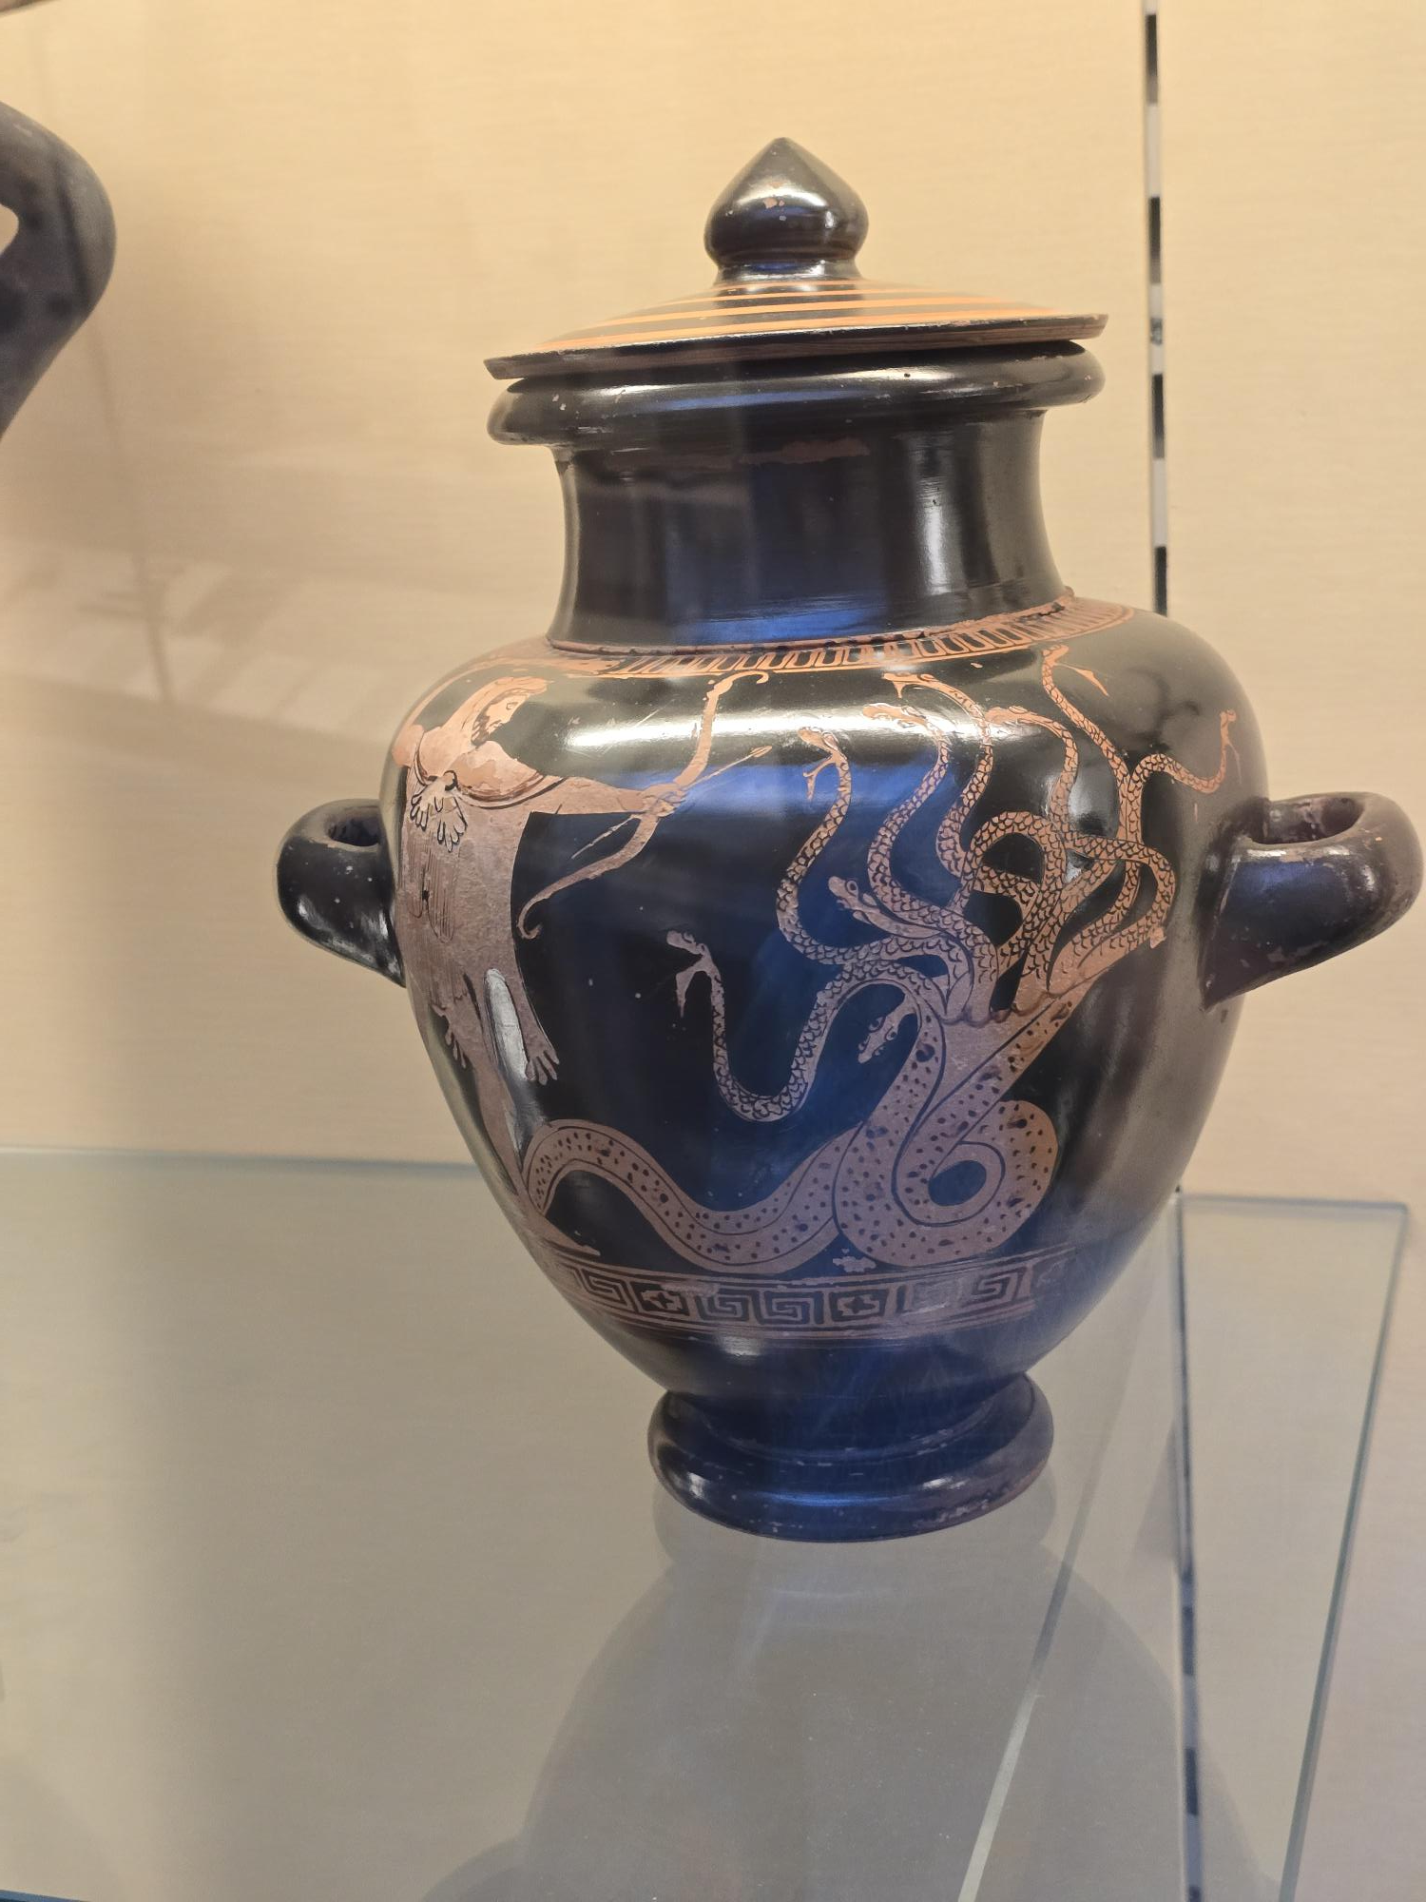
Iolaos and Heracles battling the Hydra
Etruscan vase based on a Greek painting, circa 520 BC
(Legion of Honor Museum, San Francisco)
Heracles preparing to attack the Hydra
Greek jar made in Athens, circa 480 BC
(British Museum, London)
Notes:
(I took these photos myself during visits to these museums.)

Slide 70
Hydra 4
Architecture overview
  Introduction
  Using Hydra
    Examples
    Hydra registers
    Vector instructions
    Data types
    Addressing modes
    Stored program unit
    Documentation and tools
    Hydra 4.2 functionality
    Performance
  Hardware and implementation

Slide 71
Hydra 4
Architecture overview
  Introduction
  Using Hydra
    Examples
    Hydra registers
    Vector instructions
    Data types
    Addressing modes
    Stored program unit
    Documentation and tools
    Hydra 4.2 functionality
    Performance
  Hardware and implementation

Slide 72
Using Hydra 4: A simple example
Hydra 4’s header file defines functions and macros for invoking Hydra in a C program:
Here, the hydra_vadd() function tells Hydra to begin a VADD operation with the indicated vector operands and vector length
  Hydra reads 100 short integers from the elements of the array data[] …
  … and it reads 100 long integers from every 5th element of the array inputs[]; …
  … it adds them together to get 100 sums, …
  … and then it stores these sums, as long integers, in results[]
#include "hydra4_defs.h"
long results[100], inputs[500];
short data[100];
hydra_vadd(hydra_set_vl(100),
hydra_vector(results, HYDRA_INT32),
hydra_vector(data, HYDRA_INT16),
hydra_strided(inputs, HYDRA_INT32, 5));
Equivalent to…
for (i = 0; i < 100; i++)
results[i] = data[i] + inputs[5*i];
Notes:
This C code is not quite equivalent to this Hydra operation, because the Hydra operation will saturate the result in case of a 32-bit integer overflow, while typical C compilers discard the high bits upon an overflow. Hydra’s “truncating integer” types more precisely model how C integer arithmetic works: See later in this presentation.

Slide 73
Sequential instructions
The result of a Hydra vector operation can feed directly into the next operation:
These operations automatically overlap inside Hydra as much as possible
  The hydra_vadd() function starts Hydra working on the VADD and then returns immediately
  The hydra_vmul() then sets up the VMUL operation while the VADD crunches away inside Hydra
  The VMUL waits in Hydra’s instruction buffer, then immediately runs as soon as VADD completes
#include "hydra4_defs.h"
long results[100], inputs[500];
short data[100], scales[100];
hydra_vadd(hydra_set_vl(100),
hydra_vector(results, HYDRA_INT32),
hydra_vector(data, HYDRA_INT16),
hydra_strided(inputs, HYDRA_INT32, 5));
hydra_vmul(0, // No need to set VL again if it is unchanged.
hydra_vector(results, HYDRA_INT32),
_, // Shorthand for “same vector as the result vector.”
hydra_vector(scales, HYDRA_INT16));
Equivalent to…
for (i = 0; i < 100; i++)
results[i] = data[i] + inputs[5*i];
for (i = 0; i < 100; i++)
results[i] *= scales[i];
… which computes this…
for (i = 0; i < 100; i++)
results[i] = ((data[i] + inputs[5*i]) *
scales[i]);

Slide 74
Reading Hydra’s results in firmware
When firmware wishes to look directly at Hydra’s results, it must wait for Hydra to finish:
Simulating with HydraSim will catch the error if you forget to call hydra_wait()
There is a convenient notation to run a Hydra operation and wait for it to complete:
#include "hydra4_defs.h"
long results[100], inputs[500];
short data[100], scales[100];
hydra_vadd(hydra_set_vl(100),
hydra_vector(results, HYDRA_INT32),
hydra_vector(data, HYDRA_INT16),
hydra_strided(inputs, HYDRA_INT32, 5));
hydra_vmul(0, // No need to set VL again if it is unchanged.
hydra_vector(results, HYDRA_INT32),
_, // Shorthand for “same vector as the result vector.”
hydra_vector(scales, HYDRA_INT16));
hydra_wait();
some_stuff(results[0] + results[99]);
Equivalent to…
for (i = 0; i < 100; i++)
results[i] = data[i] + inputs[5*i];
for (i = 0; i < 100; i++)
results[i] *= scales[i];
some_stuff(results[0] + results[99]);
hydra_vmul_w(…); … is the same as … hydra_vmul(…); hydra_wait();

Slide 75
Combining data types
Operations like hydra_vadd() can work with any combination of data types:
Hydra performs the necessary type conversions on its inputs and outputs as it goes:
  For each index i from 0 up to the vector length …
  Hydra reads the i’th set of input values from RAM (here, they are data[i] and inputs[i]);
  It interprets each input value as an exact mathematical number, according to its data type;
  It internally calculates the exact mathematical result;
  Then it rounds, saturates, and converts the exact result to match the output data type;
  And finally, it stores the i’th result back to RAM (here, the result goes in results[i])
#include "hydra4_defs.h"
float results[100]; // Single-precision floating-point numbers.
long data[100]; // Signed 32-bit fixed-point numbers with 22 integer bits and 10 fraction bits.
unsigned short inputs[500]; // Unsigned 16-bit integers.
hydra_vadd(hydra_set_vl(100),
hydra_vector(results, HYDRA_FLOAT),
hydra_vector(data, HYDRA_FIX32(10)),
hydra_strided(inputs, HYDRA_UINT16, 5));

Slide 76
Combining addressing modes
Also, operations like hydra_vadd() work with any combination of addressing modes:
Each mode defines how each index i = 0, 1, …, VL−1 maps to a memory address:
  For simple linear vectors: base_address + (i * element_size)
  For strided vectors: base_address + (i * stride * element_size)
  For a repeated-row matrix: base_address + ((i % width) * element_size)
  For a general matrix: base_address + ((((i / width) * row_stride) +
  ((i % width) * column_stride)) * element_size)
  … and so on, with many supported addressing modes
#include "hydra4_defs.h"
float results[5][20]; // Single-precision floating-point numbers.
long data[20][5]; // Signed 32-bit fixed-point numbers with 22 integer bits and 10 fraction bits.
unsigned short inputs[20]; // Unsigned 16-bit integers.
hydra_vadd(hydra_set_vl(5*20),
hydra_matrix(results, HYDRA_FLOAT, 20), // A 5x20 matrix.
hydra_tmatrix(data, HYDRA_FIX32(10), 5), // A 5x20 transposed view of a 20x5 matrix in RAM.
hydra_rrmatrix(inputs, HYDRA_UINT16, 20)); // A 20-element row repeated to form a 5x20 matrix.

Slide 77
Scalar values
Sometimes, an input to a vector operation will be the same for every vector element
  These are called “scalar values”
  Hydra 4 can take a scalar value directly, or it can draw a scalar value from a RAM location:
Hydra can also generate various numeric patterns as inputs:
float my_data[100];
float my_factor;
hydra_vmul(hydra_set_vl(100), // my_data[i] *= 3.1415 for all i.
hydra_vector(my_data, HYDRA_FLOAT), _,
hydra_scalar_float(3.1415));
hydra_vmul(hydra_set_vl(100), // my_data[i] *= my_factor for all i.
hydra_vector(my_data, HYDRA_FLOAT), _,
hydra_mscalar(&my_factor, HYDRA_FLOAT)); // “mscalar” = “memory scalar”.
hydra_vmul(hydra_set_vl(100), // my_data[i] *= (10+2*i) for all i.
hydra_vector(my_data, HYDRA_FLOAT), _,
hydra_pattern(10, 2));

Slide 78
Vector masks
Operations can apply conditionally to selected vector elements
  First, an operation such as vector comparison creates a vector mask with one bit per element
  Subsequent operations can be made to apply only if the mask bit is 1, or only if the mask bit is 0
float my_data[100];
uint32_t my_mask[HYDRA_VM_SIZE(100)]; // == [4], since 4*32 ≥ 100 bits.
hydra_vcmp_gt(hydra_set_vl(100), // my_mask[bit i] = (my_data[i] > 3.1415) ? 1 : 0.
hydra_mask_gen(my_mask),
hydra_vector(my_data, HYDRA_FLOAT),
hydra_scalar_float(3.1415));
hydra_vmul(hydra_mask_if(my_mask), // if (my_mask[bit i] == 1) my_data[i] *= 0.5.
hydra_vector(my_data, HYDRA_FLOAT), _,
hydra_scalar_float(0.5));
hydra_vmov(hydra_mask_else(my_mask), // if (my_mask[bit i] == 0) my_data[i] = −1.
hydra_vector(my_data, HYDRA_FLOAT),
hydra_scalar_float(-1.0));

Slide 79
How Hydra functions interface to the hardware
The functions hydra_vadd(), hydra_vector() , hydra_strided(), etc., …
#include "hydra4_defs.h"
long results[100], inputs[500];
short data[100];
hydra_vadd(hydra_set_vl(100),
hydra_vector(results, HYDRA_INT32),
hydra_vector(data, HYDRA_INT16),
hydra_strided(inputs, HYDRA_INT32, 5));
Equivalent to…
for (i = 0; i < 100; i++)
results[i] = data[i] + inputs[5*i];
… expand to a sequence of lower-level operations:
… which, in turn, translate to accessing various
Hydra hardware registers:
hydra_set_vl(100);
hydra_set_vector(HYDRA_V0, results, HYDRA_INT32);
hydra_set_vector(HYDRA_V1, data, HYDRA_INT16);
hydra_set_strided(HYDRA_V2, inputs, HYDRA_INT32, 5);
hydra_vadd(0, HYDRA_V0, HYDRA_V1, HYDRA_V2);
HYDRA_P->VL = 100;
HYDRA_P->V0CFG = 0x00000020;
HYDRA_P->V0ADDR = (int) results;
HYDRA_P->V1CFG = 0x00000010;
HYDRA_P->V1ADDR = (int) data;
HYDRA_P->V2CFG = 0x00005220;
HYDRA_P->V2ADDR = (int) inputs;
while (!(HYDRA_P->IRQ & 2)) { }
HYDRA_P->OPCODE = 0x00006210;

Slide 80
Vector registers
Like many vector machines, Hydra 4 organizes vector data as a set of vector registers
  Large vector processors such as Cray, ARM Neon, and RISC-V “V” have a large set of vector registers that directly store the vector data inside the CPU
  To save cost, Hydra instead stores the contents of each vector in the chip’s main data RAM
  Hydra’s vector registers V0–V7 are just descriptors that indicate the data type, addressing mode
  (the RAM access pattern), and base address of the data in RAM
  Functions such as hydra_set_strided() simply initialize a Vn register with that information:
  Internally, this corresponds to writing to a pair of Hydra
  registers called VnCFG and VnADDR (for some n = 0 … 7)
hydra_set_vl(100);
hydra_set_vector(HYDRA_V0, results, HYDRA_INT32);
hydra_set_vector(HYDRA_V1, data, HYDRA_INT16);
hydra_set_strided(HYDRA_V2, inputs, HYDRA_INT32, 5);
hydra_vadd(0, HYDRA_V0, HYDRA_V1, HYDRA_V2);
hydra_set_vl(100);
hydra_set_vector(HYDRA_V0, results, HYDRA_INT32);
hydra_set_vector(HYDRA_V1, data, HYDRA_INT16);
hydra_set_strided(HYDRA_V2, inputs, HYDRA_INT32, 5);
hydra_vadd(0, HYDRA_V0, HYDRA_V1, HYDRA_V2);
HYDRA_P->VL = 100;
HYDRA_P->V0CFG = 0x00000020;
HYDRA_P->V0ADDR = (int) results;
HYDRA_P->V1CFG = 0x00000010;
HYDRA_P->V1ADDR = (int) data;
HYDRA_P->V2CFG = 0x00005220;
HYDRA_P->V2ADDR = (int) inputs;
while (!(HYDRA_P->IRQ & 2)) { }
HYDRA_P->OPCODE = 0x00006210;
HYDRA_P->VL = 100;
HYDRA_P->V0CFG = 0x00000020;
HYDRA_P->V0ADDR = (int) results;
HYDRA_P->V1CFG = 0x00000010;
HYDRA_P->V1ADDR = (int) data;
HYDRA_P->V2CFG = 0x00005220;
HYDRA_P->V2ADDR = (int) inputs;
while (!(HYDRA_P->IRQ & 2)) { }
HYDRA_P->OPCODE = 0x00006210;

Slide 81
Choosing the vector registers
Handy functions such as hydra_strided() automatically select the next free Vn:
  The function then invokes hydra_set_strided()
  to initialize the selected vector Vn
  It returns a constant such as HYDRA_V2, suitable
  for passing to the function hydra_vadd()
  hydra_vadd() formats the vector numbers into the
  appropriate bits of the Hydra instruction opcode,
  combined with bits that select the instruction itself
  and some optional “modifier” bits
  It posts this opcode to the OPCODE register to start Hydra
#include "hydra4_defs.h"
long results[100], inputs[500];
short data[100];
hydra_vadd(hydra_set_vl(100),
hydra_vector(results, HYDRA_INT32),
hydra_vector(data, HYDRA_INT16),
hydra_strided(inputs, HYDRA_INT32, 5));
…
hydra_set_strided(HYDRA_V2, inputs, HYDRA_INT32, 5);
hydra_vadd(0, HYDRA_V0, HYDRA_V1, HYDRA_V2);
HYDRA_P->VL = 100;
HYDRA_P->V0CFG = 0x00000020;
HYDRA_P->V0ADDR = (int) results;
HYDRA_P->V1CFG = 0x00000010;
HYDRA_P->V1ADDR = (int) data;
HYDRA_P->V2CFG = 0x00005220;
HYDRA_P->V2ADDR = (int) inputs;
while (!(HYDRA_P->IRQ & 2)) { }
HYDRA_P->OPCODE = 0x00006210;

Slide 82
Using interrupts
Hydra can be set to send an interrupt signal to the host CPU on various conditions:
  Interrupt when Hydra is READY to receive another instruction
  Interrupt when Hydra is IDLE: All posted instructions are done
    Waiting for an IDLE interrupt is like calling hydra_wait()
  Interrupt when an ERROR occurs, etc.…
  Hydra’s IEN register controls which events, if any, will signal an interrupt
On traditional RISC CPUs, interrupts have tens or hundreds of cycles of overhead
  It is not practical to use interrupts to wait for Hydra
  in normal circumstances
  Therefore, the standard Hydra functions do not use
  interrupts by default when building for RISC-V or ARM
  Instead, they use spin loops to wait for READY or IDLE ⇒
  But interrupts are available for very long waits, e.g.,
  waiting for a big matrix-multiply or SPU program to finish
hydra_vadd_w(…)
HYDRA_P->VL = 100;
HYDRA_P->V0CFG = 0x00000020;
HYDRA_P->V0ADDR = (int) results;
HYDRA_P->V1CFG = 0x00000010;
HYDRA_P->V1ADDR = (int) data;
HYDRA_P->V2CFG = 0x00005220;
HYDRA_P->V2ADDR = (int) inputs;
while (!(HYDRA_P->IRQ & 2)) { }
HYDRA_P->OPCODE = 0x00006210;
while (!(HYDRA_P->IRQ & 1)) { }

Slide 83
Using interrupts on Chimera
Chimera’s interrupts are very fast and lightweight
  When building for Chimera, the same Hydra functions generate code that puts the thread to sleep, waiting for an interrupt
  These functions wait for the READY interrupt before posting an instruction to Hydra
    In the common case that Hydra was READY already, the interrupt is already asserted
    Chimera does not sleep, and no time is wasted
  … and they wait for the IDLE interrupt to implement hydra_wait(), hydra_vadd_w(), etc.
  Other firmware threads can run during that time
    Or the CPU can sleep, conserving power
  Here, the BSET- or BCLR-to-IEN instruction takes
  just one Chimera clock cycle ⇒
  … and the SLEEP instruction also takes one cycle
hydra_vadd_w(…)
HYDRA_P->VL = 100;
HYDRA_P->V0CFG = 0x00000020;
HYDRA_P->V0ADDR = (int) results;
HYDRA_P->V1CFG = 0x00000010;
HYDRA_P->V1ADDR = (int) data;
HYDRA_P->V2CFG = 0x00005220;
HYDRA_P->V2ADDR = (int) inputs;
while (!(HYDRA_P->IRQ & 2)) { }
HYDRA_P->OPCODE = 0x00006210;
while (!(HYDRA_P->IRQ & 1)) { }
HYDRA_P->IEN |= 2; SLEEP();
HYDRA_P->IEN &= ~2; SLEEP();

Slide 84
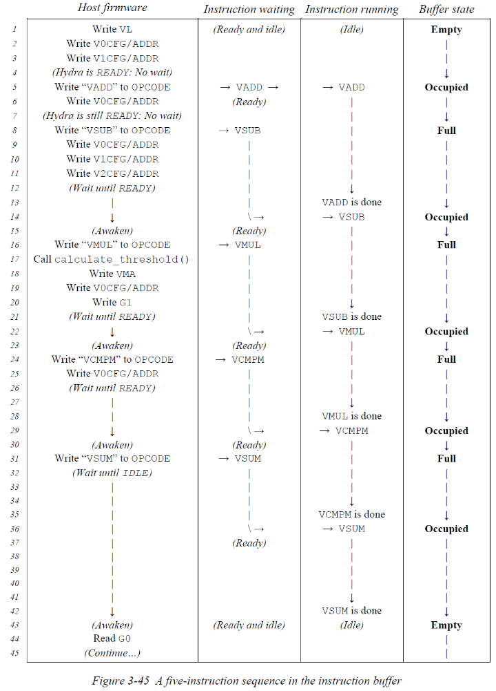
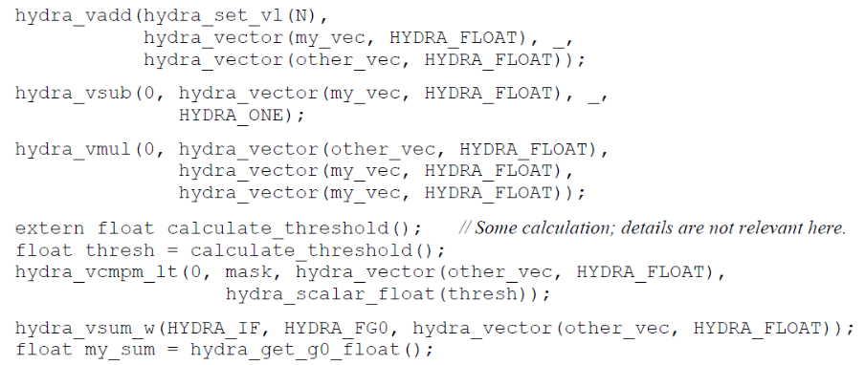
Eliminating setup overhead
Doesn’t it take time to write to all those Hydra
hardware registers for every instruction?
  Actually, no!
  During a sequence of Hydra instructions, the next
  instruction is always pending in the instruction buffer
  The time spent writing to registers, etc., completely
  overlaps the vector operations running inside Hydra
  Hydra stays busy 100% of the time (if N is large)

Slide 85
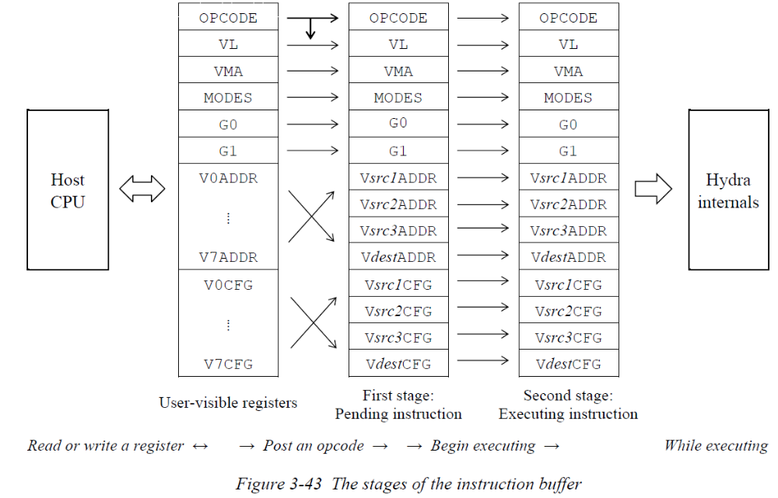
Instruction buffer
Hydra’s two-stage instruction buffer can hold one executing vector instruction …
… and one pending instruction …
… while the host sets up the
next instruction by accessing
Hydra’s registers
Instructions advance
automatically through the
instruction buffer’s stages
  Entering as they are posted
  to the OPCODE register
  Leaving as they complete
  their execution in Hydra’s
  vector pipeline

Slide 86
Example: Square root using Newton’s method
Let’s look at a real-world example: Square roots
  Hydra does not have an all-in-one “square root” operation
  Instead, it provides an instruction that estimates 1/sqrt(x) to just a few bits of precision
Three iterations of Newton’s method then refine this estimate to full single precision
  If x_{k} is an estimate of 1/sqrt(y) with relative error e_{k} …
  Then a better estimate is x_{k+1} = (1/2) * (3*x_{k} − y * x_{k}³)
  It converges quadratically: e_{k+1} ≈ e_{k}² (see Hydra User’s Guide section 4.3.7 for details)
  hydra_vrsqrte() estimates x₀ with |e₀| < 2⁻³ ⇒ ⇒ ⇒ x₃ is accurate with |e₃| < (((2⁻³)²)²)² = 2⁻²⁴
  Each Newton iteration becomes a hydra_vmulh() “multiply and halve”, a hydra_vmsub() “multiply and subtract”, and a hydra_vmul() “multiply”
  One final hydra_vmul() gives sqrt(y) = y * (1/sqrt(y))
hydra_vrsqrte(hydra_set_vl(N),
hydra_vector(results, HYDRA_FLOAT), // Output vector.
hydra_vector(data, HYDRA_FLOAT)); // Input vector.

Slide 87
Example: Square root using Newton’s method
float inputs[N], results[N], temp[N];
hydra_vrsqrte(hydra_set_vl(N),
hydra_vector(results, HYDRA_FLOAT),
hydra_vector(inputs, HYDRA_FLOAT));
for (int iter = 0; iter < 3; iter++) {
// Iterate: results = results * (1.5 − (inputs * (results²) * 0.5)).
hydra_vmulh(0, // temp = inputs * results * 0.5.
hydra_vector(temp, HYDRA_FLOAT),
hydra_vector(inputs, HYDRA_FLOAT),
hydra_vector(results, HYDRA_FLOAT));
hydra_vmsub(0, // temp = 1.5 − (temp * results).
hydra_vector(temp, HYDRA_FLOAT),
hydra_scalar_float(1.5),
_,
hydra_vector(results, HYDRA_FLOAT));
hydra_vmul(0, // results *= temp.
hydra_vector(results, HYDRA_FLOAT),
_,
hydra_vector(temp, HYDRA_FLOAT));
}
hydra_vmul_w(0, // Now sqrt(inputs) = inputs * (1/sqrt(inputs)).
hydra_vector(results, HYDRA_FLOAT),
_,
hydra_vector(inputs, HYDRA_FLOAT));
Each N-element vector operation takes N cycles
  At 400 MHz (in Byrd)
  Plus a few cycles of instruction startup overhead to fill/empty
  Hydra’s data pipeline
  This startup overhead becomes negligible as N grows large
Total time for this algorithm is 11*N cycles (plus startup overhead)
  Division using Newton’s method takes 6*N cycles
Notes:
For comparison: The SiFive E76 high-performance RISC-V CPU takes 33*N cycles for N fsqrt.s or fdiv.s instructions.

Slide 88
Example: Square root with vector registers
Recall that macros like hydra_vector() set up a “vector register” inside Hydra
  These macros normally choose the next available vector register (among V0–V7) automatically
  An alternative form, hydra_set_vector(), lets you choose the vector register yourself
We can reduce overhead by putting our working vectors directly in chosen Vn registers:
float inputs[N], results[N], temp[N];
hydra_set_vl(N);
hydra_set_vector(HYDRA_V0, inputs, HYDRA_FLOAT);
hydra_set_vector(HYDRA_V1, results, HYDRA_FLOAT);
hydra_set_vector(HYDRA_V2, temp, HYDRA_FLOAT);
hydra_vrsqrte(0, HYDRA_V1, HYDRA_V0);
for (int iter = 0; iter < 3; iter++) {
hydra_vmulh(0, HYDRA_V2, HYDRA_V0, HYDRA_V1);
hydra_vmsub(0, HYDRA_V2, hydra_scalar_float(1.5), _, HYDRA_V1);
hydra_vmul(0, HYDRA_V1, _, HYDRA_V2);
}
hydra_vmul_w(0, HYDRA_V1, _, HYDRA_V0);

Slide 89
Example: Square root with the SPU
Hydra’s Stored Program Unit can run a complete algorithm on its own inside Hydra
  Guided by a stored program made of vector operations and other MCU-like instructions:
  To run the program:
uint32_t sqrt_prog[100]; // An SPU program is just an array in RAM.
hydra_spu_begin(sqrt_prog, 100) { // Record the following sequence of Hydra operations in sqrt_prog[]:
hydra_vrsqrte(0, HYDRA_V1, HYDRA_V0); // In this context, each Hydra instr is recorded instead of running immediately.
for (int iter = 0; iter < 3; iter++) {
hydra_vmulh(0, HYDRA_V2, HYDRA_V0, HYDRA_V1);
hydra_vmsub(0, HYDRA_V2, hydra_scalar_float(1.5), _, HYDRA_V1);
hydra_vmul(0, HYDRA_V1, _, HYDRA_V2);
}
hydra_vmul(0, HYDRA_V1, _, HYDRA_V0);
hydra_spu_end();
}
Notice that the source code between the hydra_spu_begin() and the hydra_spu_end() is exactly the same as the non-SPU version of the code!
float inputs[N], results[N], temp[N];
hydra_set_vl(N);
hydra_set_vector(HYDRA_V0, inputs, HYDRA_FLOAT);
hydra_set_vector(HYDRA_V1, results, HYDRA_FLOAT);
hydra_set_vector(HYDRA_V2, temp, HYDRA_FLOAT);
hydra_vstart_w(hydra_set_vpc(sqrt_prog));

Slide 90
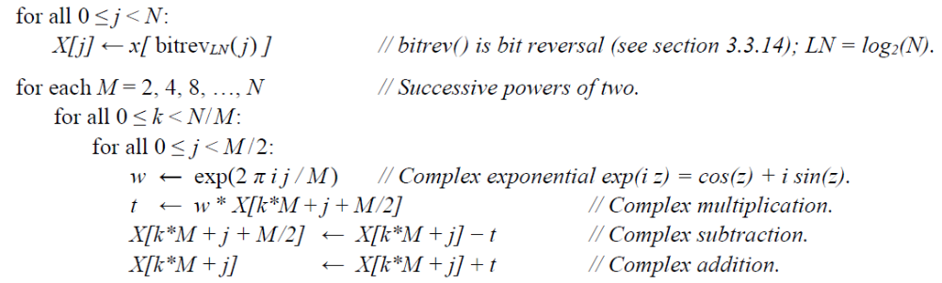
Example: Floating-point FFT
Hydra 3 performed Fast Fourier Transforms as a single, all-in-one operation
  Very convenient, but the hardware was so expensive that we had to omit it in many chips!
  Also, inefficient because the full hardware FFT didn’t fit well with Hydra’s pipeline
Hydra 4 instead provides “building blocks” that allow an efficient pipelined FFT
to be built as a firmware routine or SPU program that operates Hydra
  The algorithm, as expressed in complex numbers in the Hydra 4 User’s Guide:

Slide 91
Example: Floating-point FFT (2)
The first step uses bit-reversed
addressing to rearrange the inputs
  It also applies the arithmetic
  for M = 2 as a special case
float real[N], imag[N], temp[N], cosines[N/4];
int t = HYDRA_FLOAT;
#define REALE hydra_strided(real, t, 2)
#define REALO hydra_strided(real+1, t, 2)
#define IMAGE hydra_strided(imag, t, 2)
#define IMAGO hydra_strided(imag+1, t, 2)
#define TEMPE hydra_strided(temp, t, 2)
#define TEMPO hydra_strided(temp+1, t, 2)
hydra_set_vl(N);
hydra_vmov(0, hydra_vector(temp, t), hydra_bitrev(real, t, HYDRA_BITREV_STRIDE(N/2)));
hydra_set_vl(N/2);
hydra_vadd(0, REALE, TEMPE, TEMPO);
hydra_vsub(0, REALO, TEMPE, TEMPO);
hydra_set_vl(N);
hydra_vmov(0, hydra_vector(temp, t), hydra_bitrev(imag, t, HYDRA_BITREV_STRIDE(N/2)));
hydra_set_vl(N/2);
hydra_vadd(0, IMAGE, TEMPE, TEMPO);
hydra_vsub(0, IMAGO, TEMPE, TEMPO);

Slide 92
Example: Floating-point FFT (3)
Then several steps use a “butterfly” mode
to combine both inner loops of the FFT
into one loop across N/2 elements
  And “cosine table” and “sine table” modes
  to expand a one-quadrant RAM table of
  cosines into full sin(x) and cos(x) functions
  Total execution time is about 4*N*log₂(N)
  cycles (not counting instr startup overhead)
for (int M = 4; M <= N; M *= 2) {
uint32_t bfly_args = HYDRA_BFLY_M(M);
uint32_t sincos_args = HYDRA_SINCOS_NM(MAX_N, M) + HYDRA_SINCOS_HALF;
hydra_set_vl(N/2);
hydra_vmul(0, TEMPE, hydra_bfly(real+(M/2), t, bfly_args), hydra_cosine(cosines, t, sincos_args));
hydra_vmul(0, TEMPO, hydra_bfly(imag+(M/2), t, bfly_args), hydra_cosine(cosines, t, sincos_args));
hydra_vmadd(0, TEMPE, _, hydra_bfly(imag+(M/2), t, bfly_args), hydra_sine(cosines, t, sincos_args));
hydra_vmsub(0, TEMPO, _, hydra_bfly(real+(M/2), t, bfly_args), hydra_sine(cosines, t, sincos_args));
hydra_vsub(0, hydra_bfly(real+(M/2), t, bfly_args), hydra_bfly(real, t, bfly_args), TEMPE);
hydra_vsub(0, hydra_bfly(imag+(M/2), t, bfly_args), hydra_bfly(imag, t, bfly_args), TEMPO);
hydra_vadd(0, hydra_bfly(real, t, bfly_args), _, TEMPE);
hydra_vadd(0, hydra_bfly(imag, t, bfly_args), _, TEMPO);
}

Slide 93
Example: Floating-point FFT (4)
void hydra_fft(int N, cplx_float_t *data)
{
hydra_set_vl(N);
extern float cosines[MAX_N/4]; // First-quadrant table of cosines.
float temp[N]; // or temp[MAX_N] if variable length arrays cannot be used.
int t = HYDRA_FLOAT;
int temp_vec = hydra_set_vector(HYDRA_V7, temp, t);
uint32_t bitrev_args = HYDRA_BITREV_STRIDE(N);
hydra_vmov(0, temp_vec, hydra_bitrev(&data[0].re, t, bitrev_args));
hydra_vadd(0, hydra_strided(&data[0].re, t, 2),
hydra_complex(temp, t, HYDRA_COMPLEX_NODD),
hydra_complex(temp, t, HYDRA_COMPLEX_SWAP));
hydra_vmov(0, temp_vec, hydra_bitrev(&data[0].im, t, bitrev_args));
hydra_vadd(0, hydra_strided(&data[0].im, t, 2),
hydra_complex(temp, t, HYDRA_COMPLEX_NODD),
hydra_complex(temp, t, HYDRA_COMPLEX_SWAP));
for (int M = 4; M <= N; M *= 2) {
uint32_t bfly_args = HYDRA_BFLY_M(M*2);
uint32_t sincos_args = HYDRA_SINCOS_NM(MAX_N, M) +
HYDRA_SINCOS_HALF + HYDRA_SINCOS_DIV;
hydra_vmul(0, temp_vec, hydra_bfly(&data[M/2].re, t, bfly_args),
hydra_cosine(cosines, t, sincos_args));
hydra_vmadd(0, hydra_complex(temp, t, HYDRA_COMPLEX_SWAP), _,
hydra_bfly(&data[M/2].re, t, bfly_args),
hydra_sine(cosines, t, sincos_args));
hydra_vsub(0, hydra_bfly(&data[M/2].re, t, bfly_args),
hydra_bfly(&data[0].re, t, bfly_args), temp_vec);
hydra_vadd(0, hydra_bfly(&data[0].re, t, bfly_args), _, temp_vec);
}
hydra_wait();
}
Hydra has a “complex number
addressing mode” to facilitate
operations on complex numbers
  It optionally negates and/or swaps
  alternating vector elements, causing a
  single VADD or VMADD to perform
  90° complex rotations, etc.
This, plus a few more refinements,
gives a concise FFT algorithm
that uses just 4*log₂(N) Hydra
operations each of length N
  See hydra4_test_fft2.c in the Hydra 4
  test suite for other variants such as
  an SPU-based version

Slide 94
Hydra 4
Architecture overview
  Introduction
  Using Hydra
    Examples
    Hydra registers
    Vector instructions
    Data types
    Addressing modes
    Stored program unit
    Documentation and tools
    Hydra 4.2 functionality
    Performance
  Hardware and implementation

Slide 95
Hydra 4’s registers
Hydra has 14 host-accessible control registers
Also 16 host-accessible VnCFG / VnADDR registers that define eight vectors V0 … V7
All these registers are architecturally 32 bits wide
  (But some registers implement fewer bits)
  When Chimera is the host CPU, it can do 16-bit MOVs or 32-bit LMOVs to/from these registers
  Non-Chimera host CPUs, which use the AHB or APB bus or the Direct host interface to access Hydra, can do 8-, 16-, or 32‑bit reads or writes (usually 32 bits)
HYDRA_P->VL = 100;
HYDRA_P->V0CFG = 0x00000020;
HYDRA_P->V0ADDR = (int) results;
HYDRA_P->V1CFG = 0x00000010;
HYDRA_P->V1ADDR = (int) data;
HYDRA_P->V2CFG = 0x00005220;
HYDRA_P->V2ADDR = (int) inputs;
while (!(HYDRA_P->IRQ & 2)) { }
HYDRA_P->OPCODE = 0x00006210;

Slide 96
Address registers
Hydra works in terms of physical RAM addresses with byte granularity
  These are ordinary pointers for RISC-V / ARM hosts, or “long pointers” for Chimera 4.2 hosts
hydra4_config.vh defines each chip’s RAM address width, `HYDRA_WIDTH_W = “W”
  Hydra 4 can be built with any W from 17 to 32
  Example: W = 17 for Chimera’s basic 64KW RAM space or Byrd A0’s 128KB DTIM RAM
  Example: W = 18 on Byrd B0, allowing Hydra to address 128KB DTIM + 56KB SYS_MEM RAM
  Example: W = 32 if Hydra wants to see the chip’s full AHB address space
Registers that hold addresses are W bits wide
  They ignore the data written to their high (32 − W) bits
  For example, if W = 20 and host firmware has a pointer into data RAM “0x60012345” …
  … the host can write 0x60012345 directly to V0ADDR, which will receive the RAM-relative
  20-bit-wide address 0x12345
In Chimera systems, a compatibility feature also allows the host to use traditional Chimera 16-bit word-granular pointers (not applicable to SmartBridge or Byrd)

Slide 97
Hydra 4 registers (shown for W = 20)
Name | Offset | Bit 31 | 23 |  | 15 |  | 7 | 0
OPCODE | +0x00 | Write an opcode here to post a vector instruction
VL | +0x04 | 0x000 |  | Vector length
VMA | +0x08 | 0x000 |  | Vector mask address
VPC | +0x0C | 0x000 |  | SPU program counter
G0 | +0x10 | General register G0
G1 | +0x14 | General register G1
IRQ | +0x20 | 0x00 | Error reason |  | Int ack |  | Int flags
IEN | +0x24 | 0x000000 |  |  |  |  | Int enable
MODES | +0x28 | PRIV_ONLY | DIS/EN |  | 0x00 |  | Rounding
PCOUNT | +0x2C | Performance counter |  |  |  |  |  | Event
STATUS | +0x30 | 0x0000 |  |  | Inverted flags |  | Status flags
COMPAT_OPCODE | +0x34 | 0x0000 |  |  | Write Hydra 3 opcode
VMCNT | +0x38 | 0x000 |  | Vector mask count
PROPS | +0x3C | Version 4.2.1 = “0x0421” |  |  | Properties
VnCFG | +0x40 + 8n | ARG |  |  |  | MODE | TYPE
VnADDR | +0x44 + 8n | 0x000 |  | Vector base address
8x

Slide 98
Using Hydra in multiple threads, tasks, or cores
Most Synaptics firmware is written in terms of multiple “tasks”
  These could be Chimera threads, RTOS tasks, handlers, modules, or CPU cores all running at once
  What if several of these tasks want to use Hydra at the same time?
  One answer is to arbitrate access in the RTOS: In Hydra 3, this was the only answer
Hydra 4 supports multiple register contexts
  Multiple views of the register set just shown
  Eventually, there will be an option for multiple “full” register sets: Expensive!
  Full contexts would allow very fluid multi-tasked use of Hydra, but they are not yet implemented in Hydra 4.0–4.2 for Byrd and SmartBridge
By default (and implemented now), each additional register context is partial
  Most registers are shared, but each context has its own OPCODE, IRQ.BOUNCE, and IRQ.DONE
  This is enough to allow tasks to safely share Hydra on the granularity of SPU routines
  Alternatively, in Chimera systems, Hydra can integrate with Chimera’s hardware mutexes

Slide 99
Hydra 4
Architecture overview
  Introduction
  Using Hydra
    Examples
    Hydra registers
    Vector instructions
    Data types
    Addressing modes
    Stored program unit
    Documentation and tools
    Hydra 4.2 functionality
    Performance
  Hardware and implementation

Slide 100
Vector operations
Hydra 4 has a large repertoire of vector operations
  The hardware sees them as vector instructions for a vector processor
  To the C programmer, each vector operation looks like a function call
Almost all Hydra 4 operations take N “hclk” cycles plus a few cycles of startup overhead
  Where “N” is the vector length “VL”
  For matrices, N is the total number of matrix elements (N = VL = R*C)
  Convolutions and matrix multiplications take N*M cycles (startup overhead is paid just once)
  SIMD operation, when applicable, can reduce the number of cycles to ½ or ¼ normal (see later)
  “hclk cycles” = At the full HSO speed, e.g., ~400 MHz on Byrd, ~350 MHz on SB7900
  (On Chimera-based chips, Hydra 4, like Hydra 3, will run at twice Chimera’s pclk rate)
hydra_vrsqrte(hydra_set_vl(N), // Instruction modifier(s).
hydra_vector(results, HYDRA_FLOAT), // Output vector.
hydra_vector(data, HYDRA_FLOAT)); // Input vector.

Slide 101
Vector operations: Basic arithmetic
Operation | … performs
hydra_vadd(m, dest, src1, src2) | dest[i] ← src1[i] + src2[i]
hydra_vsub(m, dest, src1, src2) | dest[i] ← src1[i] − src2[i]
hydra_vsubn(m, dest, src1, src2) | dest[i] ← − src1[i] − src2[i]
hydra_vmul(m, dest, src1, src2) | dest[i] ← src1[i] * src2[i]
hydra_vmuln(m, dest, src1, src2) | dest[i] ← − src1[i] * src2[i]
hydra_vneg(m, dest, src) | dest[i] ← − src[i]
“m” = instruction setup or modifier bits (0 if no setup/modifiers needed)
The operands dest, src1, src2, and src3 may have any combination of data types and addressing modes

Slide 102
Vector operations: Fused multiply-add
Operation | … performs
hydra_vmadd(m, dest, src1, src2, src3) | dest[i] ← src1[i] + (src2[i] * src3[i])
hydra_vmsub(m, dest, src1, src2, src3) | dest[i] ← src1[i] − (src2[i] * src3[i])
hydra_vmsubr(m, dest, src1, src2, src3) | dest[i] ← − src1[i] + (src2[i] * src3[i])
hydra_vmsubn(m, dest, src1, src2, src3) | dest[i] ← − src1[i] − (src2[i] * src3[i])
These do the full computation, a + b*c, without rounding the intermediate product
  The “fused multiply-add” operation has many useful properties: See the Hydra 4 User’s Guide
Hydra’s VMADD is just as fast as a VMUL or a VADD alone
  The Multiply and the Add happen simultaneously, in different stages of Hydra’s pipeline
In the C language, the standard function fmaf(b, c, a) does a fused multiply-add

Slide 103
Vector operations: Multiply-accumulate
Operation | … performs
hydra_vsum(m, dest, src) | dest ← ∑_{i} src[i]
hydra_vmac(m, dest, src1, src2) | dest ← ∑_{i} (src1[i] * src2[i]) “Fast mult-accum”
hydra_vdmac(m, dest, src1, src2) | dest ← ∑_{i} (src1[i] * src2[i]) “Deterministic”
hydra_vomac(m, dest, src1, src2) | dest ← ∑_{i} (src1[i] * src2[i]) “Fully ordered”
hydra_vcmac(m, dest, src1, src2) | dest[i] ← ∑_{j≤i} (src1[j] * src2[j]) “Cumulative”
hydra_vconvo(m, dest, src1, src2) | Use VMAC as the kernel in a convolution
hydra_vmm(m, dest, src1, src2) | Use VMAC as the kernel in a matrix-multiply
Hydra offers several flavors of this operation
  VMAC, VOMAC, and VDMAC give three different useful trade-offs of speed and precision
  vs. ease of matching the result (with bit-for-bit the same rounding) in non-Hydra firmware code
  See the detailed description of Hydra’s ALU later in this presentation

Slide 104
Vector operations: Division and square root
Operation | … performs
hydra_vrcpe(m, dest, src) | dest[i] ← 1 / src[i] “Estimate accurate to 6 bits”
hydra_vrcpe2(m, dest, src1, src2) | dest[i] ← 1 / src1[i] with special treatment of extreme values for src2[i] / src1[i]
hydra_vrsqrte(m, dest, src) | dest[i] ← 1 / sqrt(src[i]) “Estimate to 3 bits”
hydra_vrsqrte2(m, dest, src) | dest[i] ← 1 / sqrt(src[i]) with special treatment of extreme values for sqrt(src[i])
hydra_vdiv(m, dest, src1, src2) | dest[i] ← src1[i] / src2[i] (Red = not yet impl’d)
VDIV is not implemented in Hydra 4.0–4.2, but simple routines based on VRCPE can do:
  Accurate floating-point division in 6 cycles per quotient (much faster than VDIV would be!)
  IEEE compliant exactly rounded floating-point division in 10 cycles per quotient
  Exact integer division in 11 cycles per quotient (or 7 cycles for short integers)

Slide 105
Vector operations: Other arithmetic
Operation | … performs
hydra_vadd3(m, dest, src1, src2, src3) | dest[i] ← src1[i] + src2[i] + src3[i] (integers)
hydra_vavg(m, dest, src1, src2) | dest[i] ← (src1[i] + src2[i]) / 2
hydra_vsubh(m, dest, src1, src2) | dest[i] ← (src1[i] − src2[i]) / 2
hydra_vmulh(m, dest, src1, src2) | dest[i] ← (src1[i] * src2[i]) / 2
hydra_vabs(m, dest, src) | dest[i] ← abs(src[i])
hydra_vasub(m, dest, src1, src2) | dest[i] ← abs(src1[i] − src2[i])
hydra_vcsign(m, dest, src1, src2) | dest[i] ← abs(src1[i]) * (src2[i] < 0 ? −1 : 1)
hydra_vshl(m, dest, src1, src2) | dest[i] ← src1[i] * (2^{src2[i]}) (integer src2)
hydra_vshr(m, dest, src1, src2) | dest[i] ← src1[i] * (2^{−src2[i]}) (integer src2)
hydra_vlog2(m, dest, src1, src2) | dest[i] ← floor(log₂(src1[i])) + src2[i]

Slide 106
Vector operations: Other arithmetic
Operation | … performs
hydra_vadd3(m, dest, src1, src2, src3) | dest[i] ← src1[i] + src2[i] + src3[i] (integers)
hydra_vavg(m, dest, src1, src2) | dest[i] ← (src1[i] + src2[i]) / 2
hydra_vsubh(m, dest, src1, src2) | dest[i] ← (src1[i] − src2[i]) / 2
hydra_vmulh(m, dest, src1, src2) | dest[i] ← (src1[i] * src2[i]) / 2
hydra_vabs(m, dest, src) | dest[i] ← abs(src[i])
hydra_vasub(m, dest, src1, src2) | dest[i] ← abs(src1[i] − src2[i])
hydra_vcsign(m, dest, src1, src2) | dest[i] ← abs(src1[i]) * (src2[i] < 0 ? −1 : 1)
hydra_vshl(m, dest, src1, src2) | dest[i] ← src1[i] * (2^{src2[i]}) (integer src2)
hydra_vshr(m, dest, src1, src2) | dest[i] ← src1[i] * (2^{−src2[i]}) (integer src2)
hydra_vlog2(m, dest, src1, src2) | dest[i] ← floor(log₂(src1[i])) + src2[i]
When operating on integers,
VSHL and VSHR are bitwise shifts, and VLOG2 finds the leftmost ‘1’ bit
When operating on floats,
VSHL and VSHR scale the exponent and VLOG2 extracts the exponent

Slide 107
Vector operations: Data motion
Operation | … performs
hydra_vmov(m, dest, src) | dest[i] ← src[i]
hydra_vmovn(m, dest, src) | dest[i] ← src[i] “Move with no side effects”
hydra_vmovlr(m, dest, src) | dest[i] ← src[i] “Move in left-to-right order”
hydra_vmov2(m, dest1, dest2, src1, src2) | dest1[i] ← src1[i] and dest2[i] ← src2[i]
hydra_vmov4(m, dest1, dest2, dest3, dest4) | dest1[i], dest2[i], dest3[i], dest4[i] ← G0
hydra_vxch(m, dest1, dest2) | dest1[i] ← dest2[i] and dest2[i] ← dest1[i]
hydra_vsel(m, dest, src1, src2) | dest[i] ← mask[i] ? src2[i] : src1[i]
hydra_vselq(m, dest, src1, src2, src3) | dest[i] ← Sine/Cosine argument reduction

Slide 108
Vector operations: Gather/compact
Operation | … performs
hydra_vmovg(m, dest, k, src1, src2) | dest[i] ← src1[src2[i]*k] “Gather under index”
hydra_vmovs(m, dest, k, src1, src2) | dest[src2[i]*k] ← src1[i] “Scatter under index”
hydra_vmovc(m, dest, src, limit) | dest[j++] ← src[i] “Compact under mask”
hydra_vmovc2(m, dest1, dest2, src, limit) | dest1[j++] ← src[i] else dest2[k++] ← src[i]
hydra_vmovx(m, dest, src) | dest[i] ← src[j++] “Expand under mask”
hydra_vmovx2(m, dest, src1, src2) | dest[i] ← src1[j++] else dest[i] ← src2[k++]

Slide 109
Vector operations: Bitwise operations
Operation | … performs
hydra_vand(m, dest, src1, src2) | dest[i] ← src1[i] & src2[i]
hydra_vandn(m, dest, src1, src2) | dest[i] ← src1[i] & ~src2[i]
hydra_vnand(m, dest, src1, src2) | dest[i] ← ~(src1[i] & src2[i])
hydra_vor(m, dest, src1, src2) | dest[i] ← src1[i] | src2[i]
hydra_vorn(m, dest, src1, src2) | dest[i] ← src1[i] | ~src2[i]
hydra_vnor(m, dest, src1, src2) | dest[i] ← ~(src1[i] | src2[i])
hydra_vxor(m, dest, src1, src2) | dest[i] ← src1[i] ^ src2[i]
hydra_vxnor(m, dest, src1, src2) | dest[i] ← ~(src1[i] ^ src2[i])
hydra_vnot(m, dest, src) | dest[i] ← ~src[i]

Slide 110
Vector operations: More bitwise operations
Operation | … performs
hydra_vbool(m, dest, src1, src2, src3) | dest[i] ← f_{G0}(src1[i], src2[i], src3[i], mask[i]) bitwise
hydra_vandv(m, dest, src) | dest ← &_{i} (src[i]) “Bitwise AND across N words”
hydra_vorv(m, dest, src) | dest ← |_{i} (src[i])
hydra_vxorv(m, dest, src) | dest ← ^_{i} (src[i])
hydra_vbrev(m, dest, src1, src2) | dest[i] ← bit reverse/rearrange_{src2[i]} (src1[i])
hydra_vpop(m, dest, src) | dest ← ∑_{i} popcount(src[i]) “Count ‘1’ bits”
hydra_vham(m, dest, src1, src2) | dest ← ∑_{i} popcount(src1[i] ^ src2[i])
hydra_vclass(m, dest, src1, src2) | dest[i] ← classify_number(src1[i]) & src2[i]

Slide 111
Vector operations: Comparison
Operation | … performs
hydra_vcmp_cond(m, dest, src1, src2) | dest[i] ← src1[i] ⇔ src2[i] ? 1 : 0
hydra_vcmpm_cond(m, mask, src1, src2) | mask[i] ← src1[i] ⇔ src2[i] ? 1 : 0
hydra_vcmpsel_cond(m, dest, src1, src2) | dest[i] ← src1[i] ⇔ G0 ? G1 : src2[i]
hydra_vnext_cond(m, dest, src1, src2) | dest ← first i for which src1[i] ⇔ src2[i]
hydra_vfind_cond(m, dest, src1, src2) | dest[j++] ← i if src1[i] ⇔ src2[i]
hydra_vfindt_cond(m, dest, src1, src2) | dest[j++] ← i if src1[i] ⇔ src2[i] and !(src1[i−1] ⇔ src2[i−1])
Hydra_vcount_cond(m, dest, src1, src2) | dest ← count of matches src1[i] ⇔ src2[i]
“cond” may be: eq, ne, lt, le, gt, ge (Basic numeric comparisons)
ltlt, ltle, lelt, lele, nltlt, nltle, nlelt, nlele (0 < src1[i] < src2[i], etc.)
aeq, ane, alt, ale, agt, age, a[n]ltlt, a[n]ltle (Compare by absolute value)
class, nclass, ord, unord (Number classification)

Slide 112
Vector operations: Min and Max
Operation | … performs
hydra_vmin(m, dest, src1, src2) | dest[i] ← min(src1[i], src2[i])
hydra_vamin(m, dest, src1, src2) | dest[i] ← min(src1[i], src2[i]) “Abs compare”
hydra_v[a]max(m, dest, src1, src2) | dest[i] ← max(src1[i], src2[i])
hydra_vminmax(m, dest1, dest2, src1, src2) | dest1[i] ← min(src1[i], src2[i]) and dest2[i] ← max(src1[i], src2[i]) “Sort a pair”
hydra_v[a]minv(m, dest, src) | dest ← min_{i} (src[i]) “Min value across vector”
hydra_v[a]maxv(m, dest, src) | dest ← max_{i} (src[i])
hydra_v[a]mini(m, dest, src) | dest ← arg min_{i} (src[i]) “Index of min”
hydra_v[a]maxi(m, dest, src) | dest ← arg max_{i} (src[i])

Slide 113
Vector operations: Sorting and median filters
Operation | … performs
hydra_vmsort(m, dest, src1, src2) | dest[i] ← smaller of src1[j++], src2[k++]
hydra_vpsort(m, dest1, dest2) | swap as needed to establish dest1[i] ≤ dest2[i]
hydra_vmed(m, dest, src, src_k) | dest ← median_{i}(src[i], k) “k’th order statistic”
hydra_vmedr(m, dest, src, src_k) | dest ← median_{i}(src[i], N−k)
hydra_vcbin(m, dest, src1, src2) | dest[i] ← classify_in_bins(src1[], src2[i])
VMSORT (in Hydra 4.2 and later) implements a Merge Sort in about N * log₂(N) cycles
  Also, VCMP + VMOVC2 implement the partitioning step of a Quicksort or Quickselect
VMED is not yet implemented in Hydra 4.0–4.2 for Byrd and SmartBridge
  Hydra’s VPSORT and VMSORT instructions are enough to construct a median filter that is much faster than any firmware implementation (17–24 cycles per output element, for a 3×3 filter)
  … though not as fast as VMED will be (9 cycles per output element)
Notes:
Note, that’s not O(N log2(N)), it’s actually 1 * N * log2(N) cycles!

Slide 114
Vector operations: Cryptographic
Operation | … performs
hydra_vcrc(m, dest, src1, src2) | dest ← CRC_{i}(src1[i]) “Cyclic redundancy check”
hydra_vrand(m, dest, src1, src2) | dest[i] ← CRC_{j≤i}(src1[j]) “Random numbers”
hydra_vxmadd(m, dest, src1, src2, src3) | “Extended-precision integer multiply-add”
hydra_vclmul(m, dest, src1, src2) | “Extended-precision carry-less multiplication”
hydra_vaes(m, dest, src1, src2) | “AES-128/-192/-256 encryption / decryption”
hydra_vxxtea(m, dest, src1, src2) | “XXTEA 128-bit encryption / decryption”
hydra_vsha2m(m, dest, src1, src2) | “SHA-256/-224 message schedule phase”
hydra_vsha2h(m, dest, src1, src2) | “SHA-256/-224 hash calculation phase”
  VCRC computes a CRC32 (or narrower) hash with any CRC polynomial
  VRAND uses the same CRC machinery, as a 32-bit LFSR, to generate pseudo-random numbers
  VXMADD accelerates the main calculation in public-key DSA/RSA cryptographic systems
  VAES, VCLMUL, and VSHA2M/H implement widely used NIST standards for encryption and hashing

Slide 115
Other operations: Controlling Hydra
Operation | … performs
hydra_vstart(m) | Start the stored program unit (SPU) at the program address given by VPC
hydra_vcall(m, n) | Start SPU at subroutine #n in program library
hydra_vnop(m) | No operation
hydra_wait() | Wait for Hydra to be Idle (all instrs are done)
hydra_wready() | Wait for Hydra to be Ready (to post an instr)
HYDRA_RESET() | Reset Hydra to idle state

Slide 116
Instruction timing
Most Hydra 4 instructions run at a speed of one iteration per hclk cycle
  If VL = N ⇒ (N + T_{SU}) hclk cycles: N plus a few (“T_{SU}”) cycles of instruction startup overhead
  Same for all data types, all addressing modes, etc.
A few instructions take more time for complex calculations:
  VOMAC: 4 * N hclks (for special uses only; normal VMAC runs at full speed)
  Convolutions and matrix multiplications: N * M cycles
  VDIV: TBD (not yet implemented in Hydra 4.0–4.2)
  VCRC: 2 hclks per input byte
  VRAND: 1–8 hclks per generated 32-bit result (depending on desired quality of randomness)
  VCLMUL: 8 hclks per 32-bit result
  VAES: 10.25 hclks per input byte (AES-128)
  VXXTEA: 9.75 hclks per input byte
  VSHA2: 4.875 hclks per input byte

Slide 117
Instruction startup overhead
How many cycles of overhead “T_{SU}” are there?
  It depends on factors including the instruction, addressing modes, and memory alignment,
  and on how Hydra is configured in a chip
  For a simple arithmetic instruction (e.g., VADD, VMUL, or VMADD) with simple linear vectors:
    In Hydra 4.0 on Byrd A and Smartbridge: T_{SU} = 14 cycles
    In Hydra 4.2 on Byrd B and future chips: T_{SU} = 9 or 10 cycles
  Therefore, T_{SU} has a small effect if N is very large, but overhead can dominate as N gets small
  ⇒ Hydra is meant to be used with reasonably large vectors, e.g., at least a dozen elements
  A future version of Hydra 4 will include “instruction joining” to help reduce the impact of T_{SU}
  (see later)
Where does the overhead come from?
  Hydra has a deep pipeline
  This allows it to clock very fast, but it creates a long latency from input to output

Slide 118
Vector processing pipeline
Hydra’s net throughput is one vector element per cycle, but each vector element passes through many stages of processing from input to output:
  Generate address and bank arbitration for src channel
  Send read request to RAM
  Receive read data from RAM
  Unpack data in ALU according to its type
  ALU multiplier first stage
  ALU multiplier second stage
  ALU adder
  ALU normalization
  ALU round, saturate, and format result
  Pack result for dest channel
  Bank arbitration for dest channel
  Send write request to RAM
  Write occurs in RAM
In the middle of a long vector operation, all 13 of these stages are busy during every cycle, with 13 successive vector elements “in flight”
Although this may seem like many stages, it is comparable to the E76 CPU’s 8-stage pipeline, accounting for the fact that Hydra can load, do arithmetic, and store all at once

Slide 119
Vector operations: Instruction modifiers “m”
Operation | … performs
hydra_set_vl(n) | VL ← n
hydra_set_vma(mask) | VMA ← address_of(mask)
hydra_mask_if(mask) | VMA ← address_of(mask), enable masking
hydra_mask_else(mask) | VMA ← address_of(mask), enable complemented masking
hydra_mask_xm(mask) | VMA ← address_of(mask), enable “extra mask”
hydra_rz() | Force round-toward-zero mode for this instr
hydra_ru() | Force round-upward (“ceiling”) for this instr
hydra_rd() | Force round-downward (“floor”) for this instr
hydra_rn(), _rnu(), _rna(), _ra() | Force other rounding modes for this instr
hydra_convo(), hydra_mm() | Convolution or matrix-multiply mode applied to any scalar-producing instruction

Slide 120
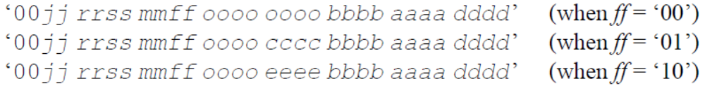
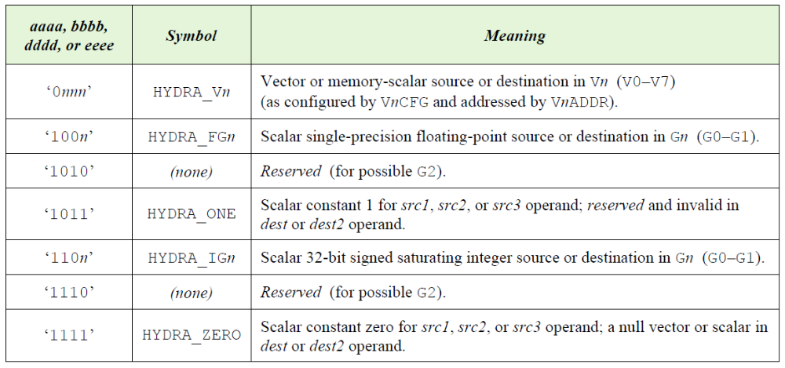
Opcode format
Every Hydra 4 instruction is
defined by a 30-bit opcode
  Firmware writes this opcode to
  Hydra’s OPCODE register to
  start a vector operation
Hydra 4’s wide opcode allows a clean format with three or four operand fields
and room for many instructions
All the operands dest, src1, src2,
and src3/dest2 support the
same choices: Any vector Vn,
or any scalar in a Gn register
  “Scalar” ⇔ Same value for all “i”
Plus modifier bits that control
vector masking, flags, rounding,
and overlapped execution
Modifiers
Instruction
src2
src1
dest
Instr
src3/dest2/
cond

Slide 121
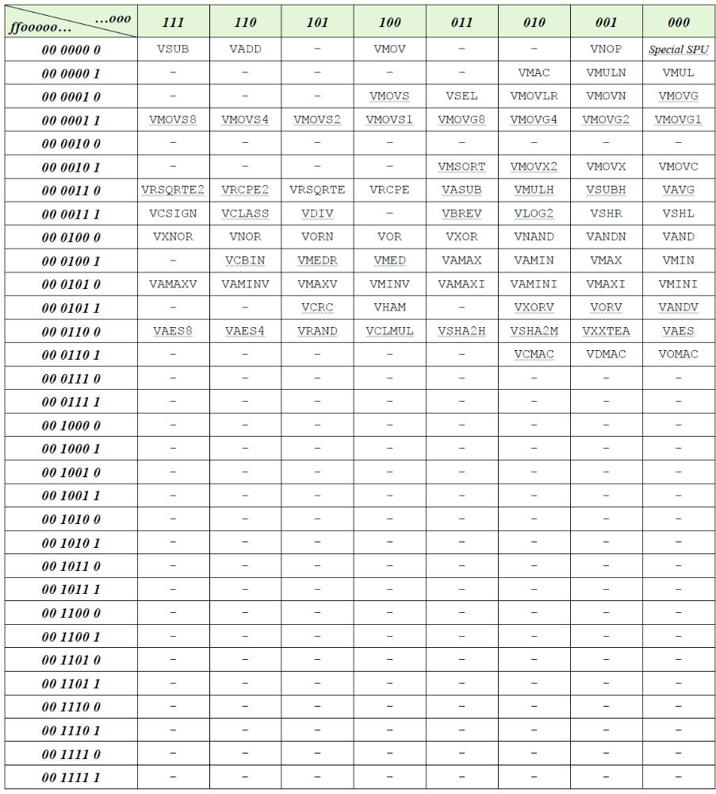
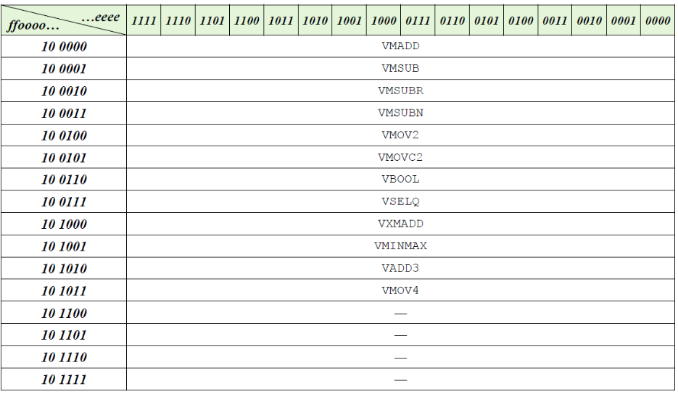
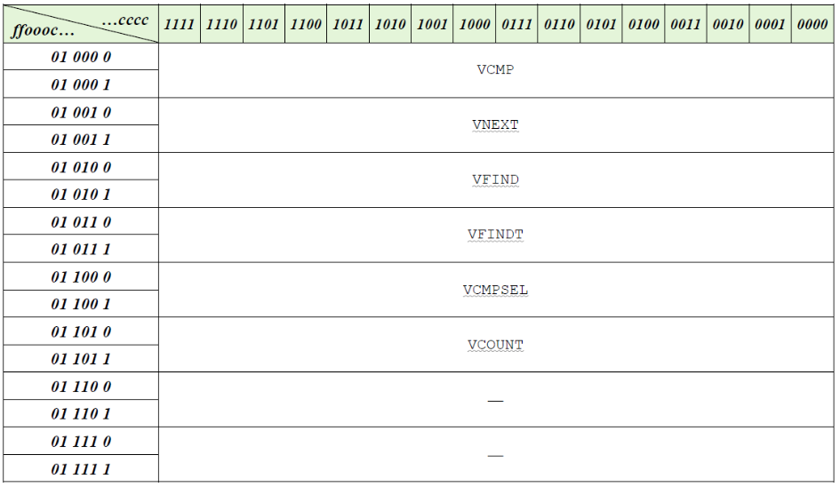
Vector instructions
There is plenty of room still free
in the space of 256 + 40 = 296
possible instruction opcodes
  We can make future improvements
  without cramming new instructions
  into odd corners of a cramped
  encoding (as happened in Hydra 3)

Slide 122
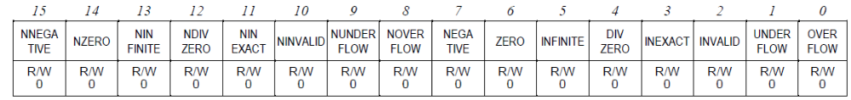
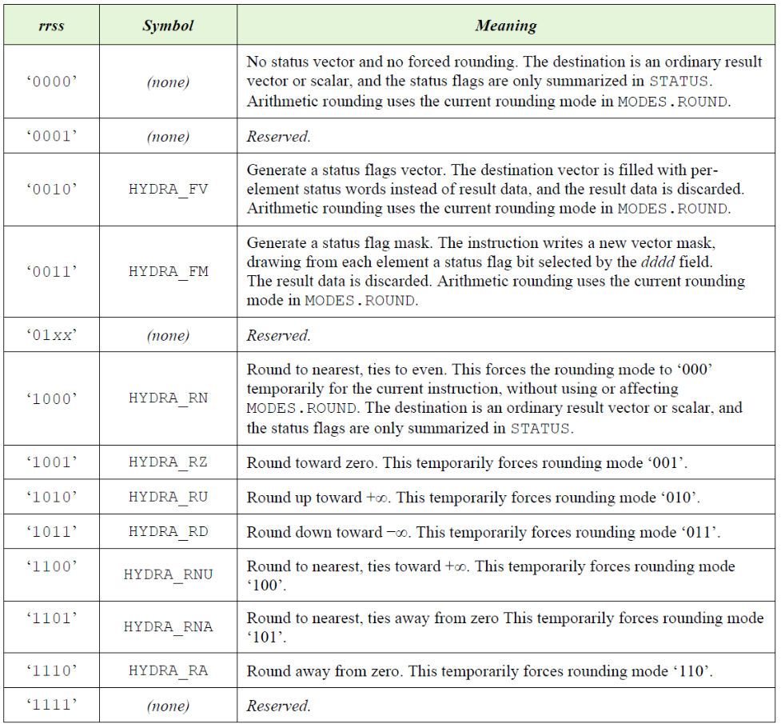
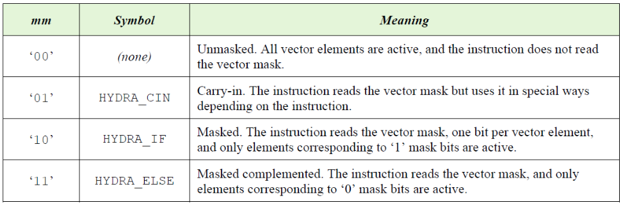
Vector mask
Any instruction can generate a vector
mask from any selected status flag
  Vector compare (VCMP) is just an
  instruction that generates 0-or-1 bits
  that reflect various comparisons
Any instruction can be conditional
on the true or complemented mask
  Masking VCMP itself forms an AND or
  OR combination of conditions
The vector mask also serves as “carry”
or “borrow” bits for arithmetic
  But because Hydra 4 can work directly
  with 32-bit integers, we will rarely need it
VM_EN and FLAG_EN are no longer
“sticky” modes, as they were in Hydra 3

Slide 123
Indexed addressing and sparse masks
Indexed addressing uses one vector as an index into another: vec1[ vec2[i] ]
  Hydra 3 allowed all three operands at once (dest, src1, src2) to use indexed addressing
  Seems cool… But it is very expensive in hardware, totally unlike any other vector architectures, and never used in real Synaptics firmware!
Hydra 4 replaces this with two specialized indexing instructions
  VMOVG (move and gather) and VMOVS (move and scatter)
  Just one indexing path in hardware that uses the src2 RAM channel for indexes: Much simpler!
Only one use was ever suggested for Hydra 3’s
“indexed-everything” mode:
  Use indexing to operate on sparse data, e.g., selected by a rarely-true condition
  On Hydra 3, this would be more efficient than vector masks if the mask has only sparse ‘1’s
  Hydra 4’s solution: Handle sparse vector masks more efficiently
  This was the right solution all along! Sparse vector masks are one of those things that people requested for years… but I could never implement because Hydra 3’s logic was just too obscure
i | 0 | 1 | 2 | 3 | 4 | 5 | 6 | 7 | 8 | 9 | 10 | 11 | 12 | 13
vm[i] | 1 | 0 | 0 | 0 | 1 | 1 | 0 | 0 | 1 | 0 | 0 | 0 | 1 | 0

Slide 124
Other things done differently from Hydra 3
No all-in-one “VFFT” instruction for Fast Fourier Transforms
  Instead, Hydra 4 has a set of FFT addressing modes that allow firmware to implement the FFT algorithm efficiently (see the example earlier)
  This fits better into Hydra’s pipeline structure ⇒ Significantly faster than Hydra 3’s VFFT
    About 4 N log₂(N) hclk cycles + O(log₂(N)) overhead for a floating-point FFT
  Each mode can be calculated cheaply ⇒ FFTs are a standard capability, not a high-cost option
  Much more flexible ⇒ We can finally provide non-power-of-two strides in FFTs
Hydra 3’s VGEN instruction becomes “pattern mode” in Hydra 4
  The address pattern of any addressing mode can be used as a sequence of integers
  Basically, the addresses bypass the RAM and are used directly as data
  Different addressing modes can generate: Consecutive integers, arithmetic sequences, scalar constants, sawtooth waves, triangle waves, stairsteps, the bit-reversal function, and more
  Any instruction can use a pattern as any source operand
  Example: Tabulating a function using its power series

Slide 125
Other things done differently (2)
Convolutions are generalized into a flexible “convolution mode”
  All accumulation-style instructions can work in convolution mode (both 1D and 2D)
  Convolving VMAC creates an FIR filter
  Convolving VMAC with packed data gives a fast + compact neural network!
  Convolving VMED creates a median filter
  Convolving VMAXV or VMINV creates a max or min filter or a neural net “maxpool” layer
  Convolving VHAM optimizes our “Hamming distance” fingerprint matching loop, etc…
Matrix multiplication also generalizes to work with any two-input accumulation
  Applied to VMAC, this gives a standard matrix multiply
  Applied to VHAM, it performs Hydra 3’s VMHAM operation
  Applied to VNEXT, it granularizes vector values using a table of thresholds
  Etc…

Slide 126
Padded convolutions
Currently, Hydra 3 and 4.0–4.2 do not support automatic “padding” in convolutions
  For example, convolving a 5x5 kernel over a 14x19 image gives a 10x15 result
  with just the interior pixels where the kernel entirely overlaps the input image
  Often, we have a 10x15 input image that we
  want to filter into another 10x15 image …
  … where the border pixels are padded,
  e.g., with implicit zeroes or duplicate values
  Currently, users must implement such padding
  “by hand” in firmware
    Compute the edge pixels in a firmware loop, or using
    Hydra 1D ops, or create an explicitly padded image
  The Hydra 4 User’s Guide defines a feature
  to do padding in hardware, but it is not yet
  implemented in Hydra 4.0–4.2
    There just wasn’t time for Byrd / SmartBridge

Slide 127
Hydra 4
Architecture overview
  Introduction
  Using Hydra
    Examples
    Hydra registers
    Vector instructions
    Data types
    Addressing modes
    Stored program unit
    Documentation and tools
    Hydra 4.2 functionality
    Performance
  Hardware and implementation

Slide 128
Data types
Each source and destination vector has a data type
Most Hydra 4 instructions accept any mix of types in their inputs and result
Some things that were special instructions in Hydra 3 are now just cases of VMOV
  For example, VFFLOAT “convert integers to floats” and VFROUND “round floats to integers” now can be done simply as VMOV’s with different src and dest types
Many things that were modes in Hydra 3 (SIGNED, SHIFT, SATURATE, INT32) are now just part of the vector type
The only real “mode” now is MODES.ROUND, which firmware will hardly ever need to change

Slide 129
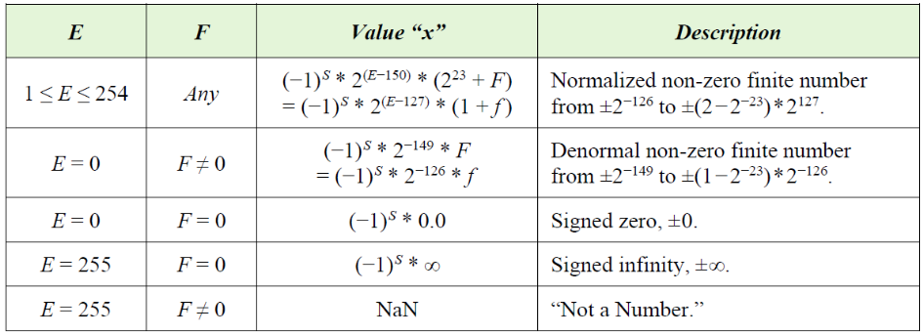
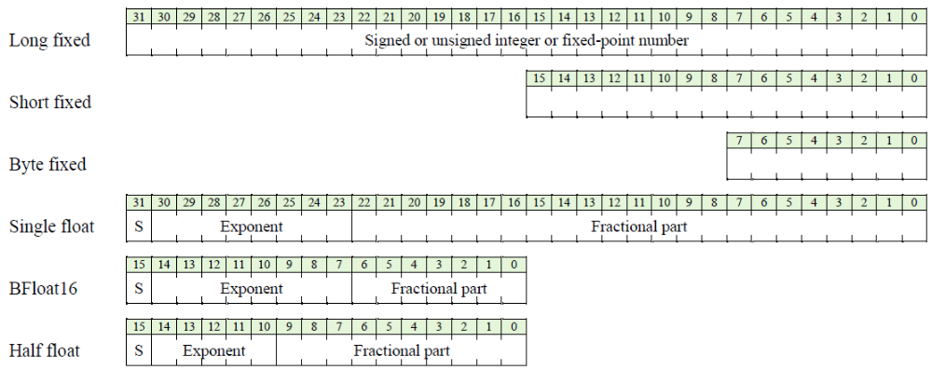
Numbers
Hydra 4 supports a variety of data types:
  Fully IEEE-compatible single-precision floats
  Two flavors of 16-bit short floats
  Signed and unsigned 8-, 16-, and 32-bit
  integers and fixed-point numbers
  Packed K-bit integers, fixed, or “Posit” floats
  for any K from 1 to 32
← A popular format in the NN/AI/ML community
← IEEE-standard half precision, as in RISC-V and ARM

Slide 130
Data types: Signed integers
Symbol | Data values
HYDRA_INT32 | 32-bit signed integers
HYDRA_INT16 | 16-bit signed integers
HYDRA_INT8 | 8-bit signed integers
HYDRA_INT | Signed integers of this machine’s “int” type
HYDRA_LONG | Signed integers of this machine’s “long” type
HYDRA_SHORT | Signed integers of this machine’s “short” type
HYDRA_CHAR | Signed integers of this machine’s “char” type
These are saturating types: An out-of-range result will saturate to the most positive or most negative representable number

Slide 131
Data types: Unsigned integers
Symbol | Data values
HYDRA_UINT32 | 32-bit unsigned integers
HYDRA_UINT16 | 16-bit unsigned integers
HYDRA_UINT8 | 8-bit unsigned integers
HYDRA_UINT | Unsigned integers of machine’s “int” type
HYDRA_ULONG | Unsigned integers of machine’s “long” type
HYDRA_USHORT | Unsigned integers of machine’s “short” type
HYDRA_UCHAR | Unsigned integers of machine’s “char” type
These, too, are saturating types: An out-of-range result will saturate to the most positive representable number (or to 0 if negative)

Slide 132
Data types: Truncating unsigned integers
Symbol | Data values
HYDRA_UTRUNC32 | 32-bit truncating unsigned integers
HYDRA_UTRUNC16 | 16-bit truncating unsigned integers
HYDRA_UTRUNC8 | 8-bit truncating unsigned integers
HYDRA_LWORD | Raw long-words of bits (same as UTRUNC32)
HYDRA_SWORD | Raw short-words of bits
HYDRA_BYTE | Raw bytes of bits
These truncating types take the low K bits of a result and discard any higher bits
  In other words: Overflows act the same as they do in C-language integer arithmetic
  In all of Hydra’s other types, out-of-range numbers instead saturate to fit in the K-bit range
  This distinction matters only in dest operands: In src operands, UTRUNC32 == UINT32, etc.

Slide 133
Data types: Truncating signed integers
Symbol | Data values
HYDRA_TRUNC32 | 32-bit truncating signed integers
HYDRA_TRUNC16 | 16-bit truncating signed integers
HYDRA_TRUNC8 | 8-bit truncating signed integers
Hydra 4.0—4.1 did not include signed counterparts of the HYDRA_UTRUNCnn types
  The result is the same if you write to a signed or unsigned truncating dest
But there are some secondary benefits to including signed-TRUNC types in the system
  E.g., the setting of the Overflow status flag depends on the signed-ness
  And it is convenient to be able to use the same truncating-typed vector as both src and dest
  Therefore, Hydra 4.2 introduces “signed” versions of the truncating integer types
  When building for Hydra 4.0—4.1, “HYDRA_TRUNCnn” is treated as a synonym for “_UTRUNCnn”

Slide 134
Data types: Fixed-point numbers
Symbol | Data values
HYDRA_FIX32(M) | 32-bit signed fixed-point with M = 0…32 fraction bits (and 32−M integer+sign bits)
HYDRA_FIX16(M) | 16-bit signed fixed-point with M = 0…16
HYDRA_FIX8(M) | 8-bit signed fixed-point with M = 0…8
HYDRA_UFIX32(M) | 32-bit unsigned fixed-point with M = 0…32
HYDRA_UFIX16(M) | 16-bit unsigned fixed-point with M = 0…16
HYDRA_UFIX8(M) | 8-bit unsigned fixed-point with M = 0…8
Fixed-point numbers are like saturating integers scaled by 2^{−M}
  An algorithm can choose M based on the data’s known range and accuracy
  M effectively puts the “decimal point” at some position within the digits
  Known as “fixed point” (vs. floating point) because M is constant across all the vector elements

Slide 135
Data types: Floating-point numbers
Symbol | Data values
HYDRA_FLOAT32 | 32-bit (fully IEEE-compatible single precision) floating-point numbers
HYDRA_FLOAT16 | 16-bit (IEEE half-precision) floats
HYDRA_BFLOAT16 | 16-bit “BFLOAT”-style floats
HYDRA_FLOAT | Synonym for HYDRA_FLOAT32
HYDRA_HFLOAT | Synonym for HYDRA_FLOAT16
HYDRA_BFLOAT | Synonym for HYDRA_BFLOAT16

Slide 136
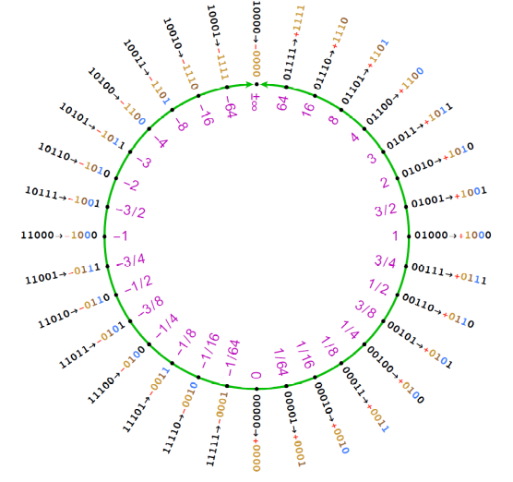
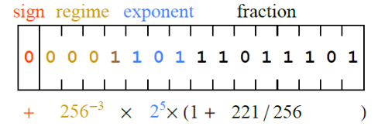
Data types: Posits
Symbol | Data values
HYDRA_POSIT32(M) | 32-bit Posits with M = 0…3 exponent bits
HYDRA_POSIT16(M) | 16-bit (or smaller) Posits
HYDRA_POSIT8(M) | 8-bit (or smaller) Posits
Hydra 4 also supports an alternative floating-point
format called “Posits”
  https://posithub.org/docs/posit_standard-2.pdf
  https://posithub.org/docs/Posits4.pdf
  When used with Hydra’s packed addressing mode,
  Posits can pack floating-point numbers
  into any number (1–32) of bits with
  a good and flexible trade between
  precision and dynamic range
NaN

Slide 137
SIMD operation
In computer architecture, SIMD (Single Instruction, Multiple Data parallelism) means splitting the normal data path (e.g., 32 bits wide for Hydra 4) into multiple lanes to process several small data items at once (e.g., 4 bytes or 2 short words per cycle)
Hydra 4.2.0 (non-”Junior”) includes a limited SIMD capability:
  VMAC / VSUM / VMM will operate on 8-bit integers at 4x speed under suitable conditions
  … i.e., when the vectors or matrix rows are a multiple of 4 bytes long, 4-byte-aligned in RAM,
  not vector-masked, etc.
With SIMD-mode VMM, Hydra 4.2 at 400 MHz (e.g., as found on the DIG2409B0 chip) can evaluate fully-connected neural networks at a speed of over 3 GOPS (3 billion add-or-multiply operations per second)
  This is more than 10x faster than firmware on a RISC-V E76 can achieve
  More than 20x faster than Chimera firmware
Future versions of Hydra will add SIMD treatment for other instructions and data types

Slide 138
Hydra 4
Architecture overview
  Introduction
  Using Hydra
    Examples
    Hydra registers
    Vector instructions
    Data types
    Addressing modes
    Stored program unit
    Documentation and tools
    Hydra 4.2 functionality
    Performance
  Hardware and implementation

Slide 139
Addressing modes
Each source or destination vector has an addressing mode
The addressing mode defines where each i’th vector element appears in RAM relative to the vector’s base address
Most Hydra 4 instructions accept any mix of modes in their inputs and result
Some things that were special instructions in Hydra 3 (e.g., VPACK, VMT) can be done as simply VMOV’s with different src and dest modes

Slide 140
Addressing modes: Basic vectors and scalars
Notation | Addressed as
hydra_vector(base, type) | Linear vector in consecutive RAM locations
hydra_strided(base, type, stride) | Strided vector: base + i*stride
hydra_ostride(base, type, offset, stride) | Strided with offset: base + offset + i*stride
hydra_mscalar(base, type) | Scalar number replicated across the vector (the number comes from RAM)
hydra_scalar_int(x) | Scalar INT32 number x encoded directly (passed using Hydra’s G0 or G1 register) (The constants x = 0 and x = 1 can be encoded without using any Gn register)
hydra_scalar_float(x) | Scalar FLOAT32 number x encoded directly (passed using Hydra’s G0 or G1 register)
hydra_rscalar(reg, type) hydra_rscalar_int/float(reg, type, x) | Scalar number of any type stored in any Hydra register

Slide 141
Addressing modes: Special modes
Notation | Addressed as
hydra_neg_vector(base, type) | A negated view of a linear source vector: The values are negated (as if by VNEG) as they come from RAM into Hydra’s arithmetic unit
hydra_abs_vector(base, type) | A linear source vector whose values are absolute-valued (as if by VABS) as they come
hydra_half_vector(base, type) | A multiplied-by-½ view of a vector in RAM
hydra_double_vector(base, type) | A multiplied-by-2 view of a vector in RAM
hydra_circular(base, type, mod) | Circular addressing: base + (i % mod)
hydra_offset_circ(base, type, mod, i0) | Offset-circular addressing: base + (i+i₀) % mod
hydra_nested(base, type, args) | A double- or triple-nested repeating pattern of memory accesses, like a combination of circular and repeated-column modes

Slide 142
Addressing modes: Matrix modes
Notation | Addressed as
hydra_matrix(base, type, C) | An RxC matrix of width C, height R = VL/C, row stride = C, and column stride = 1
hydra_tmatrix(base, type, R) | An RxC matrix which is the transposed view of a CxR matrix in the RAM whose width is R, C = VL/R, row stride = R, column stride = 1
hydra_gmatrix(base, type, C, rstride, cstride) | A matrix with general R, C, row stride, and column stride (the strides are passed in Hydra’s G0 or G1 register)
hydra_rrmatrix(base, type, C) | An RxC “repeated row” matrix where C = width, R = VL/C, row stride = 0, column stride = 1 (actually same as “circular addressing”)
hydra_rcmatrix(base, type, C) | An RxC “repeated column” matrix where C = width, R = VL/C, row stride = 1, column stride = 0

Slide 143
Addressing modes: FFT-related modes
Notation | Addressed as
hydra_bfly(base, type, args) | FFT butterfly addressing
hydra_bitrev(base, type, args) | FFT bit-reversed addressing
hydra_cosine(base, type, args) | Cosine function from cosine table
hydra_sine(base, type, args) | Sine function from the same cosine table
hydra_complex(base, type, args) | Complex numbers rotated on the complex plane by a multiple of 90º and/or conjugated, where modes encodes any combination of swapping even-with-odd elements, negating even elements, negating odd elements, and/or absolute-valuing, halving, or doubling all elements
“args” is a bit mask of mode-related options such as HYDRA_BITREV_STRIDE(stride)
or HYDRA_COMPLEX_SWAP + HYDRA_COMPLEX_ABS

Slide 144
Addressing modes: Packed mode
Notation | Addressed as
hydra_packed(base, type, K_args) | K-bit signed or unsigned integers, fixed-point numbers, or Posit-style floats packed into long words, short words, or bytes, with initial bit offset k₀ and with k_{gap} bits between items
E=8, K=8, k₀=0, k_{gap}=0
E=8, K=8, k₀=4, k_{gap}=0
E=16, K=8, k₀=4, k_{gap}=0
E=16, K=8, k₀=0, k_{gap}=4
E=16, K=8, k₀=4, k_{gap}=4
E=16, K=4, k₀=0, k_{gap}=0
E=32, K=3, k₀=6, k_{gap}=3
E=32, K=1, k₀=0, k_{gap}=0

Slide 145
Addressing modes: Other modes
Notation | Addressed as
hydra_mask_gen(mask) | In the dest operand position, generate a vector mask showing which results are non-zero (the results themselves are discarded)
hydra_mask_flag(mask) | Generate a vector mask recording a given status flag for each vector element
hydra_mask2_gen(base, type, mask, args) hydra_mask2_flag(base, type, mask, args) | Save the numeric results in a linear vector, and also generate a vector mask from a status flag
hydra_null_vector(type) hydra_null_scalar(type) | Null data source or sink of the indicated type; delivers 0’s as src; discards data as dest

Slide 146
Addressing modes: Pattern mode
Notation | Generated as
hydra_pattern(a, b) | The integer arithmetic sequence a + (b*i)
hydra_rrpattern(a, mod) | The integer sequence a + (i % mod)
hydra_rcpattern(a, div) | The integer sequence a + floor(i / div)
hydra_gpattern(a, C, rstride, cstride) | An integer sequence based on the general matrix addressing pattern
hydra_patmode(mode, esize, base, args…) (encoded as any mode with type = PATTERN) | Integer sequence according to the mode
Hydra’s pattern mode generates a pattern of integers based on the sequence of addresses produced by any chosen addressing mode
  It bypasses the RAM and uses the address sequence itself as the source data
  It can generate: Arithmetic sequences, sawtooths, stairsteps, triangle waves, bit-reversal, …

Slide 147
Hydra 4
Architecture overview
  Introduction
  Using Hydra
    Examples
    Hydra registers
    Vector instructions
    Data types
    Addressing modes
    Stored program unit
    Documentation and tools
    Hydra 4.0 functionality
    Performance
  Hardware and implementation

Slide 148
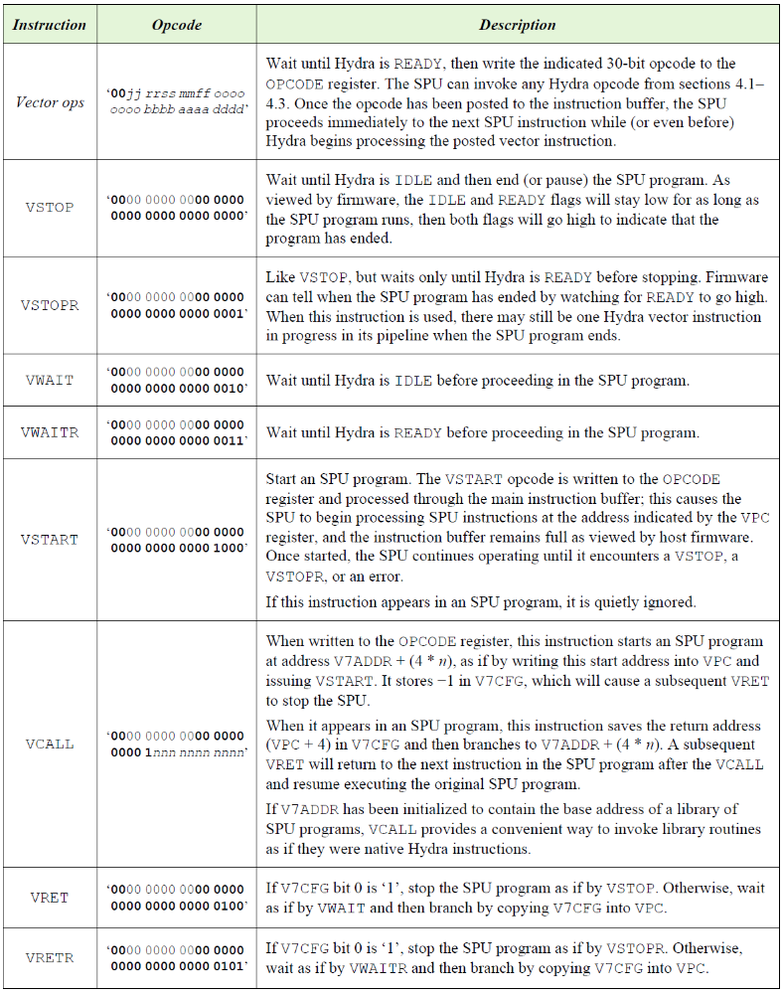

Stored program unit
Hydra 3 introduced an SPU for
autonomous operation with no
firmware handholding
This especially helps non-Chimera
CPUs with their clumsy interrupts, etc.
But Hydra 3’s SPU was so “strange” and
intricate that people didn’t use it!
Hydra 4 has a redesigned SPU
A simple SPU program is just a list
of Hydra vector instructions ending
with a VSTOP (opcode 0x0)
Notes:
This image was found on Google Images; attribution is now lost.

Slide 149
Stored program unit
Hydra 3 introduced an SPU for
autonomous operation with no
firmware handholding
This especially helps non-Chimera
CPUs with their clumsy interrupts, etc.
But Hydra 3’s SPU was so “strange” and
intricate that people didn’t use it
Hydra 4 has a redesigned SPU
A simple SPU program is just a list
of Hydra vector instructions ending
with a VSTOP (opcode 0x0)
More complex SPU programs can
do lots of things …

Slide 150
Stored program unit (continued…)
The SPU can do more than simply
issue a fixed sequence of vector
opcodes
The SPU has its own instruction set
for setting up vector operands
and other register values
The SPU can operate on any Hydra
registers while the rest of Hydra
is busy with a vector operation
(and the rest of the host CPU system
may be busy doing unrelated work)

Slide 151
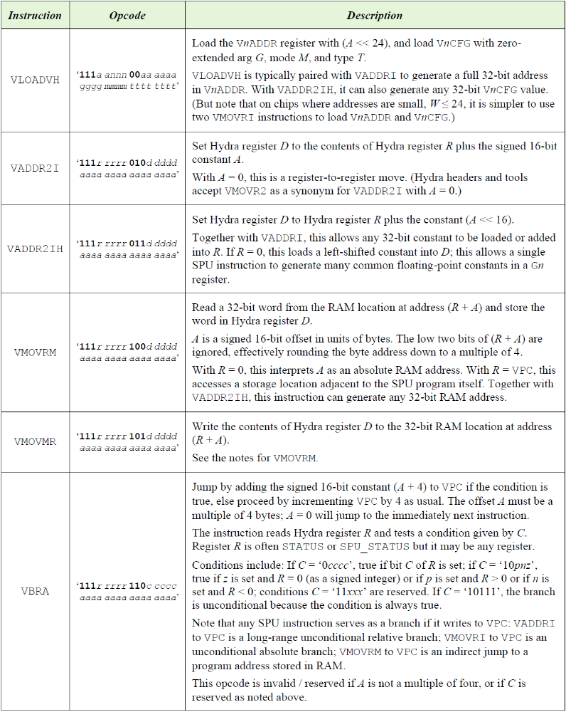
Stored program unit (continued…)
More generally, SPU opcodes are
instructions like those of a simple
microcontroller
SPU programs can have their own
conditional tests, loops, subroutines,
variables, and so on
If the algorithm does not use all
eight vector registers V0—V7,
the spare VnCFG’s and VnADDR’s
can serve as extra working registers
for the SPU program

Slide 152
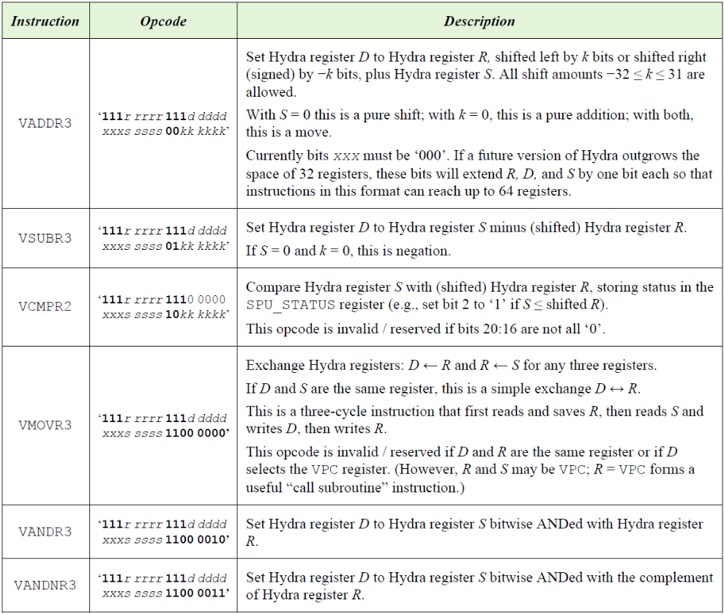
Stored program unit (continued…)
But note that the SPU is not meant
to be a fast microprocessor!
  The SPU uses a very simple sequencer
  that takes several cycles for most
  SPU instructions
  For example, the SPU has just one port
  for reading or writing Hydra registers,
  so VADDR3 takes at least three cycles
  to read registers “R” and “S” and to
  write to register “D”
  The SPU’s job is to be cheap and
  simple, while just fast enough to set up
  Hydra vector operations efficiently

Slide 153
Hydra 4
Architecture overview
  Introduction
  Using Hydra
    Examples
    Hydra registers
    Vector instructions
    Data types
    Addressing modes
    Stored program unit
    Documentation and tools
    Hydra 4.2 functionality
    Performance
  Hardware and implementation

Slide 154
Hydra 4 User’s Guide
The Hydra 4 User’s Guide describes
how to use Hydra 4
  How to program it
  Detailed descriptions of every instruction,
  addressing mode, register, and feature
  Algorithms such as sqrt(), exp(), FFTs,
  merge sorts, median filters, neural nets, etc.
  How to integrate it into a chip’s hardware
A public version will be available soon on
github.com/synaptics-hydra

Slide 155
Hydra 4 tools
No special tools are required to program Hydra 4
  The hydra4_defs.h header file defines macros such as hydra_vadd_w() for invoking Hydra
  It is self-contained: No run-time library is needed; no special compiler or RTOS support
  It works with the host CPU’s standard C or C++ compiler and debugger
#include "hydra4_defs.h"
float scalarProduct(int len, float *veca, float *vecb)
{
float result;
HYDRA_INITIALIZE(); // Normally this is called just once at startup.
// Set result = sum(veca[i] * vecb[i] for i=0…len−1).
hydra_vmac_w(hydra_set_vl(len),
hydra_mscalar(&result, HYDRA_FLOAT),
hydra_vector(veca, HYDRA_FLOAT),
hydra_vector(vecb, HYDRA_FLOAT));
return result;
}
This function is complete;
nothing else needed ⇒

Slide 156
A true Hydra “compiler”?
Wouldn’t it be great if we could simply write,
… and this would compile to a Hydra operation, if the target chip includes Hydra?
Vectorizing compilers do exist
  The Cray-1 had a vectorizing FORTRAN compiler
  OpenCL is a good modern example, or automatic vectorization of ordinary C loops
Could we port OpenCL to Hydra? Yes, if we had an army of compiler people …
  In other words, not for us, not right now anyway
  (Actually, for a RISC-V compiler it would not be that hard: Modern GCC can support vectorization)
float scalarProduct(int len, float *veca, float *vecb)
{
float sum = 0.0;
for (int i = 0; i < len; i++)
sum += (veca[i] * vecb[i]);
return sum;
}

Slide 157
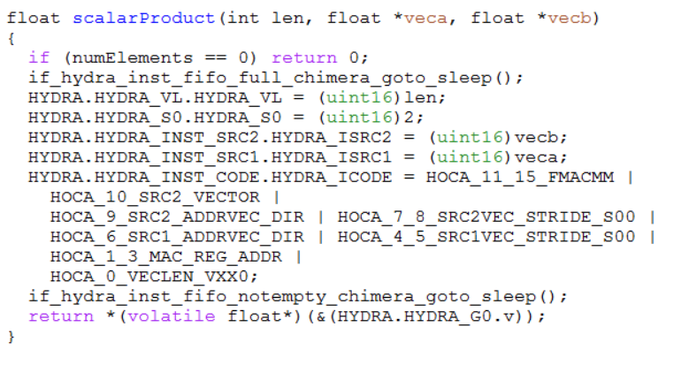
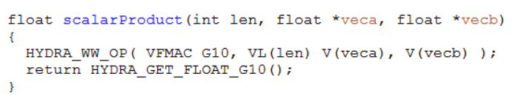
Porting legacy Hydra 3 firmware to Hydra 4
Synaptics touch and fingerprint firmware includes lots of code written for Hydra 3
  Most older code uses “HOCA_xxx” constants to painfully construct the Hydra 3 opcode
  Some newer code uses “Hydra assembler” macros to express the Hydra 3 opcode symbolically
Hydra 4’s compatibility mode makes it easy to port either style of Hydra 3 firmware to run on Hydra 4
Functions like these, originally written
for Hydra 3, can compile and run as-is
in Hydra 4’s compatibility mode

Slide 158
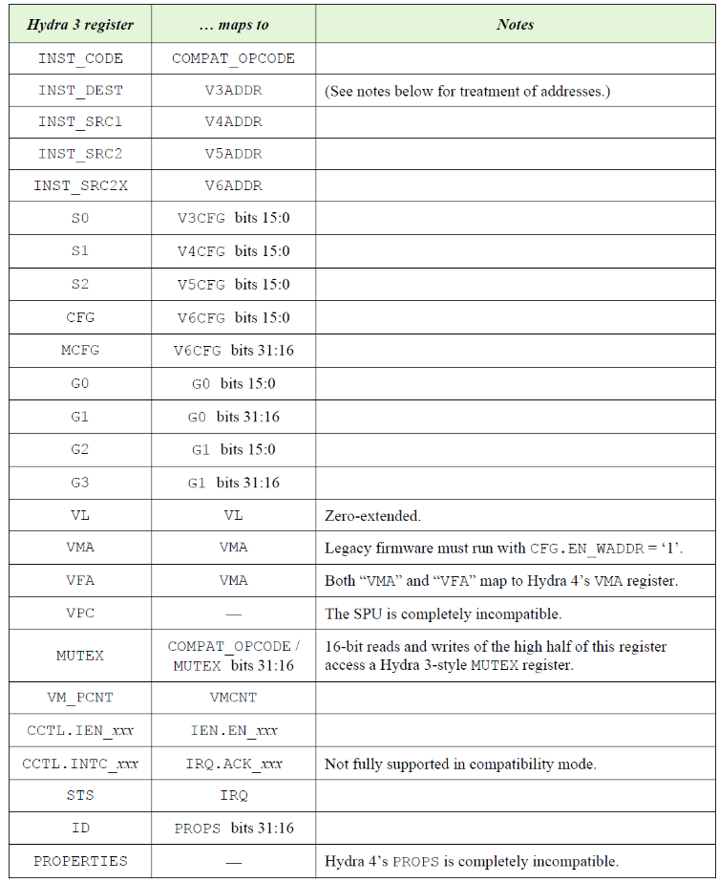
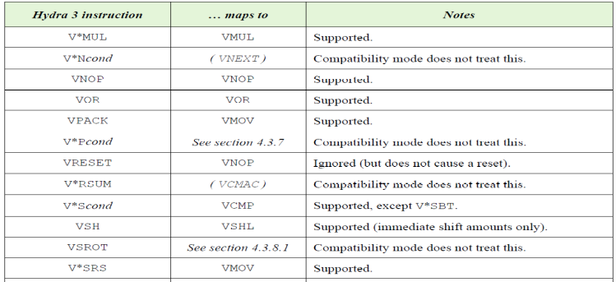
Compatibility mode
If you write a Hydra 3-style 16-bit opcode to Hydra 4’s COMPAT_OPCODE register …
  Hydra’s instruction decoder will [attempt to] translate it into a modern Hydra 4 operation
  … using a defined mapping from Hydra 3 registers
  onto Hydra 4’s register set
Simply use the hydra4_compat.h header file
in place of Hydra 3’s hydra_base.h or
hydra_registers_0x0310.h
  It defines the same Hydra 3 symbols, fields, types,
  and names as those old headers, all redefined
  appropriately for Hydra 4’s compatibility mode
  Most legacy source code that uses the Hydra 3
  headers can build unchanged with hydra4_compat.h
  If desired, a single firmware source routine can
  build for either Hydra 3 or Hydra 4 depending
  on the target chip

Slide 159
HydraSim simulator
HydraSim is a software simulator that models all versions of Hydra
  It now covers Hydra 4.0–4.2 as well as the older versions
  HydraSim gives bit-accurate answers for all Hydra instructions, plus timing estimates
  Developed by Adam Greenblatt (thanks, Adam!)
Chimera’s ChimSim simulator has HydraSim built-in
  ChimSim invokes it automatically when Chimera firmware uses Hydra
HydraSim is a library that can integrate into other simulators, as needed
  If we use a RISC-V instruction-level simulator to develop firmware for chips like Byrd …
  … we can modify that simulator to call HydraSim, just as ChimSim does
HydraSim can be integrated into any C/C++ program

Slide 160
Hosted simulation with HydraSim
HydraSim also allows “hosted” development and testing of firmware that uses Hydra:
  Compile the firmware as a native x86 program under Windows or Linux
  Use –DHYDRA_HOSTED_SIM on the compilation command line
  Link with hydra4_hosted_hydrasim.c and hydrasim.a
Firmware algorithms can now be tested and debugged with all the tools and facilities of a large computer:
  Debug with GDB or Eclipse
  Use features that would be impractical in real firmware:
  double-precision floats, printf(), file I/O, huge data arrays, etc.
In hosted mode, every Hydra macro such as hydra_vadd_w(…), hydra_vector(…), etc.,
is automatically directed to the HydraSim simulator in lieu of using real Hydra hardware

Slide 161

SIMT4 simulator
SIMT4 is a detailed simulator for Chimera chips
  It has a cycle-accurate simulation model of the Chimera CPU, and it models a chip’s peripherals,
  including Hydra,
  with the peripheral’s
  exact Verilog source
  code
  Its VSIMT4 graphical
  interface can debug
  integrated systems of
  firmware + hardware
  When firmware uses
  Hydra 4, the Hydra
  Viewer shows Hydra’s
  instruction buffer,
  arithmetic pipeline,
  and RAM channels
  and bank interfaces
  in detail

Slide 162

HydraMath library
HydraMath is a relatively simple software library that exactly emulates the numeric results of most Hydra instructions
  … but not all the addressing modes, registers, and other Hydra features
  HydraMath also can convert numbers to or from any of Hydra’s supported data formats
  It is lightweight and easier
  to use than HydraSim in
  scripting environments,
  etc.
  HydraSim internally
  uses HydraMath
  to model Hydra’s
  arithmetic precisely

Slide 163
Hydra 4
Architecture overview
  Introduction
  Using Hydra
    Examples
    Hydra registers
    Vector instructions
    Data types
    Addressing modes
    Stored program unit
    Documentation and tools
    Hydra 4.2 functionality
    Performance
  Hardware and implementation

Slide 164
Implemented so far…
The full Hydra 4 User’s Guide describes lots of functionality
There wasn’t time to implement all of it for Byrd’s and SmartBridge’s Hydra 4.0
  But it certainly includes all functionality we currently use in our touch firmware with Hydra 3
  And it includes FFT support (needed for Byrd)
  And cryptographic support (may be needed for SmartBridge or Byrd)
In fact, most features in the Hydra 4 User’s Guide have been implemented

Slide 165
Not yet implemented, omitted from Byrd
The following features from the full User’s Guide didn’t make it into SmartBridge / Byrd, but they can be added for future chips (especially if people ask for them):
  General division (VDIV)
  Fast median filters (VMED, VMEDR)
  Optimization of sparse vector masks
  Instruction “joining” optimization
  Faster “SIMD” treatment of 8- and 16-bit integer types (limited support appears in Hydra 4.2)
  Automatic edge “padding” in convolutions
  Potential additional features for neural nets, cryptography, special functions, etc.,
  beyond those described here

Slide 166
Hydra 4
Architecture overview
  Introduction
  Using Hydra
    Examples
    Hydra registers
    Vector instructions
    Data types
    Addressing modes
    Stored program unit
    Documentation and tools
    Hydra 4.2 functionality
    Performance
  Hardware and implementation

Slide 167
Performance
Various projects have achieved dramatic speed-ups by applying Hydra 3 to our touch and fingerprint algorithms
  … even though Hydra’s original inspiration, “large PC touch screens,” never took off!
Some examples:
  Gian Mario Manca & Vladan Petrovic dramatically sped up OLED noise removal for touch screens in challenging noise environments
  The quantum fingerprint matcher’s image processing module runs 6x faster using Hydra 3 than as pure firmware on Prometheus’ Xtensa processor (thanks again to Vladan)
  Eric Ding’s Hydra 3 implementation of image column-wise standard deviations runs 10x faster than as pure Chimera firmware
  Karthik’s AI-based ACM algorithm runs 3.5x faster with Hydra 3 than as Chimera firmware
  Convolutional neural networks (CNNs) run over 10x faster with Hydra 3
  (And remember that Hydra 4 is 2x faster than Hydra 3 for many operations)

Slide 168
Performance
Hydra 4 significantly outperforms SiFive’s E76 RISC-V processor …
  … even though the E76 is a full dual-issue superscalar, deeply pipelined processor
  … whose design was specifically tuned for high computational performance
Examples:
  The Byrd team reports that FFTs are ~4x faster on Hydra 4 than in E76 firmware
  Hydra 4 performs floating-point matrix multiplication 2x faster than Elkin Garcia’s firmware code, which was aggressively optimized to best fit the E76’s pipeline
    (Even though the E76, and the RISC architecture itself, has been optimized throughout its history with
    matrix multiplication as a key standard benchmark)
  Hydra 4.0 can accelerate byte-weighted neural network evaluation by nearly ~4x;
  Hydra 4.2 can accelerate the same by over 10x
  Hydra 4’s VSHA instructions are ~2x faster than the theoretically optimal assembly language E76 implementation of SHA256 (and faster still compared to practical firmware-friendly E76 code)

Slide 169


Hydra is as fast as a supercomputer …
… if you don’t mind comparing to
supercomputers that museums now use
as furniture
Hydra 3 on a 116 MHz Stockholm or Rio
chip can do 232 million sustained
floating-point operations per second
(1 add + 1 multiply on every cycle)
  Or 464 million 16-bit fixed-point ops
From a Cray-1 brochure at the
Computer History Museum in
Mountain View, California ⇒
Hydra 4 at Byrd’s 400 MHz can
sustain 800 million flops
  About as fast as Cray’s next machine,
  the quad-processor Cray X-MP
Notes:
Hydra 4 on Byrd is as fast as all four cores of the quad-core Cray X-MP!

Slide 170

Is that progress?
If the Cray-1 back in 1976 was roughly as fast as Hydra today, have we really made progress?
Hydra fits in a small portion of a small chip in a corner of your laptop or phone
Less than 0.1 mm² in Byrd’s process
It draws a few milliwatts at most
Compared to the Cray …
Cray-1 reference manual

Slide 171
Hardware details
The remainder of this presentation goes into the hardware and implementation details of each major block within Hydra
It will not be of interest to every reader
But if it interests you, by all means, keep reading!
…

Slide 172
Hydra 4
Architecture overview
  Introduction
  Using Hydra
  Hardware and implementation
    Block diagram
    Host interface
    Decode and control
    Memory interfaces
    DMA channels
    Arithmetic unit (ALU)
    Stored program unit (SPU)

Slide 173
Hydra 4
Architecture overview
  Introduction
  Using Hydra
  Hardware and implementation
    Block diagram
    Host interface
    Decode and control
    Memory interfaces
    DMA channels
    Arithmetic unit (ALU)
    Stored program unit (SPU)

Slide 174
Block diagram
Host CPU
(RISC-V, ARM, Chimera)
S
Host
intf
Registers
Decode
Bus (AHB/APB/Chimera)
M (optional)
Control
Mem intf
Stored program unit
vmask channel
Data RAM
(shown with
4 banks)
Bank intf
SPU channel
Bank intf
src1 channel
ALU
(fixed-point and floating-point datapath)
Bank intf
src2 channel
misc channel
src3
Bank intf
dest2
dest channel
hydra4.v

Slide 175
In Byrd

Slide 176
Port list: Clocks and control
Name | Dir | Domain | From/to | Description
hclk | In | Clock | clk_rst | Master clock
hclk_rst_n | In | hclk | clk_rst | Async reset, deassert sync’d to hclk
hydra_hclk_en | Out | hclk | clk_rst | Hydra asks to enable hclk clock gate
host_clk | In | Clock | clk_rst | Host interface clock
host_clk_rst_n | In | host_clk | clk_rst | Async reset, deassert sync’d to host_clk
hydra_host_clk_en | Out | host_clk | clk_rst | Hydra asks to enable host_clk clock gate
hclk_is_host_clk | In | hclk | clk_rst | Analogous to “!pclk_is_high_en”
hydra_awake | Out | hclk | HSO | Hydra is running and needs a clock
hydra_intr | Out | host_clk | CPU | Interrupt request to host CPU
scan_en | In | hclk | Test logic | Scan enable (for internal clock gates)
See the comments in hydra4.v for details about all these signals
All the rest of Hydra’s ports involve either host interfacing or memory interfacing

Slide 177
Clock gating
By default, Hydra 4 includes internal clock gates (SYNA_CLK_GATE) on its hclk and host_clk clock inputs
  Chip logic can (and should) connect these to pure ungated clock sources
Hydra 4 exports hydra_hclk_en and hydra_host_clk_en signals to allow a chip to locate Hydra’s clock gating in the chip’s central clock generator instead, if desired
  Define `HYDRA_EXTERNAL_CLOCK_GATING in hydra4_config.vh to use this option
  There is a combinational logic path from the host interface (e.g., AHB HSEL and HADDR) to hydra_host_clk_en that turns on host_clk during cycles when the host accesses a Hydra register
The hydra_awake signal is used to force the chip’s master oscillator awake
  … in case the rest of the chip goes to sleep while Hydra is still operating on a vector
  This signal comes straight from a flip-flop so that it can cleanly interface to asynchronous oscillator circuits

Slide 178
Hydra 4
Architecture overview
  Introduction
  Using Hydra
  Hardware and implementation
    Block diagram
    Host interface
    Decode and control
    Memory interfaces
    DMA channels
    Arithmetic unit (ALU)
    Stored program unit (SPU)

Slide 179
Block diagram
Host CPU
(RISC-V, ARM, Chimera)
S
Host
intf
Registers
Decode
Bus (AHB/APB/Chimera)
M (optional)
Control
Mem intf
Stored program unit
vmask channel
Data RAM
(shown with
4 banks)
Bank intf
SPU channel
Bank intf
src1 channel
ALU
(fixed-point and floating-point datapath)
Bank intf
src2 channel
misc channel
src3
Bank intf
dest2
dest channel
hydra4.v

Slide 180
Host interface
Hydra 4 supports a choice of Chimera, AHB, APB, or “Direct” interface to the host CPU
The Chimera-style interface is much easier to integrate than Hydra 3’s
  All Chimera-facing signals are registered on host_clk == pclk_master, not on hclk
  Greatly simplifies synthesis when pclk runs at ½ hclk rate (or generally, 1/N hclk)
The AHB and APB interfaces comply with AMBA standards
  They also accommodate AHB HCLK or APB PCLK running at host_clk == hclk or 1/N hclk rate
  Byrd and SmartBridge use AHB, running at full speed (host_clk == hclk)
The Direct-style interface uses a simple handshake-free, un-pipelined protocol
Note that in non-Chimera hosts, peripheral register reads/writes tend to be slow
  For example, Byrd’s E76 CPU has a few cycles of latency for operations on its AHB system port
  The Xtensa CPU on Prometheus/Triton runs its peripheral bus at ¼ the CPU clock rate
  Unavoidable: This fact motivated Hydra 4’s opcodes-with-Vn’s design, and also its SPU

Slide 181
Host interface: Chimera-style
Input signals no longer require multicycle_paths
  dmem_read0/write0_addr, dmem_write0_data, etc., are sampled on the host_clk rising edge
  (i.e., on the true pclk rising edge)
  Write data is captured in a host_clk-domain write buffer and applied during the next hclk cycle
hclk &
host_clk
hclk
only

Slide 182
Host interface: Chimera-style
Output signals are now stable throughout the pclk period
  dmem_read0_data, dmem_read0/write0_ack, hydra_intr, hydra_awake, etc., change only on the host_clk rising edge, driven by host_clk-domain registers
  Hydra registers such as VL, that are only written by the host, are clocked by host_clk

Slide 183
Host interface: Chimera-style
Some registers (such as STATUS) really must operate in the hclk domain
  These are captured in a host_clk-domain read buffer and delivered after one wait state

Slide 184
Host interface signal timing
Hydra 4 aims for the host interface to have the simplest possible signal timing
  Every input goes only to flops clocked on host_clk
  Every output comes only from flops clocked on host_clk
  Not much logic delay in between the ports and those registers

Slide 185
Port list: Chimera-style host interface (writing)
Name | Dir | Domain | From/to | Description
dmem_write0_request | In | host_clk | Addr dec | Standard Chimera signal
dmem_write0_ack[1:0] | Out | host_clk | Addr dec | Standard Chimera signal
dmem_write0_commit | In | host_clk | Addr dec | Standard Chimera signal
dmem_write0_addr_is_hydra | In | host_clk | Addr dec | Hydra block address decode
dmem_write0_addr_low[5:0] | In | host_clk | Addr dec | Low address bits within Hydra block
dmem_write0_size[1:0] | In | host_clk | Addr dec | Standard Chimera signal
dmem_write0_data[31:0] | In | host_clk | Addr dec | Standard Chimera signal
dmem_write0_guest_safe | Out | host_clk | Addr dec | Standard Chimera signal

Slide 186
Port list: Chimera-style host interface (reading)
Name | Dir | Domain | From/to | Description
dmem_read0_request | In | host_clk | Addr dec | Standard Chimera signal
dmem_read0_ack[1:0] | Out | host_clk | Addr dec | Standard Chimera signal
dmem_read0_addr_is_hydra | In | host_clk | Addr dec | Hydra block address decode
dmem_read0_addr_low[5:0] | In | host_clk | Addr dec | Low address bits within Hydra block
dmem_read0_size[1:0] | In | host_clk | Addr dec | Standard Chimera signal
dmem_read0_data[31:0] | Out | host_clk | Addr dec | Standard Chimera signal
dmem_read0_guest_safe | Out | host_clk | Addr dec | Standard Chimera signal
hydra_mutex_release_out | Out | host_clk | CPU | Standard Chimera signal

Slide 187
Host interface: AHB
The host interface complies
with the AMBA 5 AHB standard
(“AHB-Lite”)
  Again, all signals operate
  in the host_clk domain
  A write buffer and a
  read buffer transfer data
  between the hclk and
  host_clk domains
  Write buffer forwarding
  ensures the host sees the
  correct value if it writes a
  register and immediately
  reads it back

Slide 188

Host interface: AHB
Hydra’s AHB host interface
occasionally generates
wait states to delay its
response to the host’s
read or write request
  ⇒ When a read must go
  through the read buffer
  ⇒ When the host reads IRQ
  on the very next cycle
  after writing to OPCODE
  (gives time to decode the
  opcode to report errors)
  ⇒ For optional handshaking
  on writes to OPCODE and
  reads to G0 and G1

Slide 189
Port list: AHB host interface
Name | Dir | Domain | From/to | Description
ahb_hsel | In | host_clk | AHB mux | Standard AHB signal
ahb_hready | In | host_clk | AHB mux | Standard AHB signal
ahb_haddr[10:0] | In | host_clk | AHB mux | Standard AHB signal (low bits only)
ahb_hprot[3:0] | In | host_clk | AHB mux | Standard AHB signal
ahb_hsize[2:0] | In | host_clk | AHB mux | Standard AHB signal
ahb_htrans[1:0] | In | host_clk | AHB mux | Standard AHB signal
ahb_hwrite | In | host_clk | AHB mux | Standard AHB signal
ahb_hwdata[31:0] | In | host_clk | AHB mux | Standard AHB signal
ahb_hrdata[31:0] | Out | host_clk | AHB mux | Standard AHB signal
ahb_hreadyout | Out | host_clk | AHB mux | Standard AHB signal
ahb_hresp | Out | host_clk | AHB mux | Standard AHB signal
The width of ahb_addr[] is given by `HYDRA_HOST_ADDR_WIDTH in hydra4_config.vh,
any number from 7 to 31

Slide 190
AHB host interface and registers
IRQ, VPC, STATUS, VMCNT, PCOUNT, VnCFG
Error
check
Error
collect
HRESP
Next value
hclk-
domain
Registers
Curr value
Read value
SPU special R/W
rscalar special R/W
Instr
buf ctrl
Hold
HADDR
Buffered reads
hclk
HWRITE
Buffered writes
HSIZE
host_clk-
domain
Registers
Curr value
Read value
host_clk
R/W
buffer
HSEL
HTRANS
HREADY
R/W wait
HWDATA
HRDATA
HREADYOUT
OPCODE, VL, VMA, G0, G1, IRQ, IEN, MODES, VnADDR
hydra4_host_intf.v
hydra4_registers.v

Slide 191
Host interface: APB
Hydra offers an APB host interface option
  … but Hydra discourages using it, since APB is a slow protocol!

Slide 192
Port list: APB host interface
Name | Dir | Domain | From/to | Description
apb_psel | In | host_clk | APB bridge | Standard APB signal
apb_penable | In | host_clk | APB bridge | Standard APB signal
apb_paddr[10:0] | In | host_clk | APB bridge | Standard APB signal (low bits only)
apb_pprot[2:0] | In | host_clk | APB bridge | Standard APB signal
apb_pstrb[3:0] | In | host_clk | APB bridge | Standard APB signal
apb_pwrite | In | host_clk | APB bridge | Standard APB signal
apb_pwdata[31:0] | In | host_clk | APB bridge | Standard APB signal
apb_prdata[31:0] | Out | host_clk | APB bridge | Standard APB signal
apb_pready | Out | host_clk | APB bridge | Standard APB signal
apb_pslverr | Out | host_clk | APB bridge | Standard APB signal

Slide 193
Host interface: Direct-style
Hydra’s Direct-style host interface is a simple interface for use in chips that do not support the Chimera, AHB, or APB protocol
Very simple: No “ack” signals; no wait states; no AHB-style pipelining
Every request takes place, and completes, within one self-contained host_clk cycle

Slide 194
Port list: Direct host interface
Name | Dir | Domain | From/to | Description
hydra_host_req | In | host_clk | Periph bus | Request a read or write
hydra_host_write | In | host_clk | Periph bus | This request is for a write vs read
hydra_host_addr[6:0] | In | host_clk | Periph bus | Byte address of register (low bits only)
hydra_host_size[1:0] | In | host_clk | Periph bus | Access size (0=byte, 1=short, 2=long)
hydra_host_priv | In | host_clk | Periph bus | High if access is from privileged code
hydra_host_wdata[31:0] | In | host_clk | Periph bus | Data to write on this cycle
hydra_host_rdata[31:0] | Out | host_clk | Periph bus | Data that was read on this cycle
hydra_host_error | Out | host_clk | Periph bus | High if this access request is invalid

Slide 195
Hydra 4
Architecture overview
  Introduction
  Using Hydra
  Hardware and implementation
    Block diagram
    Host interface
    Decode and control
    Memory interfaces
    DMA channels
    Arithmetic unit (ALU)
    Stored program unit (SPU)

Slide 196
Block diagram
Host CPU
(RISC-V, ARM, Chimera)
S
Host
intf
Registers
Decode
Bus (AHB/APB/Chimera)
M (optional)
Control
Mem intf
Stored program unit
vmask channel
Data RAM
(shown with
4 banks)
Bank intf
SPU channel
Bank intf
src1 channel
ALU
(fixed-point and floating-point datapath)
Bank intf
src2 channel
misc channel
src3
Bank intf
dest2
dest channel
hydra4.v

Slide 197
Instruction decoding
The Decode block receives the 30-bit opcode when the host writes to OPCODE
  Also the current values of “instruction buffered” registers: VL, VMA, G0, G1, MODES.ROUND
  And the four VnCFG’s and VnADDR’s selected by the low bits of the opcode:
The decoder validates the instruction
  Adjusts IRQ.ERROR quickly enough so the host can see the error code, even if it reads IRQ immediately after writing to OPCODE
The decoder pre-processes the instruction to simplify downstream processing
  For example, instructions that write to the vector mask are converted to a K=1 packed vector dest
  Instructions written to COMPAT_OPCODE are fully translated from Hydra 3 to Hydra 4
The decoder captures the instruction into a holding buffer
  This represents the first stage of the instruction buffer as seen by the user

Slide 198
Instruction control
The Control block receives the instruction from the decoder when it is ready
  If Hydra was idle when the user wrote to OPCODE: On the very next hclk
  If Hydra was already running an instruction: When the current instruction finishes
The controller captures the instruction for execution
  This is the second stage of the instruction buffer
  The instruction buffer is expensive! 228 + 6*W flops for each stage
  But double-buffering the instructions greatly improves performance
  The host can set up the next vector operation while the current operation is still running
  In most cases, double-buffering completely eliminates this instruction setup overhead

Slide 199
Instruction control
The controller sends the instruction to the various channels and the ALU
  Currently, there is not much additional processing or “state” in the controller itself
Eventually, the controller will implement “instruction joining”
  Hydra can begin reading the next instruction’s src operands while the current instruction is still finishing up in the ALU and dest channel
  This feature is defined in the Hydra 4 User’s Guide, but not yet implemented in Hydra 4.0–4.2
    There was not enough time for it in the Byrd and SmartBridge project schedules

Slide 200
Instruction joining
Hydra 3’s and 4.2’s pipeline can do only one instruction at a time
  Instruction A must complete all its dest writes before B can read any src
  Works correctly even if any dest_{A}[i] is the same address as any src_{B}[j]
Hydra 4.x will be able to optimize this in cases when dest_{A} and src_{B}
do not overlap, or when they have only a “simple” overlap

Slide 201
Hydra 4
Architecture overview
  Introduction
  Using Hydra
  Hardware and implementation
    Block diagram
    Host interface
    Decode and control
    Memory interfaces
    DMA channels
    Arithmetic unit (ALU)
    Stored program unit (SPU)

Slide 202
Block diagram
Host CPU
(RISC-V, ARM, Chimera)
S
Host
intf
Registers
Decode
Bus (AHB/APB/Chimera)
M (optional)
Control
Mem intf
Stored program unit
vmask channel
Data RAM
(shown with
4 banks)
Bank intf
SPU channel
Bank intf
src1 channel
ALU
(fixed-point and floating-point datapath)
Bank intf
src2 channel
misc channel
src3
Bank intf
dest2
dest channel
hydra4.v

Slide 203
Memory interfaces
By default, Hydra 4 exports one memory interface for each RAM bank
  Each bank interface connects directly to one banked RAM
  hydra4_config.vh configures the number of banks (Byrd and SmartBridge have 4 banks)
  It also configures the address pattern for each bank
Preferably, a chip arranges its data RAM in interleaved banks
  I.e., the bank address patterns are configured to use the low address bits (bits 3:2 or bits 4:2)
  to select the bank
Arbitration among banks takes place inside the Hydra core
  Each bank interface sees only addresses in that bank
  The arbitration is isolated by a pipeline stage from port-level bus signal timing
Every bank may do an 8-, 16-, or 32-bit-wide read or write on every cycle

Slide 204
Memory interfaces
If an address does not fall in any bank…
  By default, this is flagged as a bus error
  Hydra 4 has an optional “General Memory port”
  If it is present, non-bank accesses go out on this port
  Typically the General Memory port would go to the chip’s
  bus matrix, e.g., to allow Hydra to “DMA” into peripherals,
  Flash, or other memories
  (Byrd A0 and SB7900 do not have a general memory port:
  No need to DMA into DAQ/DASE or other peripherals;
  uncached Flash is too slow for direct access to be useful)
  (But Byrd B0 uses it to connect Hydra to SYS_MEM RAM)
If W is configured with just enough address bits to cover
the entire data RAM (e.g., as it is on Byrd and SmartBridge) …
  Then every possible address falls in one of the banks
  … and a General Memory port is not needed or useful

Slide 205
Memory protocol options
Hydra 4 offers two types of signaling for its RAM interfaces:
  Direct style (similar to Hydra 3’s RAM signaling)
  AHB style
The main difference is whether write data and “ack” are pipelined
  This also affects the behavior of request/addr/size signals during wait states
The “Direct” method is more efficient and easier to work with
  Very similar to the “tightly coupled RAM” interface of many commercial MCUs
  Byrd and SmartBridge use it for their direct Hydra-to-RAM interfaces instead of AHB-style
  Note that this signaling convention is not the same as Chimera’s dmem_read/write bus signaling
  But it is much like how Hydra 3 accessed the RAM in prior Chimera-based chips
The Banked Memory and General Memory interfaces can each independently choose either Direct or AHB signaling

Slide 206
Memory interface signals
Wait state on read
Wait state on write
Direct style ⇒
AHB style ⇒
(HSEL/HTRANS)
(HWRITE)
(HADDR)
(HREADYOUT)
(HREADY)
(HRDATA)
(HWDATA)
(HRESP)

Slide 207
Memory interface signal timing
The memory interface operates in the hclk clock domain
Most memory interface signals have little logic delay between ports and flops
One exception: hydra_ramN_ack
  Hydra has significant logic between this port and its internal flops
  Is this acceptable? (Initial synthesis results say “yes”)
  These are among the worst Hydra timing paths in the
  synthesis report (but better than the worst E76 paths)
  Hydra’s RTL has an option to pipeline this signal,
  but it is expensive (many gates and flops) so we
  didn’t use it for Byrd A; we did need it for Byrd B
Previously, the worst timing path was from
hydra_ramN_rdata to the many channel FIFOs
  This has already been fixed with a pipeline stage
  (also expensive — optional, but needed in Byrd!)

Slide 208
Port list: RAM bank interface (if Direct-style)
Name | Dir | Domain | From/to | Description
hydra_ramN_req | Out | hclk | RAM bank N | Request a read or write
hydra_ramN_ack[1:0] | In | hclk | RAM bank N | RAM can perform the current request
hydra_ramN_addr[W-1:0] | Out | hclk | RAM bank N | W = `HYDRA_WIDTH_W in config.vh
hydra_ramN_write | Out | hclk | RAM bank N | Current request is a write
hydra_ramN_size[1:0] | Out | hclk | RAM bank N | Current request data size (8, 16, or 32)
hydra_ramN_rdata[31:0] | In | hclk | RAM bank N | RAM read data (delayed 1 hclk)
hydra_ramN_wdata[31:0] | Out | hclk | RAM bank N | Current RAM write data
hydra_ramN_ready | Out | hclk | — | (Unused for Direct-style)
hydra_ramN_error | In | hclk | — | (Supported but typically unused and tied low for direct-style memories)
Repeated for each N = 0 … `HYDRA_NUM_BANKS−1
These signals operate much like the old Hydra 3 RAM interface signals
  (Except that bank arbitration happens inside Hydra instead of in the RAM controller)

Slide 209
Port list: RAM bank interface (if AHB-style)
Name | Dir | Domain | From/to | Description
hydra_ramN_req | Out | hclk | RAM bank N | Connect to AHB HSEL
hydra_ramN_ack | In | hclk | RAM bank N | Connect to AHB HREADYOUT
hydra_ramN_addr[W-1:0] | Out | hclk | RAM bank N | Connect to AHB HADDR[W-1:0]
hydra_ramN_write | Out | hclk | RAM bank N | Connect to AHB HWRITE
hydra_ramN_size[2:0] | Out | hclk | RAM bank N | Connect to AHB HSIZE (8, 16, or 32 bits)
hydra_ramN_rdata[31:0] | In | hclk | RAM bank N | Connect to AHB HRDATA
hydra_ramN_wdata[31:0] | Out | hclk | RAM bank N | Connect to AHB HWDATA
hydra_ramN_ready | Out | hclk | RAM bank N | Connect to AHB HREADY
hydra_ramN_error | In | hclk | RAM bank N | Connect to AHB HRESP
Repeated for each N = 0 … `HYDRA_NUM_BANKS−1
Note: hydra_ramN_wdata, _ready, _error are delayed 1 hclk relative to Direct-style
Also connect HBURST = 3’b000, HPROT = 4’b0001, HMASTLOCK = 1’b0
and HTRANS = { hydra_ramN_req, 1’b0 }

Slide 210
Port list: General Direct-style master interface
Name | Dir | Domain | From/to | Description
gen_mem_req | Out | hclk | Gen RAM | Request a read or write
gen_mem_ack[1:0] | In | Hclk | Gen RAM | RAM can perform the current request
gen_mem_addr[W-1:0] | Out | hclk | Gen RAM | W = `HYDRA_WIDTH_W in config.vh
gen_mem_prot | Out | hclk | Gen RAM | Current request is a privileged access
gen_mem_write | Out | hclk | Gen RAM | Current request is a write
gen_mem_size[1:0] | Out | hclk | Gen RAM | Current request data size (8, 16, or 32)
gen_mem_rdata[31:0] | In | hclk | Gen RAM | RAM read data (delayed 1 hclk)
gen_mem_wdata[31:0] | Out | hclk | Gen RAM | Current RAM write data
gen_mem_error | In | hclk | Gen RAM | (Supported but typically unused and tied low for direct-style memories)

Slide 211
Port list: General AHB master interface
Name | Dir | Domain | From/to | Description
gen_mem_hsel | Out | hclk | AHB mux | Standard AHB signal
gen_mem_hready | Out | Hclk | AHB mux | Standard AHB signal
gen_mem_haddr[W-1:0] | Out | hclk | AHB mux | Standard AHB signal
gen_mem_hprot[3:0] | Out | hclk | AHB mux | Standard AHB signal
gen_mem_hsize[2:0] | Out | hclk | AHB mux | Standard AHB signal (8, 16, or 32 bits)
gen_mem_htrans[1:0] | Out | hclk | AHB mux | Standard AHB signal (IDLE or NONSEQ)
gen_mem_hburst[2:0] | Out | hclk | AHB mux | Standard AHB signal (always 3’b000)
gen_mem_hwrite | Out | hclk | AHB mux | Standard AHB signal
gen_mem_hmastlock | Out | hclk | AHB mux | Standard AHB signal (always 1’b0)
gen_mem_hwdata[31:0] | Out | hclk | AHB mux | Standard AHB signal
gen_mem_hrdata[31:0] | In | hclk | AHB mux | Standard AHB signal
gen_mem_hreadyout | In | hclk | AHB mux | Standard AHB signal
gen_mem_hresp | In | hclk | AHB mux | Standard AHB signal

Slide 212
Memory interfaces
(×N banks)
size, write, masked, addr
size, write
(optional add’l
pipe stage)
masked
select chan
addr
req
Cur_chan
Bank
match
size, write
addr
(Direct)
Priority
Round-robin
Taken
taken_out
(AHB)
taken_in
Cur_chan
_r1
req
wait
commit
wdata
wdata
ack
ack, wdata_pop
Cur_chan
_r2
pending_writes
pending_reads
rdata, rdata_push
rdata
Hold
(×6 channels)
← To memory
(optional extra pipe stage)
To DMA channels →
hydra4_bank_intf.v

Slide 213
Hydra 4
Architecture overview
  Introduction
  Using Hydra
  Hardware and implementation
    Block diagram
    Host interface
    Decode and control
    Memory interfaces
    DMA channels
    Arithmetic unit (ALU)
    Stored program unit (SPU)

Slide 214
Block diagram
Host CPU
(RISC-V, ARM, Chimera)
S
Host
intf
Registers
Decode
Bus (AHB/APB/Chimera)
M (optional)
Control
Mem intf
Stored program unit
vmask channel
Data RAM
(shown with
4 banks)
Bank intf
SPU channel
Bank intf
src1 channel
ALU
(fixed-point and floating-point datapath)
Bank intf
src2 channel
misc channel
src3
Bank intf
dest2
dest channel
hydra4.v

Slide 215
DMA channels
Hydra 4 internally has six channels for transferring data to or from memory
  A read-only src1 channel
  A read-only src2 channel
  A write-only dest channel
  A “misc” channel which can either read src3 or write dest2 (depending on the instruction)
  A special read-only channel for reading vector masks
  A special channel for reading SPU programs and performing SPU loads/stores
These channels contend with each other for access to the RAM bank interfaces
  Each channel wants to talk to one bank according to its current RAM address
  When several channels all want to use the same bank, Hydra uses a priority rule first,
  then round-robin arbitration if RAM contention persists

Slide 216
DMA channels
 | 0 | 1 | 2 | 3 | 4 | 5 | 6 | 7
0000
0001
0002
0003
0004
0005
0006
0007
0008
0009
000A
000B
000C
000D
000E
000F
0010
0011
0012
0013
0014
0015
0016
0017
0018
0019
001A
001B
001C
001D
001E
001F
0020
As shown earlier, Hydra (like the Cray-1 and other vector machines)
needs to perform multiple parallel reads and writes per cycle
to keep its data pipeline busy
  Interleaved banks of RAM allow Hydra to do
  this automatically, with no user intervention
  Hydra does not require users to manage the
  location or alignment of vectors in RAM
  Hydra’s channel FIFOs make this possible
Fetch B | B[0] | B[1] | B[2] | B[3] | B[4] | B[5] | B[6] | B[7] | B[8] | B[9]
Fetch C |  | C[0] | C[1] | C[2] | C[3] | C[4] | C[5] | C[6] | C[7] | C[8] | C[9]
Exec (1) |  |  | [0] | [1] | [2] | [3] | [4] | [5] | [6] | [7] | [8] | [9]
Exec (2) |  |  |  | [0] | [1] | [2] | [3] | [4] | [5] | [6] | [7] | [8] | [9]
Write A |  |  |  |  | A[0] | A[1] | A[2] | A[3] | A[4] | A[5] | A[6] | A[7] | A[8] | A[9]

Slide 217
RAM read/write channels with FIFOs
Hydra’s several channels to RAM operate simultaneously and independently
Each RAM channel has a FIFO (first-in/first-out) data buffer
Banked RAM
src1 data
Read FIFO
Arithmetic Unit
src2 data
Read FIFO
dest data
Write FIFO

Slide 218
RAM read/write channels with FIFOs
The read and write FIFOs create some “slack” in the pipeline
This makes Hydra extremely tolerant of arbitrary vector alignments
Hydra starts by reading both source vectors simultaneously
  If the arrays’ alignment in RAM is such that B[i] falls in a
  different bank than C[i] for every i …
  … and likewise there is no conflict when writing to A[i] …
  … then everything is simple:
Banked RAM
“B”
Arith Unit
“C”
“A”
Fetch B | B[0] | B[1] | B[2] | B[3] | B[4] | B[5] | B[6] | B[7] | B[8] | B[9]
Fetch C | C[0] | C[1] | C[2] | C[3] | C[4] | C[5] | C[6] | C[7] | C[8] | C[9]
Exec (1) |  | [0] | [1] | [2] | [3] | [4] | [5] | [6] | [7] | [8] | [9]
Exec (2) |  |  | [0] | [1] | [2] | [3] | [4] | [5] | [6] | [7] | [8] | [9]
Write A |  |  |  | A[0] | A[1] | A[2] | A[3] | A[4] | A[5] | A[6] | A[7] | A[8] | A[9]

Slide 219
RAM read/write channels with FIFOs
Suppose B[i] lands in the same bank as C[i], because B and C are similarly aligned in RAM
  Hydra will fetch B[0] on the first cycle …
  … but its attempt to fetch C[0] at the same time will stall due
  to a bank conflict
  Hydra will hold B[0] in its channel FIFO while it tries to
  read C[0] again on the next cycle
  The “B” RAM channel simultaneously reads B[1], which
  also succeeds because B[1] and C[0] fall in different banks
    They must, since B[1] and B[0] are in different interleaved banks
    while B[0] and C[0] were in the same bank
Banked RAM
“B”
Arith Unit
“C”
“A”
Fetch B | B[0] | B[1]
Fetch C | stall | C[0]
Exec (1)
Exec (2)
Write A

Slide 220
RAM read/write channels with FIFOs
Hydra quickly falls into a pattern fetching B[i+1] together with C[i] on each cycle “i”,
free of bank conflicts
  The “B” FIFO always holds one data value:
  It pushes and pops one value on every cycle
  The “C” FIFO always passes its data straight through
No special attention is required by the user
Firmware can casually allocate arrays like B and C
without micro-managing their location and alignment
Banked RAM
“B”
Arith Unit
“C”
“A”
Fetch B | B[0] | B[1] | B[2] | B[3] | B[4] | B[5] | B[6] | B[7] | B[8] | B[9]
Fetch C | stall | C[0] | C[1] | C[2] | C[3] | C[4] | C[5] | C[6] | C[7] | C[8] | C[9]
Exec (1) |  |  | [0] | [1] | [2] | [3] | [4] | [5] | [6] | [7] | [8] | [9]
Exec (2) |  |  |  | [0] | [1] | [2] | [3] | [4] | [5] | [6] | [7] | [8] | [9]
Write A |  |  |  |  | A[0] | A[1] | A[2] | A[3] | A[4] | A[5] | A[6] | A[7] | A[8] | A[9]

Slide 221
RAM read/write channels with FIFOs
Now suppose A[0] also lands so that it would conflict with the reads of B[4] and C[4]
Hydra absorbs two results into its write-channel FIFO as it waits for a chance to write to A
Again, it naturally falls into a pattern where RAM accesses
go at full speed with no conflicts
For these particular vector alignments, the steady state is:
  FIFO “B” always holds one value, pushing and popping each time;
  FIFO “C” always passes straight through;
  FIFO “A” always holds two values, pushing and popping each time
Banked RAM
“B”
Arith Unit
“C”
“A”
Fetch B | B[0] | B[1] | B[2] | B[3] | B[4] | B[5] | B[6] | B[7] | B[8] | B[9]
Fetch C | stall | C[0] | C[1] | C[2] | C[3] | C[4] | C[5] | C[6] | C[7] | C[8] | C[9]
Exec (1) |  |  | [0] | [1] | [2] | [3] | [4] | [5] | [6] | [7] | [8] | [9]
Exec (2) |  |  |  | [0] | [1] | [2] | [3] | [4] | [5] | [6] | [7] | [8] | [9]
Write A |  |  |  |  | stall | stall | A[0] | A[1] | A[2] | A[3] | A[4] | A[5] | A[6] | A[7]

Slide 222
RAM read/write channels with FIFOs
Hydra shares access to the RAM with the host CPU and (in some chips) with other DMA peripherals
  The host CPU and DMA get top priority, and Hydra’s FIFOs soak up the resulting stalls naturally
⇒ Each RAM-read channel issues “read” requests to RAM as fast as it can go
⇒ The RAM-write channel deposits results to RAM as fast as the RAM can take them
⇒ If a FIFO ever fills to capacity (~4 items), the pipeline stalls upstream to relieve “back pressure”
⇒ If a FIFO ever runs empty, the pipeline stalls downstream until more data is available
Fetch B | B[0] | B[1] | B[2] | B[3] | B[4] | B[5] | B[6] | B[7] | stall | B[8] | B[9]
Fetch C | stall | C[0] | C[1] | C[2] | C[3] | C[4] | stall | C[5] | C[6] | C[7] | C[8] | C[9]
Exec (1) |  |  | [0] | [1] | [2] | [3] | [4] | — | [5] | [6] | [7] | [8] | [9]
Exec (2) |  |  |  | [0] | [1] | [2] | [3] | [4] | — | [5] | [6] | [7] | [8] | [9]
Write A |  |  |  |  | A[0] | A[1] | A[2] | A[3] | A[4] | — | A[5] | A[6] | A[7] | stall | A[8] | A[9]

Slide 223
Bank contention for linear vectors
This timing diagram (from actual simulation results, as shown in the Hydra User’s Guide) shows a VMADD instruction with four linear (stride-1) vectors
  The vector base addresses have been chosen to create worst-case bank contention
  All three source vectors start in bank 2, causing two bank-conflict stalls at the start (in yellow)
  The dest vector starts in bank 0, which happens to be busy serving src1, then src2, then src3
  at time 12 when the first
  result emerges from the
  pipeline: This causes
  three more stalls
  Once the FIFOs have
  absorbed the stalls,
  operation continues
  at full speed

Slide 224
Bank contention for strided vectors
When a vector’s stride is a multiple of 4
(actually, a multiple of the number of
RAM banks), every element in it will fall
in the same bank
  This can slow Hydra noticeably even
  if the other vectors are linear ⇒
  And it can slow down
  dramatically if the vectors
  are aligned the same
  and all are stride-4! ⇒

Slide 225

Channels: Other functions
The channel’s sequencer counts cycles to determine when the channel is done
  … and it counts the nested sub-cycles of matrices and convolutions
The address generator produces a
sequence of RAM addresses for
the selected addressing mode
  For linear mode and stride mode:
  Simple addition
  For matrix addressing: Add either
  the row stride or the column stride
  Special formulas for FFT addressing,
  matrix multiply, convolutions, etc.
Sketch of address
generation for src1 ⇒
in 2D convolutions

Slide 226
Channels: Other functions
Also…
A source unpacker or dest packer for packed addressing mode
  It also realigns 16- or 8-bit data into the appropriate lanes of memory wdata/rdata
  And merges adjacent byte/short reads or writes into 32-bit accesses when possible
  And it is used for instructions that generate a vector mask
Logic to handle incoming vector masks
  With a parallel FIFO for “mask” bits and a few other control bits
  The channel suppresses the RAM read or RAM write for any masked-out vector element
Extra pipeline stages in several places to help meet 400 MHz timing

Slide 227
DMA channel (each of src1, src2, dest, misc)
writing, rscalar, pattern
count
special R/W
addr
FIFO
first
rdata
Front
Unpack
column_count
last
final
alu_dest
Pack
kernel_count
select_row
src1 only
first, last, masked
Tag FIFO
kernel_column_count
alignment info
Align FIFO
Sequencer
Channel FIFO
addr
Row stride
esize
Mask logic
Column stride
row_addr
FFT adjust
<<
+
Packing stride
Control
outer_addr
Index value
start
src1 only
active
advance
outer_row_addr
done
Address generator
hydra4_channel.v

Slide 228
Vector mask channel
There is a specialized, read-only channel for vector masks
It reads 32-bit words from the vector mask and holds the most recent two words
  This is enough to cover the current mask bit of every active src and dest channel
  It sends the relevant mask bits to all the channels depending on each channel’s current count
Eventually, Hydra 4.x will support “vector mask optimization”
  Each channel can see the next several upcoming mask bits
  The channel can skip multiple iterations when conditions are right
  If the next 2^{K} mask bits are visible and they are all ‘0’s, then linear or strided addressing can skip through 2^{K} iterations at once: Adjust the address by (stride << K) instead of by (stride)
  If all the channels are able to skip in this way, Hydra can run quickly on “sparse” masked vectors
  Hydra 3’s design made this impossible, but Hydra 4 is architected to allow it
  This feature is defined in the Hydra 4 User’s Guide, but not yet implemented in Hydra 4.0–4.2

Slide 229
Hydra 4
Architecture overview
  Introduction
  Using Hydra
  Hardware and implementation
    Block diagram
    Host interface
    Decode and control
    Memory interfaces
    DMA channels
    Arithmetic unit (ALU)
    Stored program unit (SPU)

Slide 230
Block diagram
Host CPU
(RISC-V, ARM, Chimera)
S
Host
intf
Registers
Decode
Bus (AHB/APB/Chimera)
M (optional)
Control
Mem intf
Stored program unit
vmask channel
Data RAM
(shown with
4 banks)
Bank intf
SPU channel
Bank intf
src1 channel
ALU
(fixed-point and floating-point datapath)
Bank intf
src2 channel
misc channel
src3
Bank intf
dest2
dest channel
hydra4.v

Slide 231
Arithmetic unit
src1
src2
src3
Hydra 4 has a single arithmetic pipeline
for all data types (integer, fixed, float, Posit)
Hydra 4’s pipeline has many more stages
than Hydra 3’s
  But actually, Hydra 3’s float pipeline ran at
  half speed …
  … so it took four hclk’s for a multiply-add
  … and Hydra 4 is designed to clock
  significantly faster than before
  SiFive’s E76 CPU has 5-cycle latency, too,
  for floating-point operations
It’s a fact: A chip this fast needs a deep pipeline!
  The long pipeline does not hurt throughput,
  but it affects instruction startup time
Unpack, negate
Prep
Multiply 1
Multiply 2
Shift
Wide adder
Normalize
Shift, round, saturate
Channel packer
dest
= src1 + (src2*src3)

Slide 232

Arithmetic pipeline
src1
src2
src3
The ALU pipeline advances once per hclk cycle
It consumes one value from each source channel
(src1, src2, src3) whenever all three channels have
a value available in their channel FIFOs
  Otherwise (e.g., if RAM bank contention slows one src),
  a “bubble” passes through the pipeline for that cycle
Unpack, negate
(Stage 1)
Prep
Multiply 1
Multiply 2
(Stage 2)
Shift
(Stage 3)
Wide adder
(Stage 4)
Normalize
(Stage 5)
Shift, round, saturate
(Stage 6)
Channel packer
VMUL on 8-element vectors with 3 stall cycles
dest

Slide 233
Arithmetic pipeline
src1
src2
src3
When live data is in the output stage,
it goes to the dest channel
  Or the ALU pipeline stalls if the dest channel
  is not ready to accept data (dest FIFO is full)
For simple vector operations, data flows
through at a rate of one multiply-add
calculation per hclk
  (But with several hclk’s of latency)
Some instructions (such as VCRC) have
different execution patterns, controlled
by a simple state machine in the ALU
  For simplicity, Hydra 4.0–4.2 uses the same
  six-stage pipeline structure for all instructions
Unpack, negate
(Stage 1)
Prep
Multiply 1
Multiply 2
(Stage 2)
Shift
(Stage 3)
Wide adder
(Stage 4)
Normalize
(Stage 5)
Shift, round, saturate
(Stage 6)
Channel packer
dest

Slide 234
Numbers
Hydra 4’s ALU operates internally on a special internal float-like format
  A 9-bit integer exponent E and a 33-bit integer significand F
  The numeric value is 2E * F
  Both components are signed integers in two’s complement notation
  Plus a few extra bits to encode the special values ±0, ±∞, and NaN
  This format can express all numbers that are representable in all of Hydra’s data types
The ALU datapath converts all inputs to this form in its input stage
  Thus, Hydra instructions can have any mixture of data types: E.g., float32 ← int32 * float16
The datapath converts results back to the desired data type in its output stage

Slide 235
Internal number format
Format | Exponent (9 bits 2s-comp) | Significand (33 bits 2s-comp) | Notes
float32 | Add bias | Signed fraction | To convert to internal format, negate if sign=1 and insert an explicit leading ‘1’ if not denormal To convert from this format, negate if negative, round, and normalize
bfloat16 | Add bias | Signed fraction
float16 | Add bias | Signed fraction
int | 0 | Sign-extend | Significand can be treated as a 33-bit signed integer
unsigned | 0 | Zero-extend
fixed SQ.k | −k | Sign-extend
fixed UQ.k | −k | Zero-extend
posit | Variable size | Sign-extend | Special conversion rules

Slide 236
Multiply-accumulate
src1
src2
src3
The VMAC instruction computes a sum
of products
Challenge: How to accumulate efficiently
when the latency through the pipeline
is many cycles?
When (src1, src2, src3) are all integers
or fixed-point numbers:
  The addition step is a simple integer add,
  which can be done with one-cycle latency
  A 96-bit accumulator calculates the
  mathematically exact sum (up to 2³¹ products
  of pairs of 33-bit signed numbers), giving a
  precise and deterministic result
Unpack, negate
(Stage 1)
Prep
Multiply 1
Multiply 2
(Stage 2)
Shift
(Stage 3)
Wide adder
(Stage 4)
Normalize
(Stage 5)
Shift, round, saturate
(Stage 6)
Channel packer
dest

Slide 237
Multiply-accumulate
src1
src2
src3
When floating-point inputs are involved:
  The natural loop latency around the “addend”
  side of the ALU is four cycles
  Hydra 4 offers several flavors of MAC
  instruction to deal with this
VOMAC (“ordered accumulate”):
  Emulates a simple “for” loop iterating over
  the vector elements from left to right
  It really does take 4 cycles per iteration!
  VOMAC runs 4x slower than normal
  vector instructions
  Hydra provides the VOMAC instruction
  for completeness, but it is not satisfying
  and will rarely be used in practice
Unpack, negate
(Stage 1)
Prep
Multiply 1
Multiply 2
(Stage 2)
Shift
(Stage 3)
Wide adder
(Stage 4)
Normalize
(Stage 5)
Shift, round, saturate
(Stage 6)
Channel packer
dest

Slide 238
Multiply-accumulate
src1
src2
src3
VDMAC (“deterministic accumulate”):
  Runs at full speed
  Still recirculates the ALU with 4-cycle latency
  Result: Four partial sums will circulate
  around inside the ALU, each one summing
  1/4 of all the elements
  At the end, VDMAC runs a few irregular
  cycles to collect and sum together
  the four partial sums
  Orchestrated by a simple state machine
  in the ALU’s control logic
Unpack, negate
(Stage 1)
Prep
Multiply 1
Multiply 2
(Stage 2)
Shift
(Stage 3)
Wide adder
(Stage 4)
Normalize
(Stage 5)
Shift, round, saturate
(Stage 6)
Channel packer
dest

Slide 239
Multiply-accumulate: VDMAC sequencing
AB = A + B; CD = C + D; Σ = A + B + C + D
Notes:
Why does this diagram show 5 ALU stages when the previous slide showed 7? First, because this operation has a 32-bit result type so the “channel packer” stage can be bypassed. That leaves an ALU with 6 stages of processing sandwiched between 7 registers. The first and last of those registers correspond to the FIFO buffers shown in the diagram here, leaving 5 internal register stages in the ALU.

Slide 240

Multiply-accumulate: VDMAC sequencing
AB = A + B; CD = C + D; Σ = A + B + C + D
https://safelyendangered.com

Slide 241
Multiply-accumulate: Rounding error
VDMAC will not give quite the same result as VOMAC
Their floating-point rounding errors will not match:
  Floating-point addition does not obey the associative law of “true” addition
  For example, “1.0 + (10⁻¹⁰) − 1.0” gives 0.0 instead of 10⁻¹⁰ when evaluated naturally
  (from left to right) using single-precision floats
  10⁻¹⁰ is so small, it rounds away to nothing when added to 1.0 in single-precision
  Therefore, the calculation gets a very different answer than “1.0 − 1.0 + (10⁻¹⁰)”,
  even though they are mathematically equivalent!
However, VDMAC’s result can be
precisely reproduced by a reasonably
simple and deterministic firmware loop
  Hence the “D” in “VDMAC”

Slide 242
Multiply-accumulate
src1
src2
src3
VMAC (“fast accumulate”):
  Most ordinary multiply-accumulations
  should use the plain “VMAC” instruction
  Runs at full speed
  For fixed-point operands, it runs as
  shown earlier
  For floating-point operands, VMAC
  runs like VDMAC but (potentially)
  with higher precision accumulations
  that give better results …
  … but would be hard to reproduce
  exactly in host CPU firmware
  (Note that higher-precision float VMAC
  is not yet implemented; in Hydra 4.0–4.2,
  VMAC on floats currently works exactly
  the same as VDMAC)
Unpack, negate
(Stage 1)
Prep
Multiply 1
Multiply 2
(Stage 2)
Shift
(Stage 3)
Wide adder
(Stage 4)
Normalize
(Stage 5)
Shift, round, saturate
(Stage 6)
Channel packer
dest

Slide 243
ALU: Other operations
The Hydra 4 User’s Guide defines a wide variety of operations on vectors:
  Bitwise operations
  Various flavors of MIN / MAX
  Hamming distance
  Cryptographic functions, etc.
  Find, compress, expand, gather, scatter, …
  Fast medians
  Integer and float division in all rounding modes
  Fast SIMD treatment of 16-bit integer arithmetic
  Optimized treatment of sparse vector masks
  Padding for convolutions
  Instruction joining
The ones in red were not implemented in Hydra 4.0–4.2 on SmartBridge and Byrd
  Future chips can include these and other improvements in Hydra 4.3 or later

Slide 244
Hydra 4
Architecture overview
  Introduction
  Using Hydra
  Hardware and implementation
    Block diagram
    Host interface
    Decode and control
    Memory interfaces
    DMA channels
    Arithmetic unit (ALU)
    Stored program unit (SPU)

Slide 245
Block diagram
Host CPU
(RISC-V, ARM, Chimera)
S
Host
intf
Registers
Decode
Bus (AHB/APB/Chimera)
M (optional)
Control
Mem intf
Stored program unit
vmask channel
Data RAM
(shown with
4 banks)
Bank intf
SPU channel
Bank intf
src1 channel
ALU
(fixed-point and floating-point datapath)
Bank intf
src2 channel
misc channel
src3
Bank intf
dest2
dest channel
hydra4.v

Slide 246
Stored program unit
The stored program unit is designed to be simple
It has a simple channel to read SPU instructions
  Normally it reads consecutive words into a FIFO buffer
  The decoder pops words from the FIFO and executes them
  A branch instruction flushes the FIFO and restarts the channel
  reading from a new address
  Load/store instructions stop the FIFO, run a single read or write,
  then restart the channel as if upon a branch
The SPU can read or write one Hydra register on each cycle
using a “special R/W” interface to the registers block
SPU instructions that do more than one read or write
are sequenced into several cycles
  The SPU is not meant to be a high-performance CPU!

Slide 247
Stored program unit
Instr FIFO
Decode
State
machine
rdata
vpc
Addr
+4
SPU DMA channel
post an opcode
Holding
<<
+/−
CMP condition
Special R/W
(to registers)
hydra4_spu.v

Slide 248
Thank You

