Slide 1


Using Industry-standard AI Techniques to Solve Real-world Display Problems at the Edge
March 2026
Dave Gillespie
Synaptics Fellow
EWC2026 Session 7.6: Use Cases

Slide 2
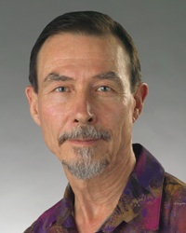
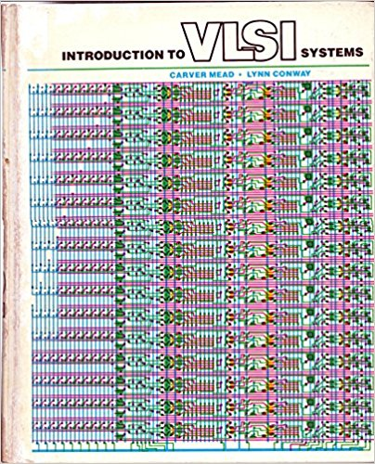
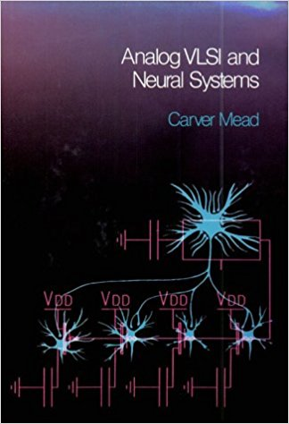

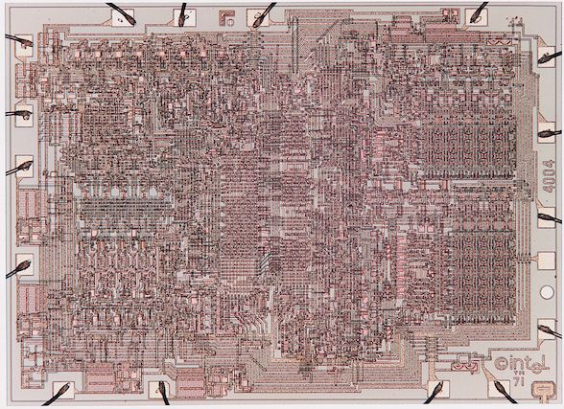
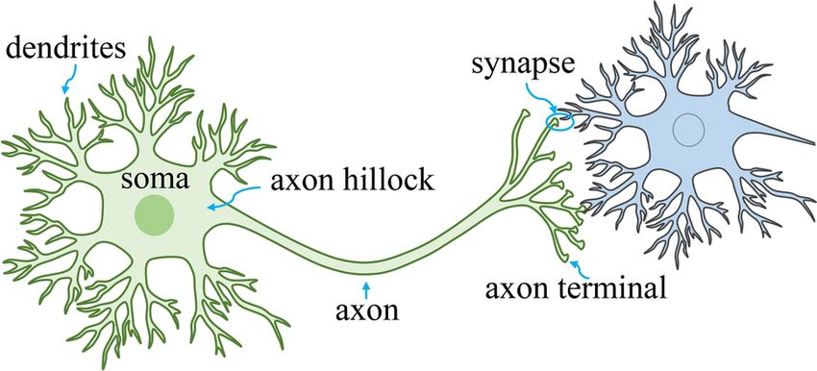
Synaptics
Founded in 1986 to find commercial applications for neural networks in analog chips
  Carver Mead: Professor emeritus at Caltech;
  co-wrote the foundational textbook of Silicon Valley;
  co-founded the field of Computation and Neural Systems (CNS)
  Federico Faggin: “Father of the microprocessor”
  (4004, 8008, 8080 at Intel; founded Zilog; Z80, Z8)
  National Medal of Technology and Innovation (both)
  and the Kyoto prize (both)
We built some amazing chips that performed quite well …
  … But the market just wasn’t there for ultra-low-power
  AI chips in 1986
  Could it be that we were a little ahead of our market? ☺
Notes:
Photos found on Google Images
Neural drawing is from researchgate.net (via Google Images)

Slide 3
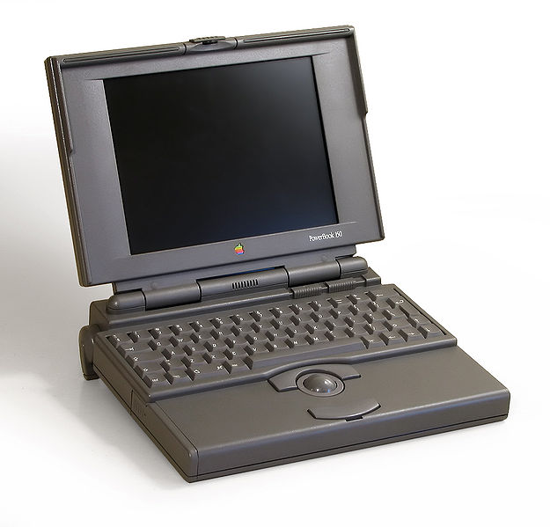
Synaptics in Touch
I joined Synaptics in 1991 (from Carver’s lab at Caltech)
  Around that time, Federico sat on Logitech’s board
  He saw them struggling with trackballs for early laptops
  Laptops wanted to be flat: A ball is not flat!
  Federico thought Synaptics might use its expertise in
  pattern recognition and imaging to create a “flat trackball”
  We got it to work… and there was a ready market!
We soon reinvented Synaptics as a Touch company
  Many people still know us as a leader in touch sensing chips
  In 2026, we still do a good business in touchpads, touchscreens, and fingerprints
Nowadays, we do much more than just Touch
  See our Astra™ Edge AI chips at our booth at Embedded World
  But in today’s presentation, we will discuss AI in chips much smaller than Astra
Notes:
Photos found from Google Images
Neural drawing is from researchgate.net (via Google Images)

Slide 4

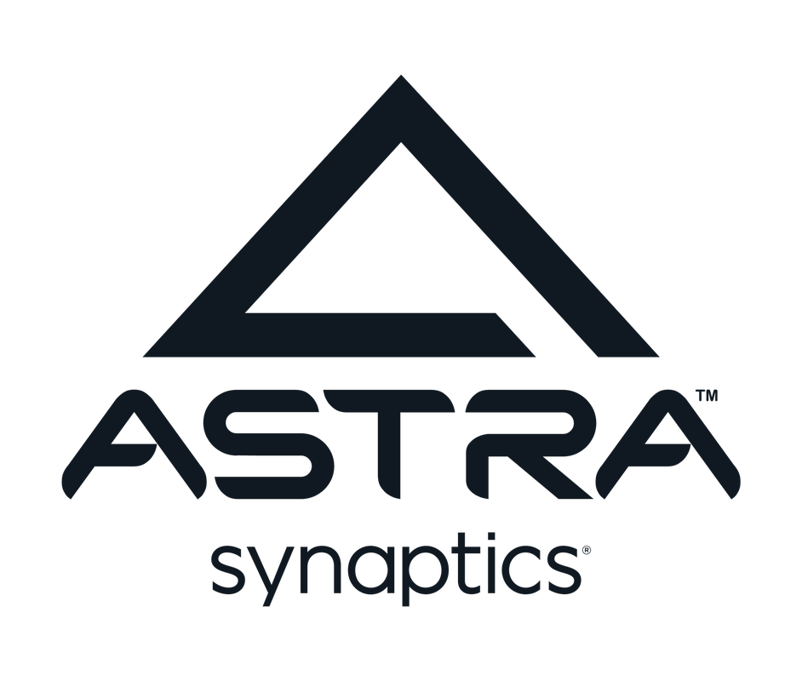
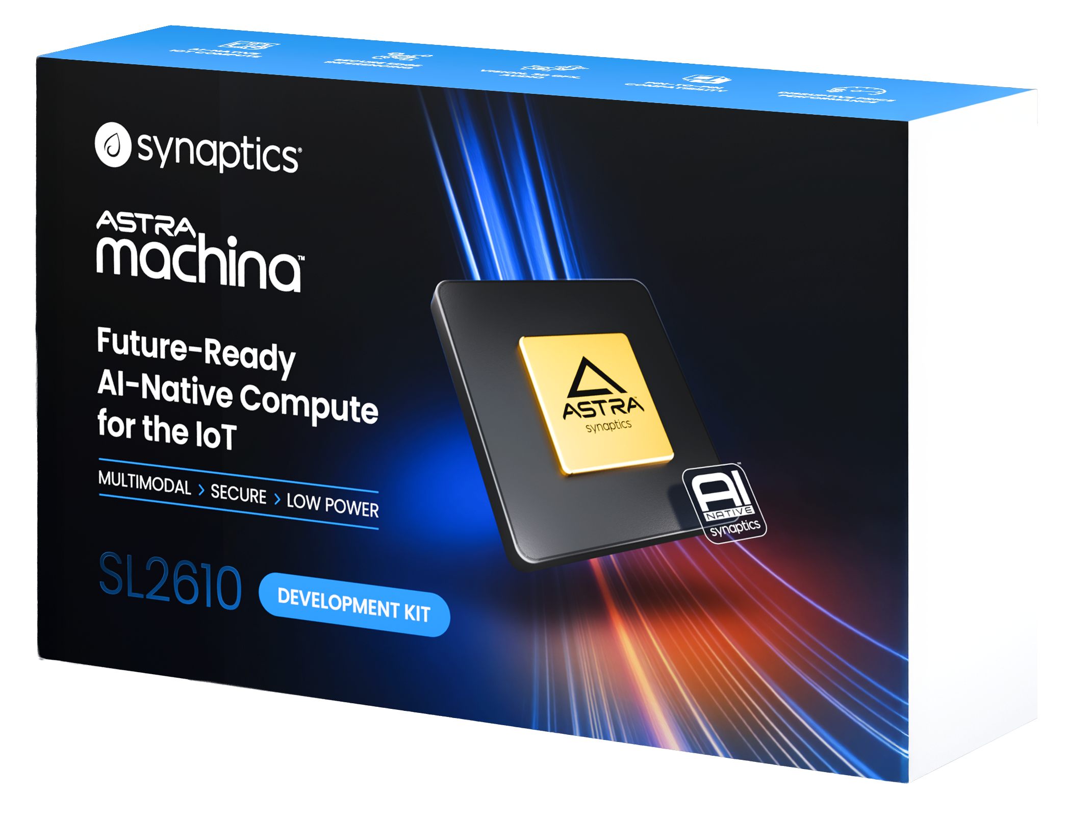
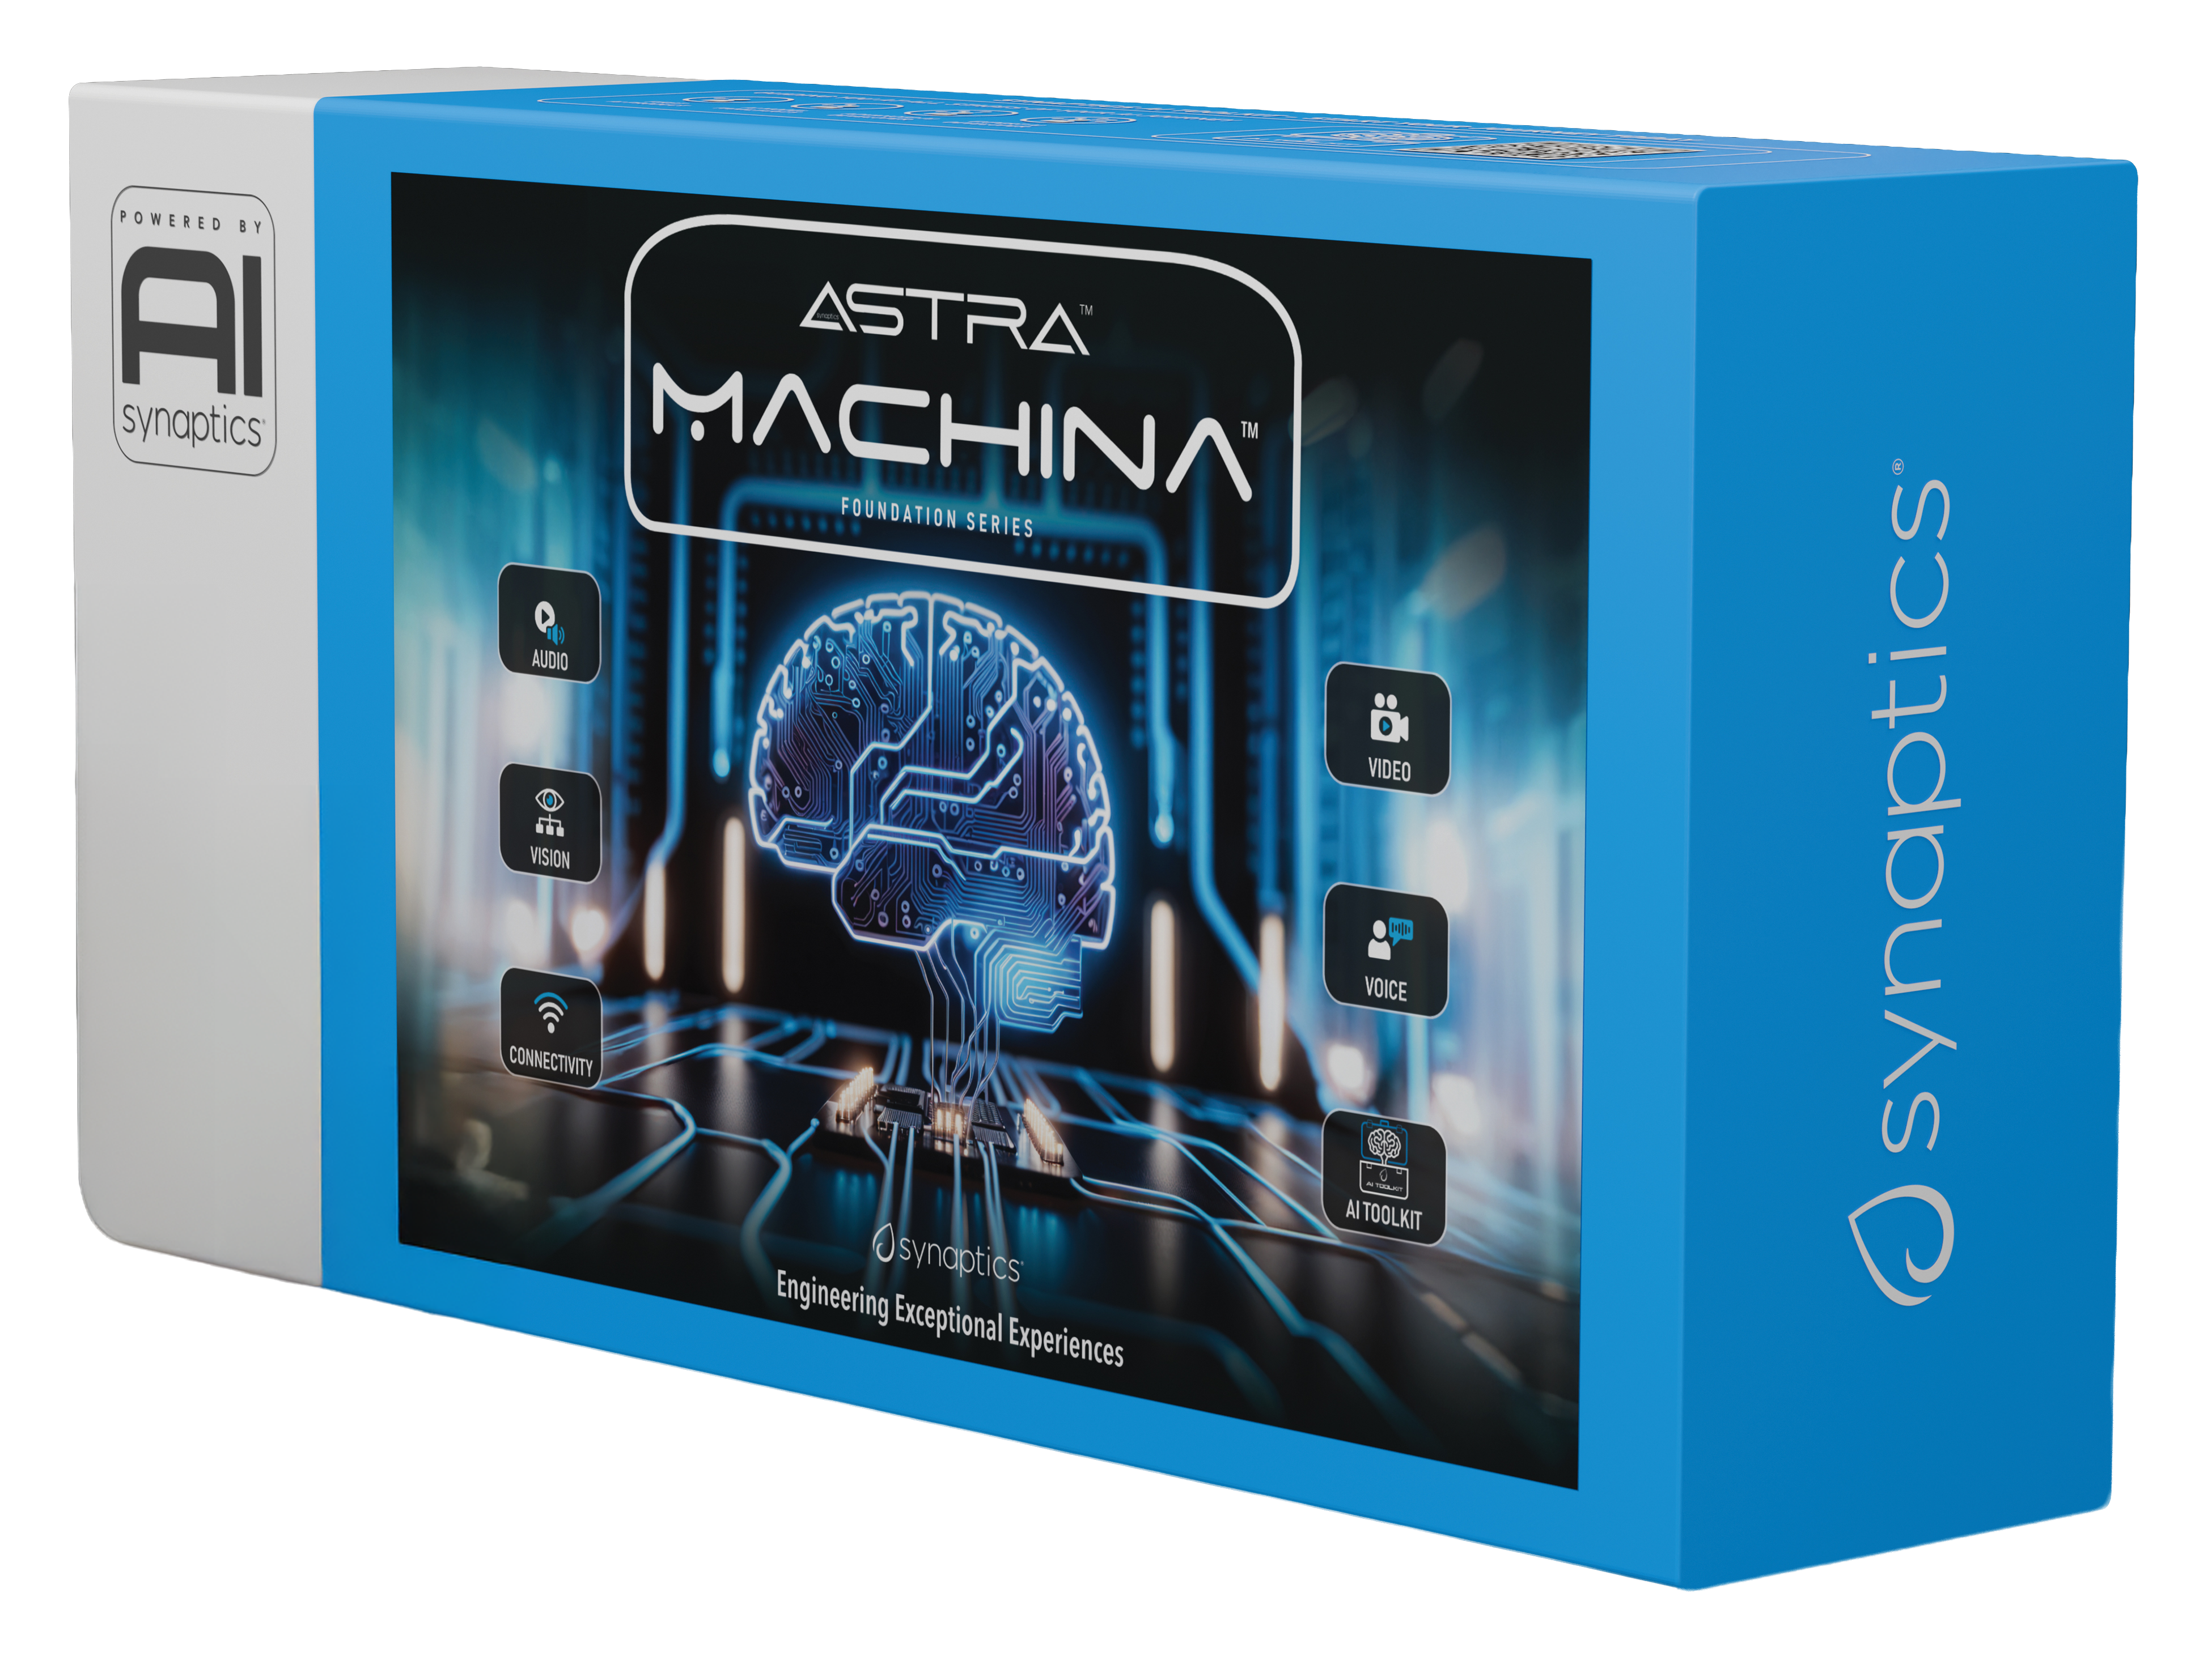
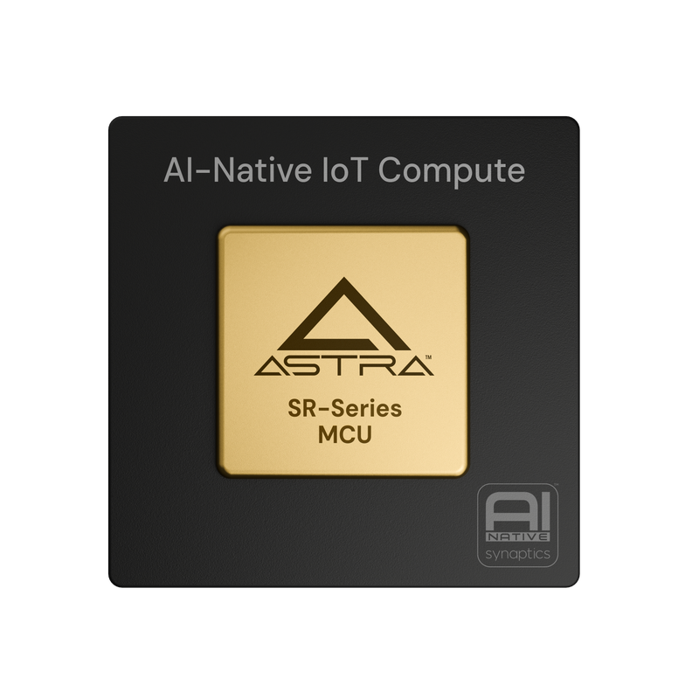
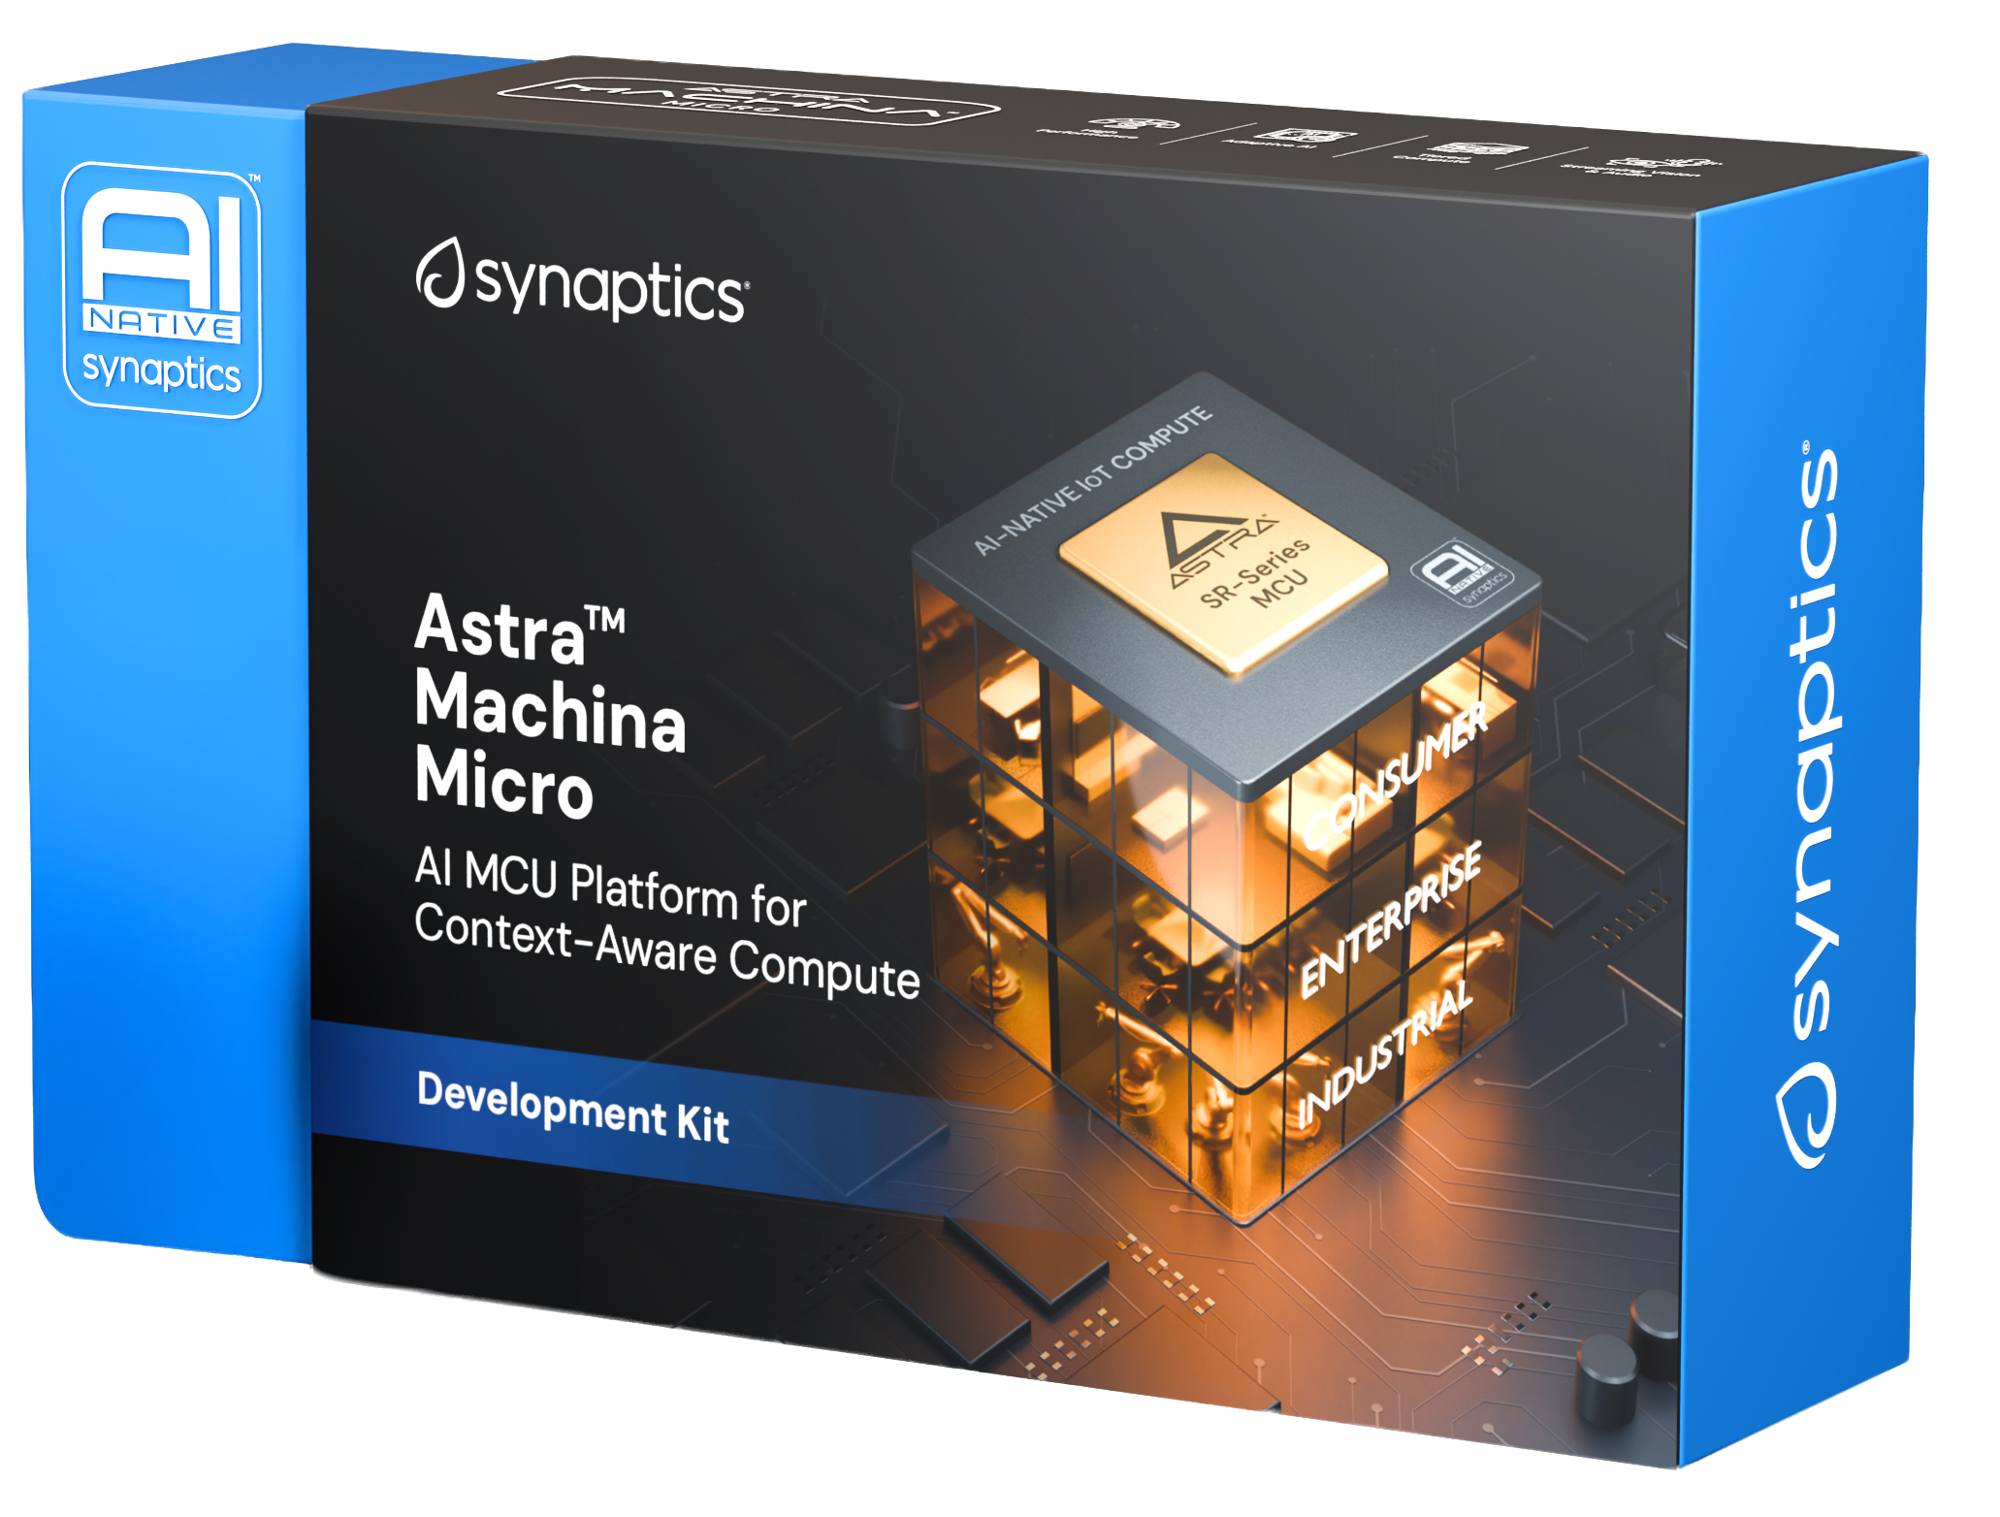
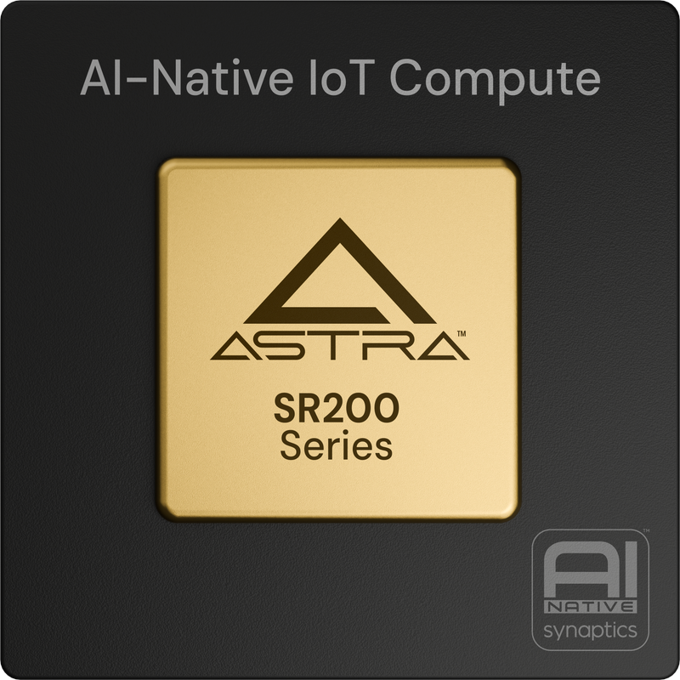
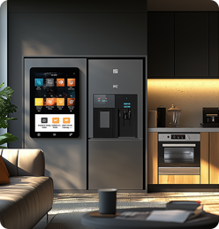
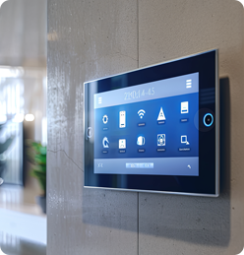
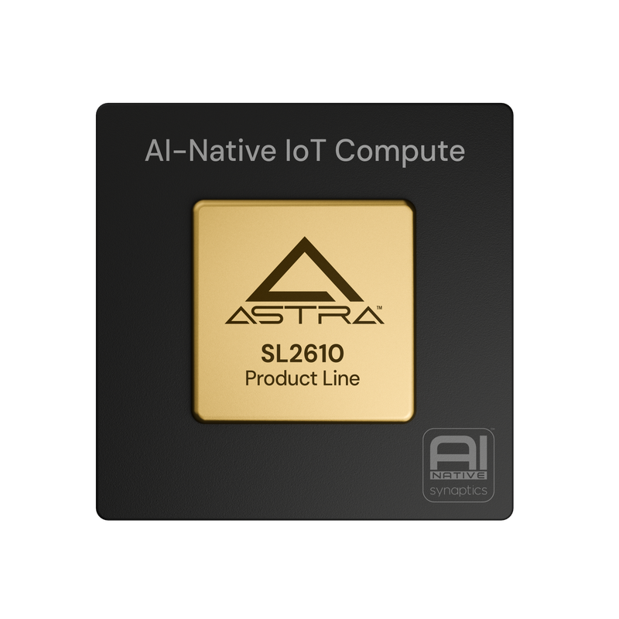
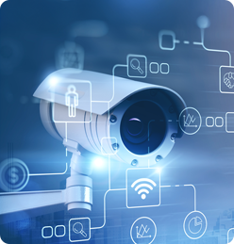
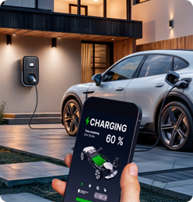
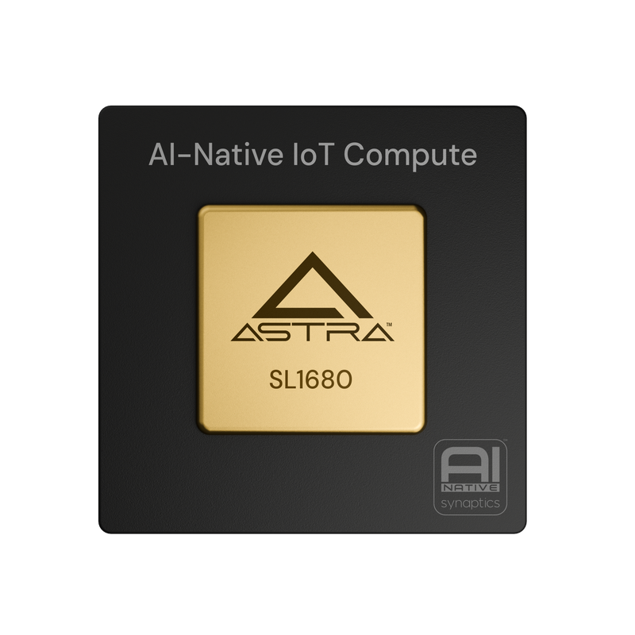
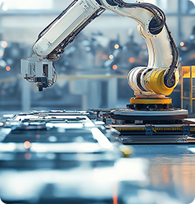
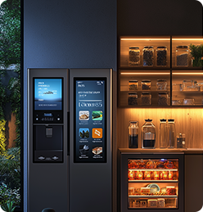
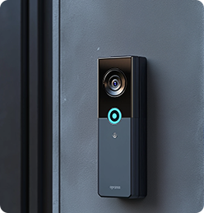
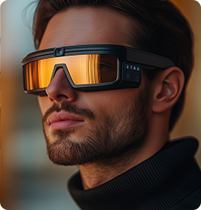
Synaptics Astra™
Scalable Edge AI Processors
AI-NATIVE IOT COMPUTE
Scalable AI-Native IoT Platform for Consumer, Industrial & Enterprise Markets
SR-Series
SL-Series
AI-native Linux® and Android™ Processors
High-performance Context-aware AI MCUs
SL2600 Series
SL1600 Series
SR100 Series
SR200 Series
Sampling
Production
Production
Development
developer.synaptics.com

Slide 5
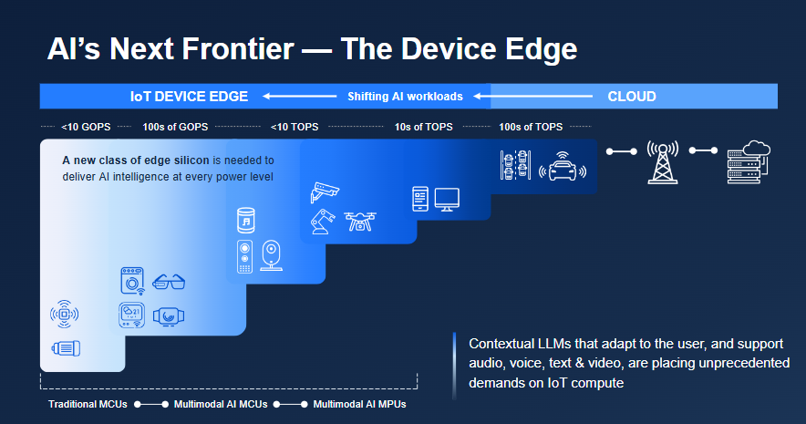
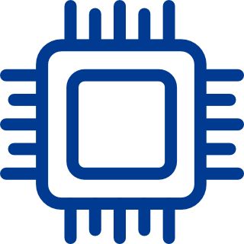
The Edge of the Edge
Today, there is much talk about IoT devices at “The Edge” of the system
Usually, “The Edge” means “anything smaller than The Cloud”
  Application processors for
  smart phones, etc.
  Astra Edge AI chips ⇒
Synaptics Touch chips
operate at the Edge
of that Edge!
  Literally at the periphery
  of an “Edge” device
  Where space is very
  constrained, and even
  1 GOPS is a luxury

Slide 6
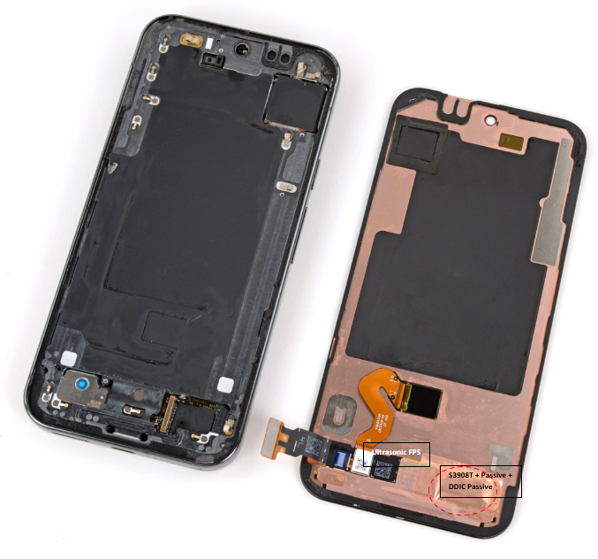
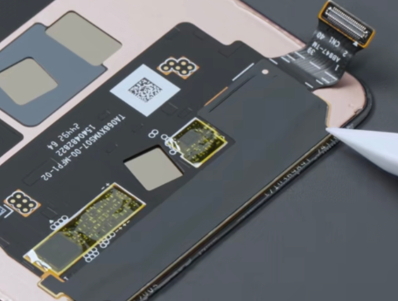
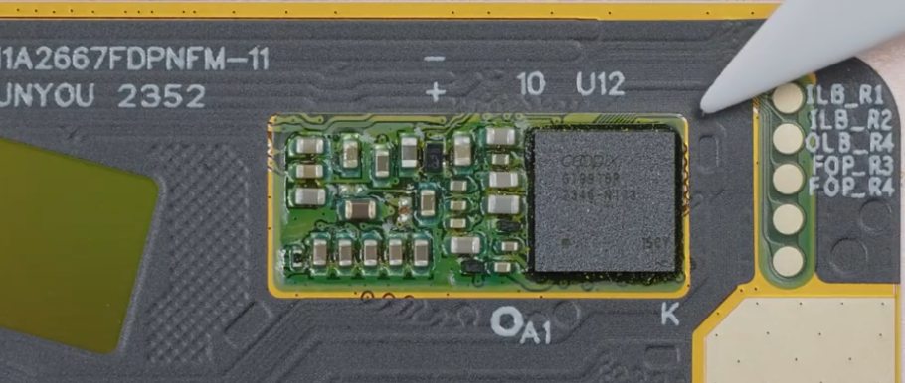
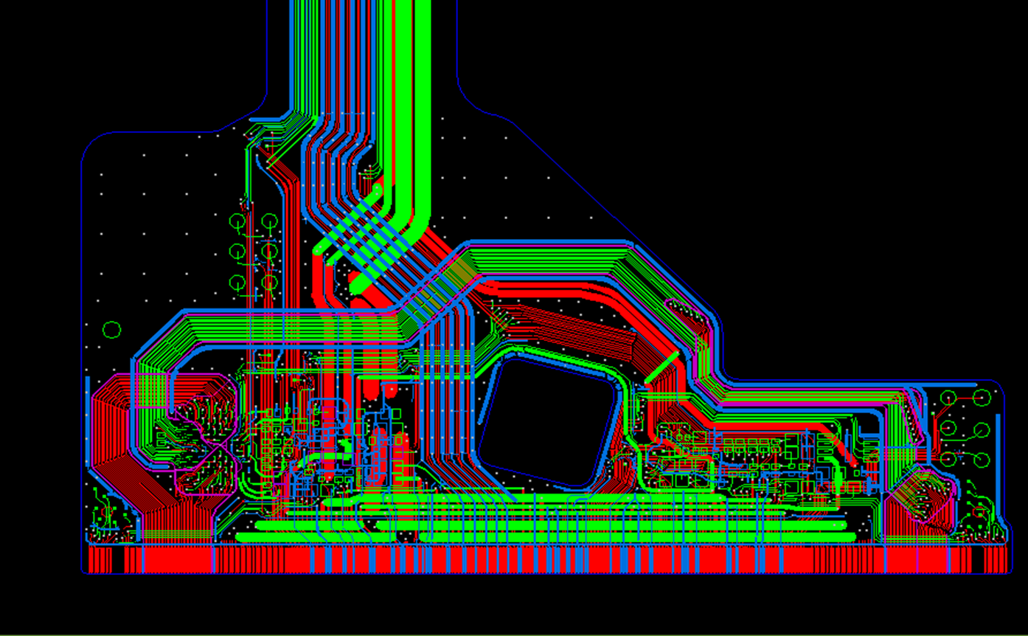
The Edge of the Edge: Touch
The chip must be physically close to the sensor
      60+ connections to the sensor matrix
      <1 fF noise floor in measurements
      >1 pF parasitics
Small package footprint
      Space is at a premium: Impacts battery size
      Typically <5 mm, targeting <3 mm
Cost-sensitive
Requires a sophisticated AFE
… plus significant digital signal processing
  All of which must fit in a small, efficient ASIC
  No room for a big CPU or NPU

Slide 7
Touch ASICs
Touch chips are small microcontrollers:
  One modest MCU core
  100–400 MHz
  Power budget in mW
  Mixed-signal, high-voltage, embedded Flash
  ⇒ Low-density silicon process
  ⇒ Logic is expensive
Far too small for “Edge AI”?
Actually, no!
  We have found that even these humble devices can make good use of AI
  ... at the very small scale
So, after 40 years, Synaptics has come back around to doing
AI in ultra-low-power mixed-signal chips!
  64K–128K bytes of RAM
  100K–300K Flash memory for firmware

Slide 8
Room at the Edge
Touch is not alone in this!
The market for high-end 16-bit and low-end 32-bit microcontrollers is huge
  At least ~10 billion shipped yearly — 1/4 of all micros shipped [ChatGPT]
There is plenty of room for AI solutions at this very small end of the spectrum
Predictive Maintenance
Keyword Spotting In Home Assistants
Wearable Tech
Industrial Automation
Low-power Person Presence Detection Using Cameras
Detecting machine anomalies or motor faults by monitoring current and vibration
Always-on wake word detection (“Alexa”, “Siri”) running directly on the MCU
Detecting hand movements and gestures using IMU sensors
Identify machine defects by analyzing their sound signatures
Security, safety

Slide 9
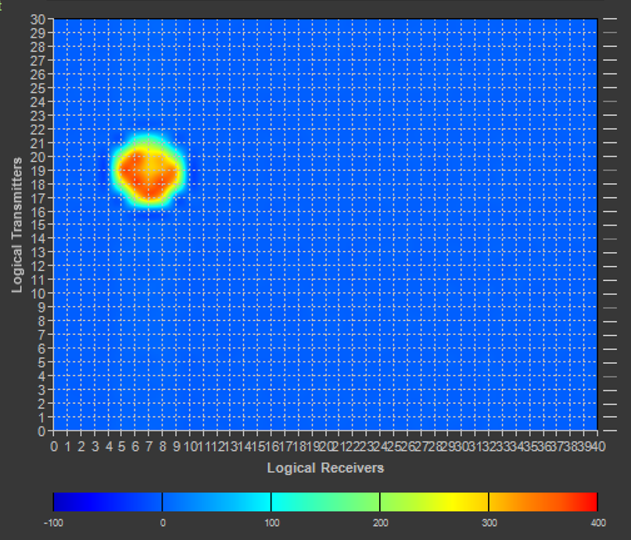
Touch Processing
Image Corrections
Sensing occurs in the analog domain
  The physical world is analog!
But a great deal of signal processing
must be digital / firmware
Firmware processing makes multiple passes through the touch image
  E.g., 40x30 touch pixels
This is a hard-real-time system
  Typically, a 2 ms budget per frame
To meet this tough time budget,
we accelerate many computations
using Vector Processing
Baseline
Segmentation
Tracking
Classification
Report
Vector-friendly operations

Slide 10
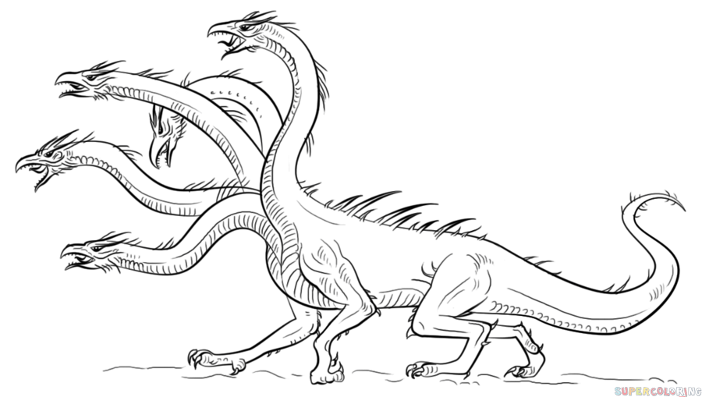
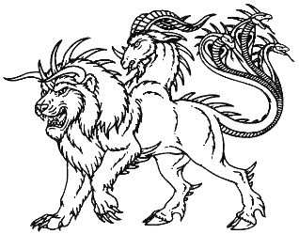
Hydra vector accelerator
Synaptics touch controllers pair a modest MCU with a vector coprocessor called Hydra
  In small chips: Our own Chimera MCU + Hydra 3 ⇒ < 200K gates, like a comparable Cortex-M4F
  In larger chips: SiFive E7 (dual-issue 8-stage RISC-V) + our Hydra 4 ⇒ ~ 400K gates
Hydra accelerates many algorithms in our touch and fingerprint firmware, such as:
  Integer / fixed / float arithmetic on arrays of data
  Data compression; sorting; searching
  Encryption; hashing; pseudo-random numbers
  Special functions; complex arithmetic
Hydra makes some unusual design decisions
to bring vectors to the world of tiny MCUs
  Signal processing; image processing; FFTs
  Linear algebra; matrix multiply
  Convolutions; median filters (1D and 2D)
  Neural networks (fully connected; CNNs)
Chimera and Hydra
of Greek legend

Slide 11
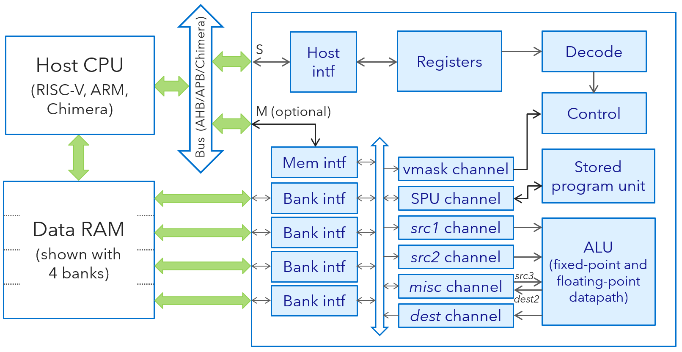
Big ⇒ RISC-V “V”, ARM SVE / MVE | Small ⇒ Hydra coprocessor
Many wide vector registers in the CPU | Vector data resides in the main data RAM
Many ALUs / FPUs operating in parallel | Stream the data through one pipelined ALU / FPU
Vector Load + Vector Arithmetic + Vector Store are separate instructions | Multiple DMA channels load and store data in parallel with the ALU’s operation
To keep the ALUs busy, combine all these loads, arithmetic, and stores in superscalar fashion | The ALU is 100% utilized during large vector operations: No need for a big superscalar CPU
Without superscalar, a RAM-to-RAM vector multiply would need 4 cycles [load + load + mult + store] to do (e.g.) 4 floating-point multiplications | Same net speed: One float multiplication per cycle For neural nets: Up to 4 SIMD byte MACs per cycle ⇒ 3.2 GOPS at 400 MHz (our fastest touch chip)
V0
V1
V2
V3
V4
V5
V6
⁝
V30
V31
 | [0] | [1] | [2] | [3] | [4] | [5] | ∙∙∙ | [VL-1]
…
Hydra 4.2
ALUs
vfmul.vv v30,v1,v3
128–1024 bits
vle32.v v1,(a2)
vse32.v v30,(t0)
RISC-V Vector extension

Slide 12
Big ⇒ RISC-V “V”, ARM SVE / MVE | Small ⇒ Hydra coprocessor
Vectors need a lot of RAM bandwidth | Vectors still need a lot of RAM bandwidth!
RAM bandwidth comes from wide cache access: Read or write a whole cache line at a time | RAM bandwidth comes from multiple DMA channels connected to multiple banks of RAM
Big chips need a data cache anyway … | Small chips prefer to use tightly-coupled data RAM …
… so wide cache access is a natural fit | … and several small RAMs are faster than one big RAM, so we get our multiple-banked RAM for free
Scalable to almost arbitrarily huge systems | Optimized specifically for small “edge” systems
V0
V1
V2
V3
V4
V5
V6
⁝
V30
V31
 | [0] | [1] | [2] | [3] | [4] | [5] | ∙∙∙ | [VL-1]
Load
Store
Data
cache
…
Hydra 4.2
ALUs
vfmul.vv v30,v1,v3
128–1024 bits
…
vle32.v v1,(a2)
vse32.v v30,(t0)
RISC-V Vector extension

Slide 13
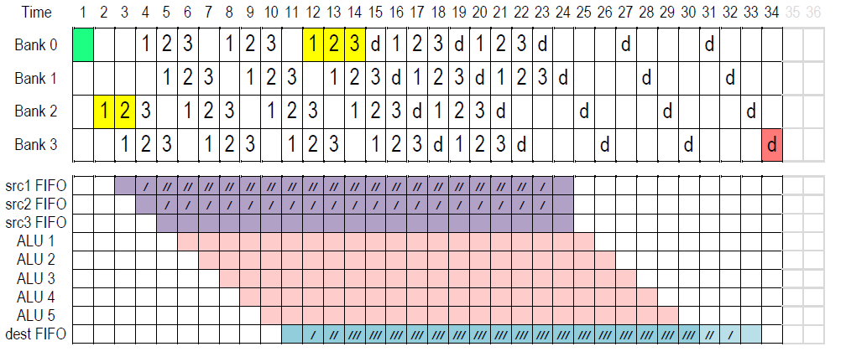
How Hydra accesses RAM
RAM banks are interleaved, with bank selected by addr bits 3:2 (for four 32-bit-wide banks)
Each DMA channel has its own address generator, and a small FIFO buffer
  This structure allows our firmware to allocate vectors easily and naturally as C-language arrays
  Channel FIFOs smooth out any bank conflicts due to the vectors’ alignments in memory
⇐ VMADD (fused multiply-add), VL = 20

Slide 14
A fully-connected neural network using Hydra 4
Each layer is a matrix multiplication with byte inputs and a byte weight matrix:
uint8_t inputs[R][W]; // If inputs[] and outputs[] are vectors instead of full matrices, let R = 1.
float16_t outputs[R][C]; // Types can be mixed; here we use half-precision floating point.
int8_t weights_trn[C][W]; // Transposing the weight matrix facilitates SIMD operation since both inputs[]
// and weights[] draw their elements consecutively from RAM.
hydra_vmm(hydra_set_vl(R * C),
hydra_matrix(outputs, HYDRA_FLOAT16, C),
hydra_matrix(inputs, HYDRA_UINT8, W),
hydra_matrix(weights_trn, HYDRA_INT8, W));
// Firmware may do other work while Hydra operates.
hydra_wait();
// Now use either a firmware loop or Hydra to apply the desired
// activation function to outputs[].
For a convolutional network (CNN), use vconvo in place
of vmm, or two vmax’s to create a maxpool layer

Slide 15
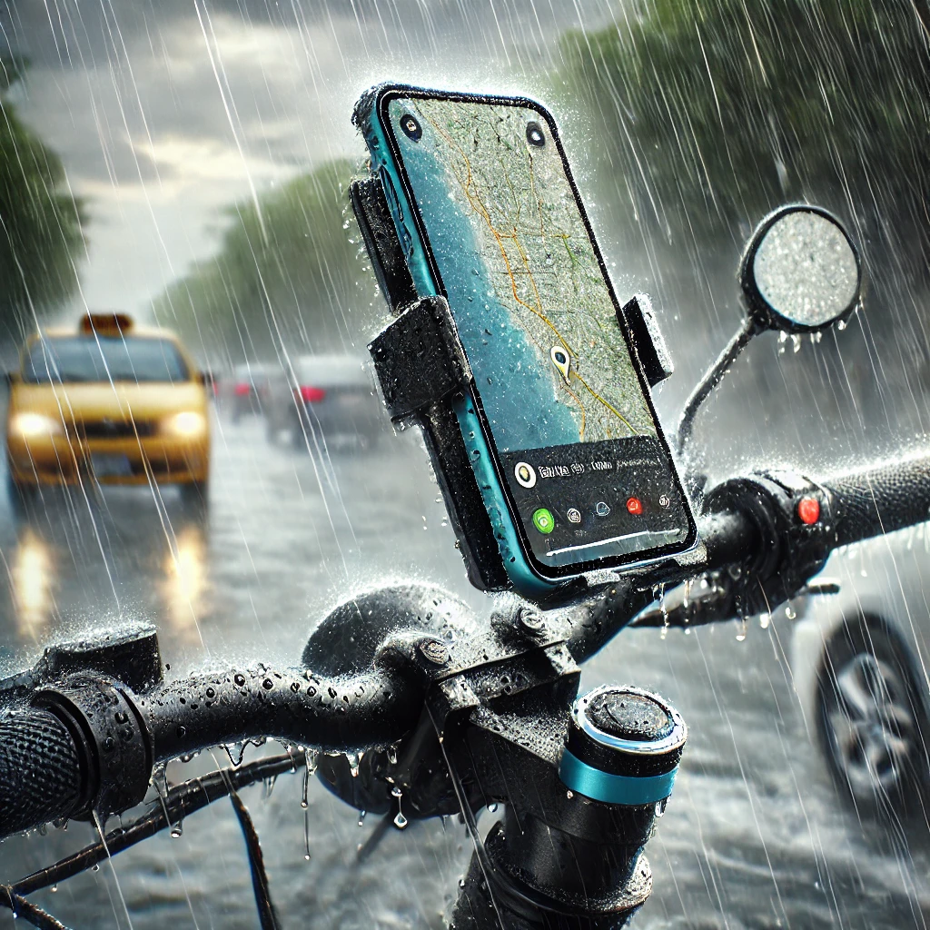
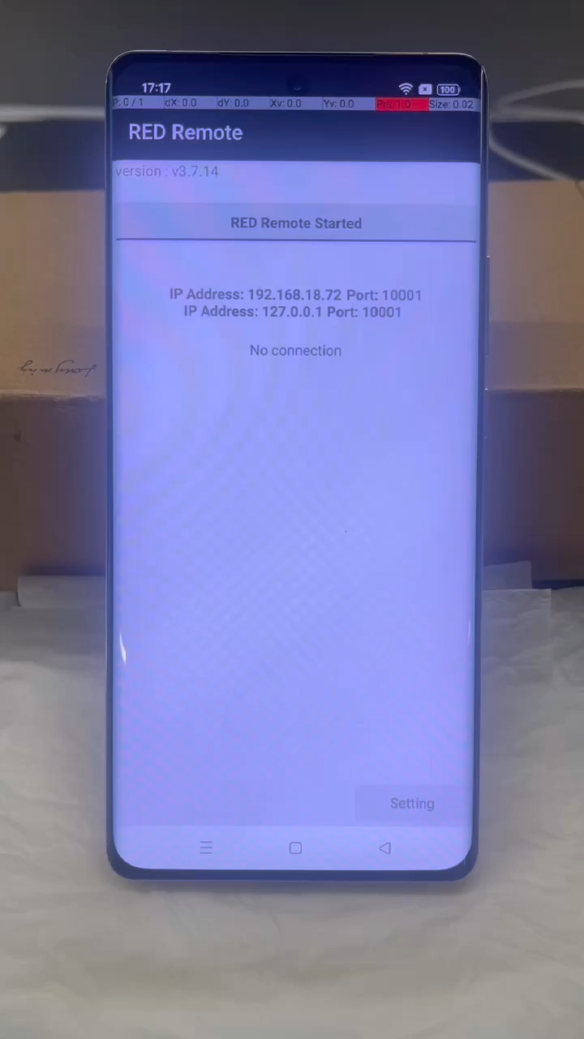
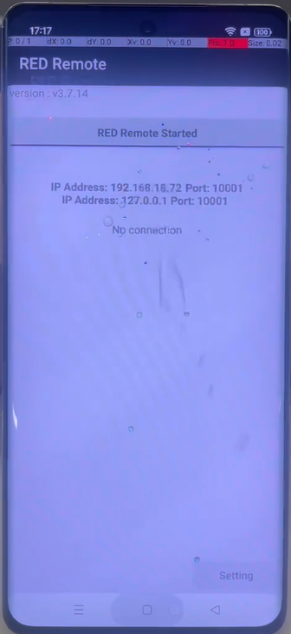
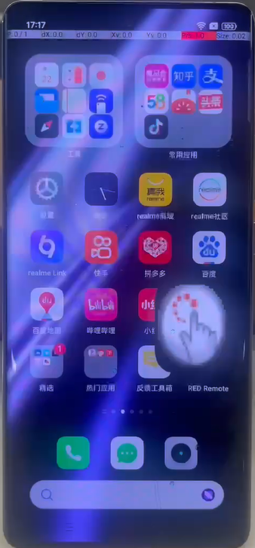
Use case: MoistureAI
Droplet
Scenario
Delivery worker in the rain
Challenge.
Traditional feature detection algorithms struggle with this problem
Raindrops can be mistaken for valid
finger touches
When drops slide to the bottom edge, they may “touch” on-screen controls
Video

Slide 16
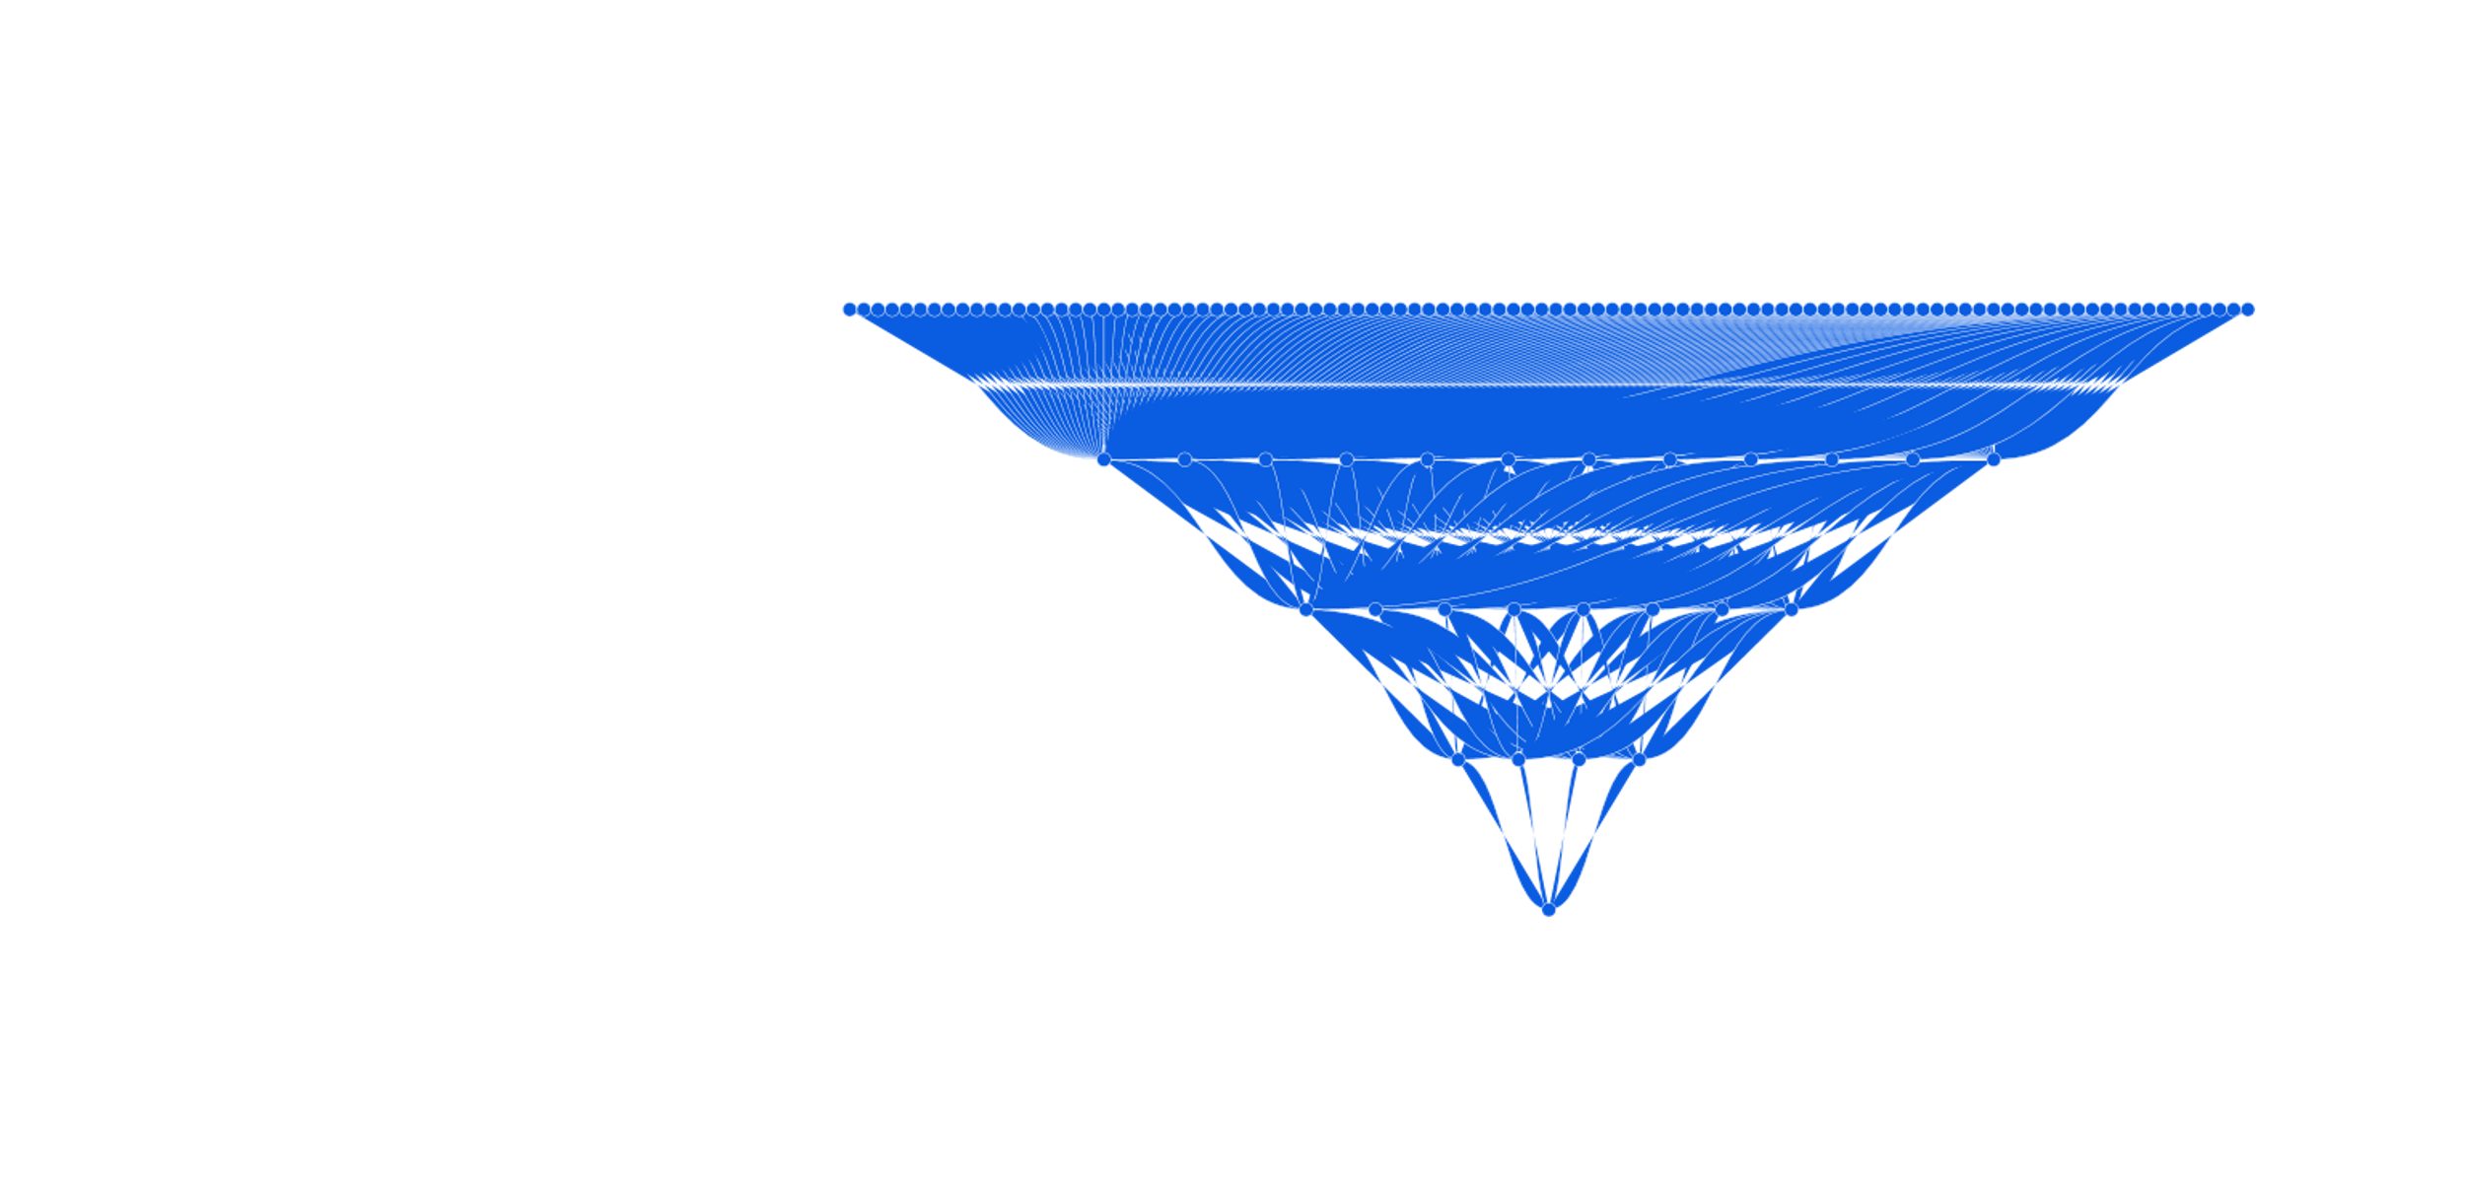
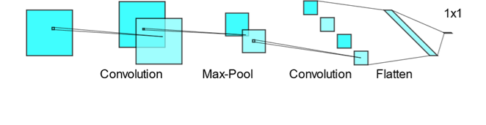
MoistureAI: Approach
Train with data taken from real system
Use TensorFlow Lite
Binary classification
  Label 0: Finger tap/swipe
  Label 1: Raindrop
Solution #1:
  Fully connected neural network (FCNN)
  Four layers, RELU / Sigmoid
Solution #2:
  Convolutional neural network (CNN)
  Two layers + maxpool
(Thanks to Longming Cheng, Karthik S. Vadivel, and Derek Solven)
Used to guide the image
processing algorithms
 | FCNN | CNN
Code (bytes) | 1428 | 3336
Model (bytes) | 1358 | 188
RAM (bytes) | 720 | 1648
Time (us) | 356 | 358

Slide 17
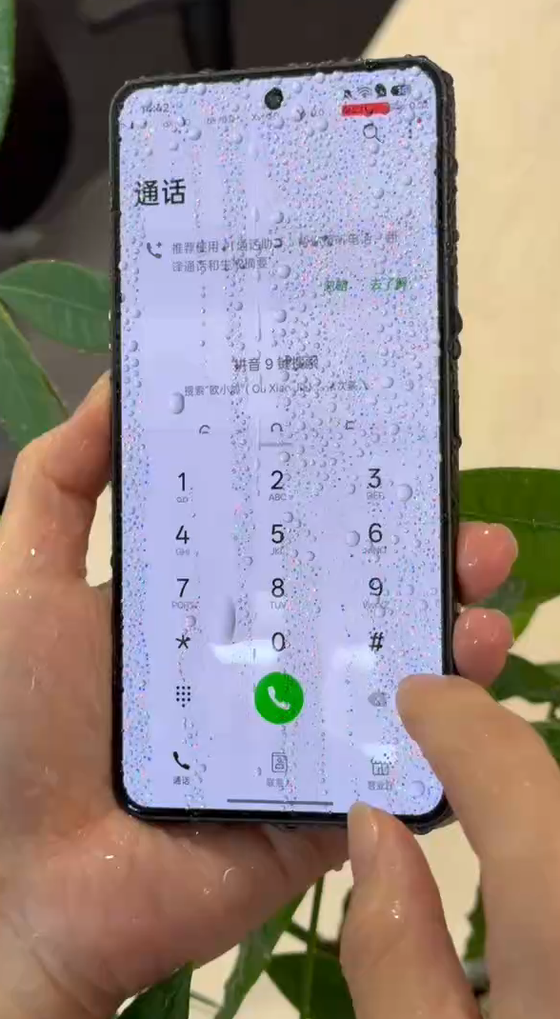
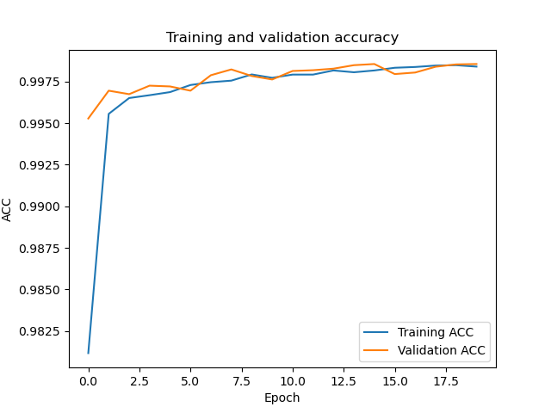
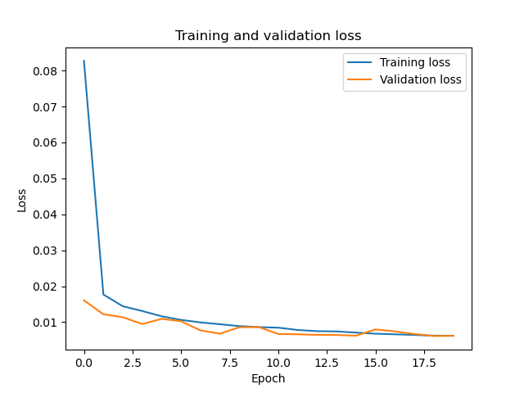
MoistureAI:
Deployment and results
Dataset tensor
Label 0: 47008 (Finger)
Label 1: 60519 (Raindrop)
Full integer quantization
FLOAT32 → INT8
Deploy to customer
Model params: 1358
Inference time: 356 us
(using Hydra 3, ~0.5 GOPS)
  In mass production today
Accuracy:
42936 / 43012 (99.82%)
Error Rate:
76 / 43012 (0.18%)
Video
Daling

Slide 18
Summary
AI isn’t only for TOPS‑class devices:
It shines on tiny problems too
With the right hardware architecture,
ML can run even inside very tiny chips
Touch isn’t “AI‑heavy” — it benefits greatly
even from small models
Small ML models + hardware support
⇒ huge UX improvements
We believe this pattern will repeat for many
kinds of small, edge-of-the-edge sensors

Slide 19
Thank you

